Slide 1

Office of the Governor | Mississippi Division of Medicaid
The Division of Medicaid
Adult Day Care Services
Provider Training
Office of Long Term Services and Supports
Updated July 21, 2026

Slide 2
LTSS Team
Misty Jenkins
Senior Director
Long Term Services & Supports
Nancy Dampier
Director
HCBS Provider Relations
Gabrielle Grant
LTSS Solutions Manager
Paulette Johnson
Director
Long Term Care
Kenosha Williams
Lead Reviewer
E&D Provider Enrollment
Alexis Martin
Reviewer
E&D Provider Enrollment
Penelope Boyd
CSP Beneficiary Support
Terri Wilkerson
E&D Beneficiary Support
Estel Stringer
ID/DD Beneficiary Support
2

Slide 3

Who is this training for?
This training is for providers who are currently enrolled to provide Adult Daycare (ADC) Services under the MS Division of Medicaid Elderly & Disabled (E&D) Waiver.
Training should be completed by:
  Agency Owner
  Administrator and/or
  Program Director
  If the individual completing this training exits the company, the training must be completed by the individual hired to fill that vacant role. If there is a new owner or partnership is with to the agency, they must also complete and attest to this training.
Notes:
The Medicaid Administrative Code is one of the required training topics for all staff. Our objective here today is to train the staff who can represent the agency in an audit.
Providers may use these training materials to train other employees of their agency.

Slide 4

Throughout this presentation you will see the purple “MORE INFO” graphic. Click this graphic for a pop-up with additional information or helpful tips.
Click the pop-up box again to collapse the box and move to the next slide.

Slide 5

Overview of Training
DOM HCBS Team
Overview of the Waiver Program
Covered Services
Updates
Training Topics
Organizational Changes
Facility Requirements
Staffing Requirements
Primary & Auxiliary Services
Records Maintenance
Additional Resources
Marketing, Referrals & PSS
Annual Updates for FOC List
Quality Management
Resources for Success
Reporting Medicaid Fraud & Abuse
Introduction
This presentation is color coded with the corresponding colors shown under Training Topics. This will help you quickly locate the topics for future reference.
Please note the yellow “update” indicators. When you see this symbol know this indicates any changes or clarifications made in the Admin Code and updated made to the training materials.
Notes:
This presentation is color coded with the corresponding colors shown under Training Topics. This will help you quickly locate the topics for future reference. Please note the “update” symbol on a few of the slides. When you see this symbol, that know this indicates any changes or clarifications made to this training to better educate our viewers.

Slide 6


LTSS
Long Term Services & Supports
High Risk Provider Revalidation
CMS is requiring “high risk” providers to complete off-cycle revalidation due to being in the high-risk category. This applies to all HCBS providers who have not already completed a revalidation in the past year.
Providers who do not submit their revalidation packet by the date noted on the letter Gainwell mails to them, which is 60 days from the date of the letter, will go into payment suspension until the revalidation is submitted.
Notes:
If you receive a revalidation notice, do not ignore it.

Slide 7
Elderly & Disabled Waiver:
Home and Community Based Services
The E&D Waiver is administered and operated by the Division of Medicaid.
Beneficiaries enrolled in the E&D Waiver must reside in a private residence that is fully integrated with opportunities for full access to the greater community and meets the requirements of a Home and Community-Based (HCB) setting in 42 C.F.R. § 441.301(c)(4) and (5).
Beneficiaries enrolled in the E&D Waiver are prohibited from receiving additional Medicaid services through another waiver program.
It is the responsibility of the Medicaid provider to verify a Medicaid beneficiary’s eligibility each time the beneficiary appears for a service.
Notes:
It is the responsibility of the Medicaid provider to verify a Medicaid beneficiary’s eligibility each time the beneficiary appears for a service.
Providers should not rely solely on information from the case managers. If a member loses eligibility, claims can not be paid and depending on the reason for the loss in eligibility, it may be that eligibility cannot be reestablished, and providers may not be reimbursed.

Slide 8
E&D Waiver Beneficiary Eligibility Criteria
Beneficiaries must have BOTH financial eligibility, as determined by the Regional Office, and clinical eligibility, as determined by the Division of Medicaid office of Long Term Services & Supports.
Who is Eligible?
Must be twenty-one (21) years of age or older.
Must require nursing facility level of care as determined by a comprehensive long-term services and supports (LTSS) assessment.
Must meet the criteria in one (1) of the following Categories of Eligibility (COE):
Supplemental Security Income (SSI) eligible under 20 C.F.R. § 416.202, or
An aged, blind or disabled individual who meets all factors of institutional eligibility.
If income exceeds the current institutional limit, the individual must pay the Division of Medicaid the portion of their income that is due under the terms of an Income Trust to qualify.
Beneficiaries enrolled in the E&D Waiver cannot reside in a nursing facility or licensed or unlicensed personal care home.
In the event of imminent danger to the beneficiary, caregiver or service provider, the beneficiary may be discharged from the waiver immediately.
Notes:
Beneficiaries must have BOTH financial eligibility, as determined by the Regional Office, and clinical eligibility, as determined by the Division of Medicaid office of Long Term Services & Supports.

Slide 9

Covered Services
  The Division of Medicaid covers certain home and community-based services as an alternative to institutionalization in a nursing facility through the Elderly and Disabled Waiver (E&D). These services are:
    Adult Day Care Services
    Personal Care Services
    In-Home Respite Services
    Case Management
    Environmental Safety Services
    Medication Management
    Home Delivered Meals
    Institutional Respite
    Extended Home Health
Notes:
There are many services covered under the E&D Waiver, but this training covers Adult Day Services.

Slide 10

Adult Day Care Service is designed to meet the needs of aged and disabled individuals through:
Individualized Care Plan
Provision of meals
Transportation to and from the site
Social, health and recreational activities
Information on and referral to vocational services
Notes:
ADC services are designed to meet the needs of Waiver members through the provision of 1 meal and two snacks served on site each day, transportation to & from the site, and social health and recreational activities.

Slide 11
Adult Day Care Services
Adult Day Care (ADC) includes community-based comprehensive programs which provide a variety of health, social and related supportive services in a protective setting during daytime and early evening hours.
This community-based service is designed to meet the needs of aged and disabled people through an Individualized Service Plan (ISP), including personal care and supervision, provision of 1 meal & 2 snacks, limited medical care, transportation to and from the site, social, health and recreational activities.
ADC providers must be compliant with all applicable state and local building restrictions as well as all zoning, fire, and health codes and ordinances and meet the requirements of the Americans with Disabilities Act (ADA). The Americans with Disabilities Act | ADA.gov
ADC providers may only serve counties within sixty (60) minutes from the facility.
ADC providers must provide choices of food and drinks during the day, this will require a contract with a food vendor licensed by MS Department of Health, or a permit to operate a kitchen from the MSDH to prepare meals onsite.
ADC providers must offer safe, accessible transportation.
ADC facilities must be open, at minimum, 8am – 5pm, Monday through Friday, except major holidays.

Slide 12

Administrative Code Part 208, Chapter 1
Home and Community Based Services
Administrative Code Part 208, Chapter 1 is currently available for review on the website. Throughout this presentation will be several links to additional resources, this will all be available on the HCBS Providers webpage.
Link: https://medicaid.ms.gov/wp-content/uploads/2025/05/Title-23-Part-208-HCBS-LTC-eff.-6.1.25.pdf
Notes:
Administrative Code Part 208, chapter 1 is currently available for review on the website. Throughout this presentation will be several links to additional resources, this will all be available on the HCBS Providers webpage.

Slide 13

We want to hear from you!
Currently enrolled providers please share with us your agency’s success and highlight what makes your program unique in servicing your community.
Had a recent activity that participants really enjoyed? Share a few photos and a description of the activity. (If participants are included in photos a signed release form must be submitted to DOM to give authorization for their image to be shared.)
Remodeled or made improvements to your facility? Share the before and after and how it has improved services.
Did you have a really great turnout at your last quarterly advisory committee meeting? Tell us how you did it!
Simply email HCBSProviders@medicaid.ms.gov with a brief description of your success or highlights and attach any photos or videos you’d like to share. We’d love the opportunity to show off the hard work and dedication of DOMs ADC Providers!

Slide 14
Organizational Changes & Compliance
Change of Ownership
Relocations
Business Line of Credit
Billing
Notes:
Our first round of training topics will be on different types of Organizational Changes, including changes in ownership or location, and ongoing compliance with billing requirements and lines of credit.

Slide 15
Reporting Changes
Admin Code, Part 208, Rule 1.5 requires that Waiver providers must report: changes in contact information, administrative staffing, ownership and licensure within ten (10) calendar days to the Division of Medicaid.
Providers must be aware that reporting changes to Gainwell, or via the MESA Provider Portal, is not the same as reporting changes to the Medicaid Office of Long Term Services & Supports.
HCBS Providers must report all changes to LTSS first and receive approval for changes in location, then changes may be reported to Gainwell.
Notes:
Waiver providers must maintain compliance with all current waiver requirements, rules, regulations and administrative codes as specified by the Division of Medicaid. This especially includes reporting changes in contact information, administrative staffing, ownership, and licensure within ten (10) calendar days to the Division of Medicaid.
HCBS Providers must report all changes to LTSS first to ensure compliance standards have been met.

Slide 16
Changes of Ownership (CHOW)
Our Office frequently sees providers who are selling their business without notifying the Division of Medicaid timely. We’d like to remind everyone that there cannot be a transfer of ownership of your Medicaid issued provider ID without first notifying Medicaid. We must ensure that the new owners are qualified to provide the services and go through all required credentialing. As a reminder, the NEW owner is responsible for maintaining all files and documents from the previous owner for auditing purposes.
The new owner is assuming all responsibility and liability for all claims that were filed prior to the transfer. A provider/facility that undergoes a change of ownership must notify the Office of LTSS within ten (10) days, and the Office of Provider Enrollment within thirty-five (35) days after any change in ownership.
A CHOW packet must be received, reviewed, and approved by the Office of Long-Term Services & Supports before the provider can complete a Mississippi Medicaid Provider Application Packet.
The new provider must continue to maintain all Medicaid beneficiary records for at least five (5) years, unless an alternative method for maintaining the records has been established in writing and approved by the Division of Medicaid as required by Health Insurance Portability and Accountability Act of 1996 (HIPAA).
Notifying DOM of Change of Ownership within 35 days of change
Completing a CHOW application with LTSS
New owner must maintain beneficiary file records for a minimum of five (5) years
Notes:
There cannot be a transfer of ownership of your Medicaid issued provider ID without first notifying Medicaid.
We must ensure that the new owners are qualified to provide the services and go through all required credentialing. As a reminder, the NEW owner is responsible for maintaining all files and documents from the previous owner for auditing purposes.
The new owner is assuming all responsibility and liability for all claims that were filed prior to the transfer. A provider/facility that undergoes a change of ownership must notify the Office of LTSS within ten (10) days, and the Office of Provider Enrollment within thirty-five (35) days after any change in ownership.
A CHOW packet must be received, reviewed, and approved by the Office of Long-Term Services & Supports before the provider can complete a Mississippi Medicaid Provider Application Packet.
The new provider must continue to maintain all Medicaid beneficiary records for at least six (5) years, unless an alternative method for maintaining the records has been established in writing and approved by the Division of Medicaid as required by Health Insurance Portability and Accountability Act of 1996 (HIPAA).

Slide 17
If the current owner is adding ownership that is less than 5%,
CHOW is not required.
A change in information will need to be submitted to provider enrollment.
If the current owner is adding ownership that is 5% or greater
CHOW is required.
complete section B2 of the Disclosure Form to make the updated change

Slide 18
CHOW
Change of Ownership
Sell
Transfer provider number with the sell.
New owner submits a CHOW packet with OLTSS.
Buy Out
Terminate provider number
New owner applies for a new provider number.
New owner must meet the requirement of being established and providing services for one (1) year for the service type applying for.
Begin the provider enrollment process through OLTSS.
Beneficiary files remain with the previous owner(s) who is responsible for any past or future audits findings.
Beneficiary files transfers with the provider number to the new owner(s). The new owner is responsible for any past (5 years) or future audit findings.
Notes:
This chart will help you determine whether or not a CHOW is required. If you are selling your business and transferring the Medicaid Provider Number to a new owner, then a CHOW is required.
If you are selling your business and the new owner is establishing a new Medicaid Provider ID, a CHOW is not required but DOM must still be notified.

Slide 19
Relocations
Providers must submit any proposed changes to location, supervisory staffing, or organizational contact information, to the Division of Medicaid Office of LTSS for approval prior to implementing the requested change.
If you’re planning to relocate, contact our office first. We are happy to do a virtual walk though with you of your new location.
The Office of Long Term Services & Supports must complete a virtual site visit to ensure that the new location meets the requirements of an ADC facility before owner signs a new lease agreement or purchase.
Provider must complete a relocation Smartsheet link for review and an onsite visit will be completed for final approval.
Once the new location is approved, providers must submit a Change of Address form in MESA.
Smartsheet Link:
https://app.smartsheet.com/b/form/019ae5b0e27d7bd8ae23e8acf81e5ee1
Notes:
Please note that all providers must notify OLTSS first prior to a relocation of any office. Completing a Change of Address Form and undergoing a site visit with Gainwell does not equal an update nor an approval of the location to the Freedom of Choice list. Our office has its own set of criteria that Gainwell may not include to ensure compliance outlined in the Administrative Code.

Slide 20
Business Line of Credit
Establish and maintain a business line of credit for business operations from either a financial institution licensed to conduct banking or other Financial Deposit Insurance Corporation (FDIC) or National Credit Union Administration (NCUA) insured financial institutions.
The approval amount for the business line of credit must be enough to cover operational costs/expenditures for at least three (3) months at all branch locations.
Prior to the implementation of MESA, newly enrolling providers were required to establish a business line of credit.
With updates to the Administrative Code, all E&D providers are required to establish and now maintain a business line of credit for operations as proof of financial solvency.
To ensure continuity of business operations and member services, providers must maintain a line of credit available to use in the event that there are reimbursement delays in claims processing with the Division of Medicaid. The line of credit will ensure that your agency can continue payroll processes.
Notes:
To ensure continuity of business operations and member services, providers must maintain a line of credit available to use in the event that there are reimbursement delays in claims processing with the Division of Medicaid. The line of credit will ensure that your agency can continue payroll processes.
While claims reimbursement is typically one week after the submission of payable claims, DOM does have up to one year following the submission of claims to complete reimbursement.

Slide 21
There are key differences of a business line of credit and a business loan. A loan is a one-time disbursement, whereas a line of credit is revolving and you only pay interest on the amount you draw.
Business Loan
Large, one-time expense like equipment purchases, property or expansion
A single lump sum is disbursed at the start
Business Line of Credit
Ongoing or short-term needs like inventory, payroll, or managing seasonal cash flow.
You can draw funds as needed up to your credit limit.
Fixed monthly payments of principal an interest over a set term.
Typically, lower interest rates, especially for large, long-term loans.
Less flexible, as the entire amount is disbursed upfront.
Planning major investments with predictable costs.
Pay interest only on the amount drawn. As you repay, the funds become available to borrow again
Variable interest rates; you only pay interest on what you use.
Highly flexible, allowing you to borrow and repay as needed.
Managing unpredictable cash flow fluctuations.
Business Loans does not meet the requirement for a business line of credit.
Notes:
Some may confuse a business loan as a business line of credit. A business loan is a one-time disbursement with fixed month payments until the loan is pay back in full with interest. A line of credit is revolving You can draw funds as needed and repay only the amount drawn. Once the amount drawn is repaid, the funds become available to borrow again. Business loans does not meet the requirement for business line of credit.

Slide 22

Elderly & Disabled Waiver
ADC Reimbursement
Modifier | Procedure Code | Service Name | Rate | Maximum Allowable Units and Ages | Provider Type and Place of Service (POS)
(U1 Modifier) | S5100 | Adult Daycare Services | $4.93 per unit | Ages: 21-999 Maximum: 16 units daily | Taxonomy: 261QA0600X
Waiver claims are billed with a unique modifier to assist with identifying the source of coverage for services, for the E&D waiver that modifier is U1.
The chart reflected here outlines the rates and information needed for billing E&D services. To note, while ADC bills directly through our fiscal agent Gainwell, Personal Care and In-Home Respite providers are required to utilize an Electronic Visit Verification software.
ADC providers bill monthly, no sooner than the first day of the month following the month in which services were rendered.
The Division of Medicaid requires providers to submit claims no later than three hundred sixty-five (365) calendar days from the date of service.
The Division of Medicaid has three hundred sixty-five (365) calendar days from the date of receipt to process all claims.

Slide 23



Billing & Remittance Advice
Billing Monthly
Rule 1.10G ADC Providers must bill for Elderly and Disabled (E&D) Waiver services no sooner than the first (1st) day of the month following the month in which services were rendered
Providers must submit claims billed in fifteen (15) minute increments for the duration of time the services were provided.
The provider will be reimbursed by the Division of Medicaid the lessor of the maximum daily cap or the total amount of the fifteen (15) minute increment units billed for that day.
Claims must be based on services that have been rendered to beneficiaries as authorized by the Plan of Services and Supports (PSS), accurately billed by qualified waiver providers, and in accordance with the approved waiver.
It is the responsibility of the Medicaid provider to verify a Medicaid beneficiary’s eligibility each time the beneficiary appears for a service. Providers should not just rely on information from Case Managers. Instructions for verifying member eligibility and other insurance coverage is included in the below linked video. https://www.youtube.com/watch?v=DbQtKgLNy5M
Providers must review/reconcile their Remittance Advice (RA), available in MESA, with billed claims to ensure that all claims billed have been reimbursed or determine the reason for the denial. Providers should not assume that just because they received a deposit, that all claims were paid. You can access this information by following the instructions in the below linked video (beginning at minute 19:05). https://www.youtube.com/watch?v=lLeapclHFHs
Notes:
Are you getting paid? How do you know for sure? Providers must submit claims billed in fifteen (15) minute increments for the duration of time the services were provided. The claims must reflect actual time in and actual time out each day.
The provider will be reimbursed by the Division of Medicaid the lessor of the maximum daily cap or the total amount of the fifteen (15) minute increment units billed for that day. In simpler terms, providers bill for the full time of services rendered and the system will cap the claim at the allowed maximum.

Slide 24
The Division of Medicaid conducts post-payment utilization reviews to ensure the services provided were on the beneficiary’s approved PSS.
Records documenting the provision of services must be maintained by the providers of waiver services for a minimum of five (5) years.
If, at the conclusion of the five-year period, there is ongoing litigation or an open audit, the provider must maintain these records until the litigation or audit is concluded.
Billing Documentation
Billing documentation must include beneficiary or representative signature to substantiate services.
Representatives cannot own or be employed by the provider agency.
If additional guidance is needed, reach out to our office.
Notes:
Admin Code Rule 1.10 Reimbursement
All waiver services require documentation, which must include signatures of the beneficiary or their caregiver. Later in this presentation there is more information on the types of documentation required, and some tips on appropriate storage and retention of those records.

Slide 25

Change of Ownership
Relocations
Business Line of Credit
Billing
Failing to notify LTSS if the current owner is adding ownership that is greater than 5%
Failing to receive building approval from LTSS prior to relocating.
Failing to maintain a business line of credit after approval and receiving a provider number.
Failing to bill for services no sooner than the first (1st) day of the month following the month in which services were rendered
Frequent Issues of Non-Compliance
Organizational Changes

Slide 26
Facility Requirements
Building
Facility Maintenance

Slide 27

Building Requirements
ADC facility must have a well-maintained facility which includes:
Safe, home like environment
Activity space
ADA compliant restroom
ADA Parking
Rest area
Employee space
Locked storage
Two main ADA compliant exit doors
Adequate seating
ADC facilities require on-site review by the Office of Long Term Service & Supports prior to Waiver services being rendered. The facility must be well maintained, both inside and out.
As previously covered, providers are prohibited from relocating without prior approval from our office.
The following slides will help you ensure you obtain and maintain compliance with physical site requirements.
Notes:
ADC facilities require on-site review by the Office of Long Term Service & Supports prior to Waiver services being rendered. The facility must be well maintained, both inside and out. As discussed earlier, providers are prohibited from relocating without prior approval from our office. The following slides will help you ensure you obtain and maintain compliance with physical site requirements.

Slide 28
Program Area
At least sixty (60) square feet of temperature regulated program space for multi purpose use for each day service attendee,
Sufficient, ADA-accessible safe seating available for all beneficiaries
A safe, well-lit environment free from hazards including, but not limited to, obstructed walkways, weapons including knives and firearms, steps more than 7” tall, ramp grades with greater than 8.33% slope, and exposed electrical cords,
Rest Area
Separate from activity areas, reasonably near a restroom, supervised, equipped with a working call button, and appropriately furnished for safely resting and/or lying down
Staff Area
Private space to permit staff to work and store records without interruption which must include a separate restroom and break space located within the facility
Parking
Sufficient, adequately lit parking available to accommodate family members, caregivers, visitors, employees and volunteers.

Slide 29
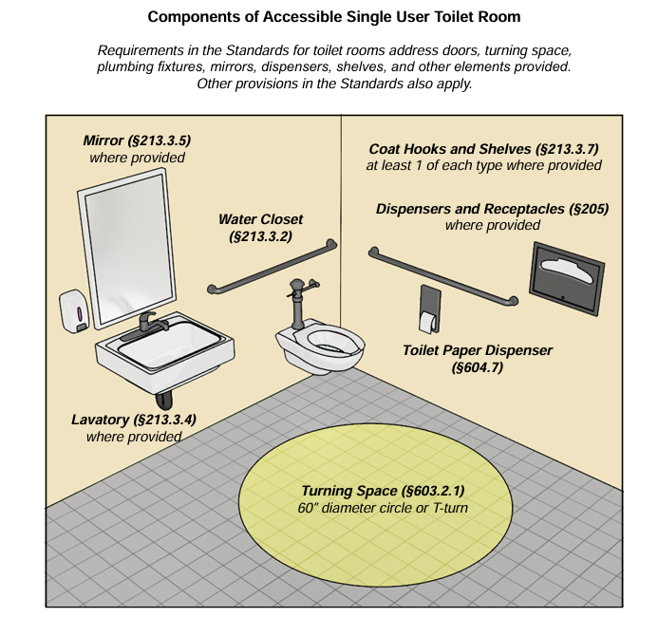
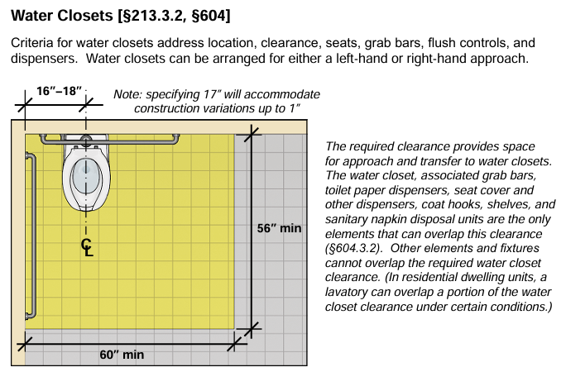
ADA Compliant Restrooms
Restroom(s) which have:
  At least one toilet for every ten (10) beneficiaries attending the ADC, at least one of which must be ADA compliant, and no more than forty (40) feet from the activity area and equipped with a call button;
  Access to sinks/faucets with water temperature between 100-115 degrees Fahrenheit; and
  Supplies including toilet paper, disinfecting soap, and paper towels.
https://www.access-board.gov/ada/guides/chapter-6-toilet-rooms/#components-of-accessible-single-user-toilet-room

Slide 30
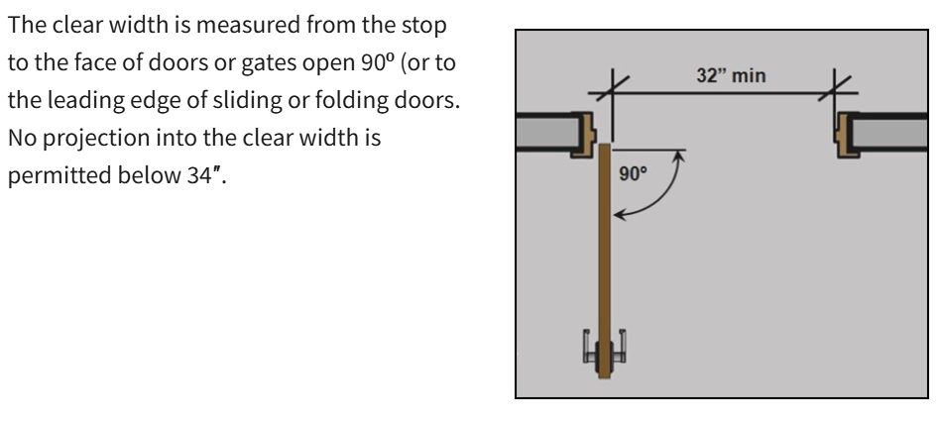
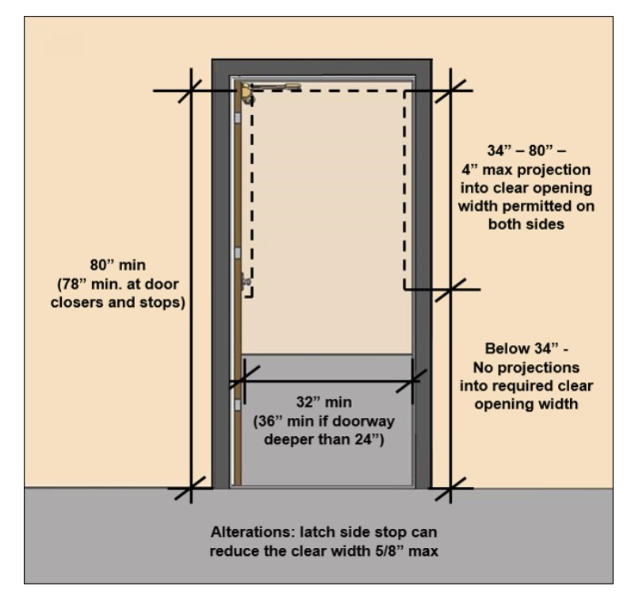
Exits
Facilities must have at least two (2) well-identified ADA compliant exits with doors that must:
  Be either open to the outside or no more than ten (10) feet from an outside exit;
  Be side-hinged and swing out in the direction of exit,
  Have an operable alarm system, and
  Not be locked in a manner that would prevent immediate exit in the event of an emergency.
  Click link to learn more about ADA compliant Doors, Doorways and Gates: https://www.access-board.gov/ada/guides/chapter-4-entrances-doors-and-gates/#doors-doorways-and-gates

Slide 31
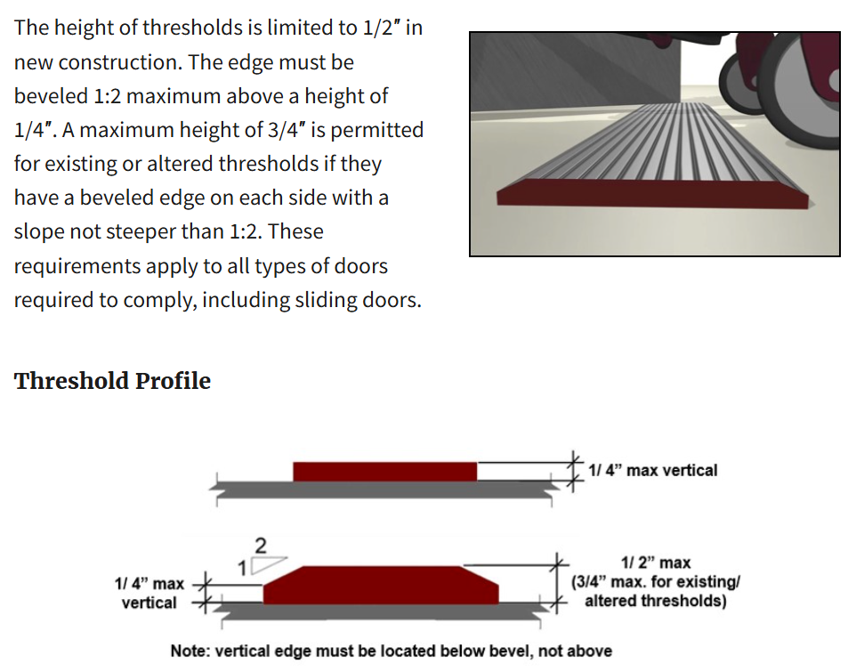
Thresholds
https://www.access-board.gov/ada/guides/chapter-4-entrances-doors-and-gates/#thresholds
Notes:
ADA threshold compliance rules regarding the maximum height and slope of transitions at doorways. These guidelines ensure wheelchair users, walkers, and individuals with mobility aids can safely pass through doorways without tripping, getting stuck, or requiring assistance

Slide 32
Facility Setting
ADC settings should not restrict a beneficiary within a setting, unless such restriction is documented in the person-centered plan, all less restrictive interventions have been exhausted, and such restriction is reassessed over time.
The person-centered service plan should identify and document setting options based on the beneficiary’s needs and preferences, including non-disability specific settings, from which the beneficiary can select.

Slide 33
ADC settings do not include the following:
An institution for mental diseases,
An intermediate care facility for individuals with intellectual disabilities (ICF/IID),
A hospital, or
Any other locations that have qualities of an institutional setting, as determined by the Division of Medicaid, including but not limited to, any setting:
Located in a building that is also a publicly or privately operated facility that provides inpatient institutional treatment,
A nursing facility,
Located in a building on the grounds of or immediately adjacent to a public institution, or
Any other setting that has the effect of isolating beneficiaries receiving Medicaid.

Slide 34
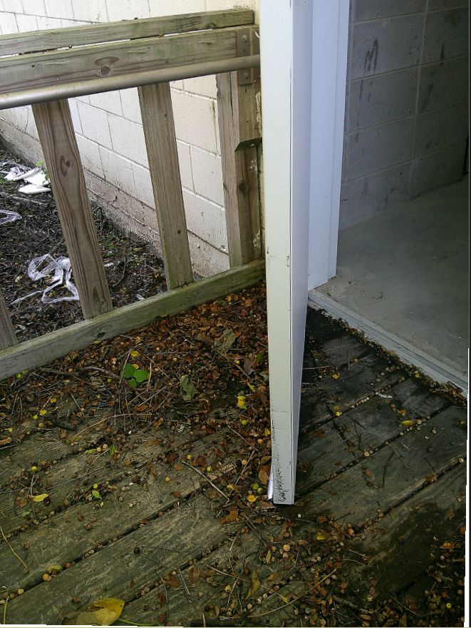

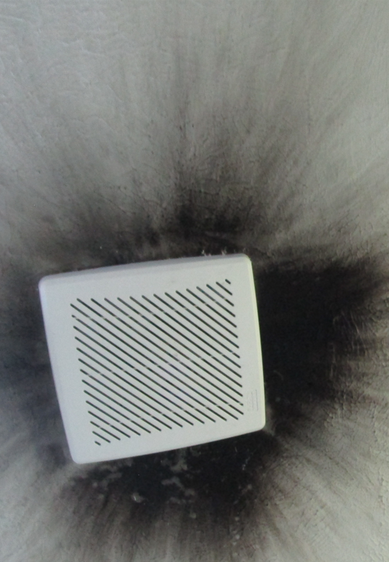

Maintaining Your Facility
All ADC facilities must be compliant with applicable federal, state and local building requirements as well as all zoning, fire, OSHA, health codes and ordinances. It must also meet the requirements of the Americans with Disabilities Act (ADA)
Exits
Plumbing
Electrical
Flooring & Thresholds
Notes:
Take time every 3-6 months to review DOM policies and be sure your facility is continuing to follow requirements for documentation, fire and emergency preparedness, pest control, decluttering, testing call buttons, etc.
Make it a point to regularly complete a maintenance checklist as part of your upkeep so that things don’t fall into disrepair. When needed repairs are identified, have a plan in place to address them timely. A small leak in the roof can quickly turn into a rotting floor, or a mold infestation that can make you, your staff, and your clients very ill.
One of the best ways to ensure that your audits will go smoothly, is to conduct your own internal audits regularly.

Slide 35





Common Non-Compliance: Unfinished Wood
MS Dept of Health requires that all toilet rooms be constructed of impervious materials free from defects.
Unfinished wood poses several health and safety hazards due to the rough finish or splinters which can injure delicate skin. Wood which is not properly sealed poses a health and safety hazard due to the ability to absorb bodily fluids or other liquids such as mop water leading to bacterial growth or mold as well as rot.
Wood stain does not seal the wood in the way a clear finish like polyurethane does. While stains penetrate the wood and add color, they don't provide a protective layer against moisture, scratches, or everyday wear. A topcoat, such as polyurethane, varnish, or lacquer, is needed to seal and protect the stained wood.
Notes:
MS Dept of Health requires that all toilet rooms be constructed of impervious materials free from defects.
Unfinished wood poses several health and safety hazards due to the rough finish or splinters which can injure delicate skin. Wood which is not properly sealed poses a health and safety hazard due to the ability to absorb bodily fluids or other liquids such as mop water leading to bacterial growth or mold as well as rot.
Wood stain does not seal the wood in the way a clear finish like polyurethane does. While stains penetrate the wood and add color, they don't provide a protective layer against moisture, scratches, or everyday wear. A topcoat, such as polyurethane, varnish, or lacquer, is needed to seal and protect the stained wood.

Slide 36
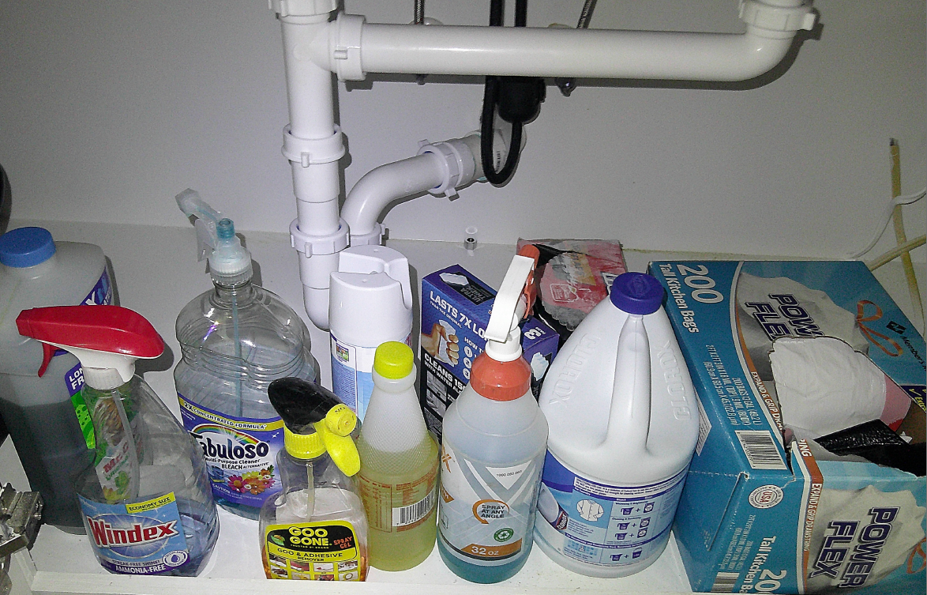
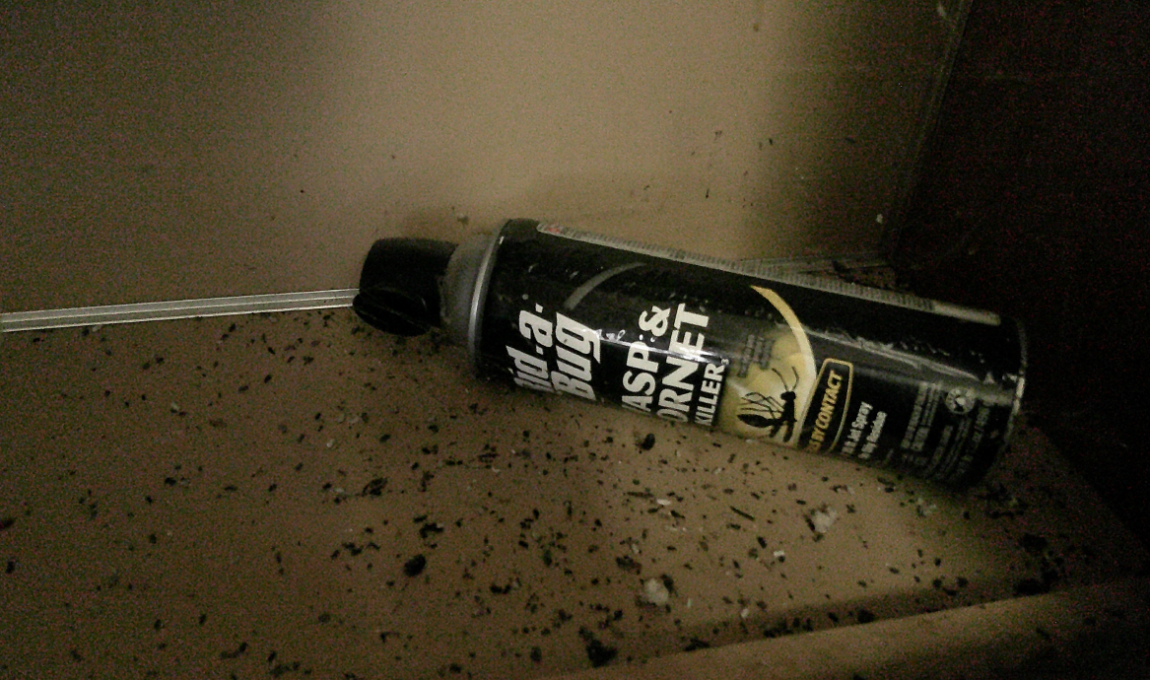
Pest Control & Chemical Storage
Facilities must have a locked, storage area for all toxic substances including cleaning supplies
Maintenance must include regularly scheduled pest control
Notes:
Maintenance must include regularly scheduled pest control. Infestations will result in Immediate Jeopardy.
Facilities must have a locked, storage area for all toxic substances including cleaning supplies

Slide 37
Facility Maintenance
Documents & Logs:
Annual Fire Safety Inspection
Maintenance Plans:
Schedule for regular disposal of expired foods
Schedule replacement of blown out light bulbs throughout the facility.
Schedule daily rounds to ensure adequate supply of tissue, soap and paper towels in restrooms
Schedule for testing exit alarms, smoke detectors, & fire extinguishers
Policy for Repairs & Maintenance
Log of Maintenance, Repairs, & Janitorial Services
Pest Control
Annual Facility Review Attestation
Protocols of storage of toxic chemicals
ADC facility records must include documentation of maintenance and janitorial services, including which staff are responsible for identifying and correcting needed repairs. Someone must be responsible for disposing expired foods, testing alarms, restocking supplies, and so forth.
Notes:
ADC facility records must include documentation of maintenance and janitorial services, including which staff are responsible for identifying and correcting needed repairs. Someone must be responsible for disposing expired foods, testing alarms, restocking supplies, and so forth.

Slide 38
ADC Facility & Maintenance Forms
HCBS Setting Assessment Form
This 4-page self-assessment tool helps ADC providers ensure they are in compliance with regulations set by CMS final rule in 2014.
The requirements reflect CMS’ intent that all waiver beneficiaries receive services in settings that are integrated in and support full access to the community.
  Facility Review Form
  Building requirements
  ADA regulations
  Interior furnishing
  Fire safety
  Food service
  Transportation
Fire Safety Form
Annual inspections required
Completed during enrollment
Must be kept on file for audit
In addition to the annual fire safety surveys, providers must also perform quarterly drills for fire and inclement weather. Documentation of these drills must be maintained and available for audit.
Link: https://medicaid.ms.gov/wp-content/uploads/2021/09/Adult-Day-Care-HCB-Assessment-Fillable-Form-9.2021-1.pdf
Link: https://medicaid.ms.gov/wp-content/uploads/2025/07/ADC-Facility-Office-Review-Form-7.24.25.pdf
Link: https://medicaid.ms.gov/wp-content/uploads/2025/06/Fire-Safety-Inspection-for-ADC-.pdf
The 3-page ADC Facility Review Attestation was designed to help ADC providers understand site requirements, including but not limited to ADA compliance, fire safety, food service, and transportation. ADC providers can use this tool to identify areas that need to be addressed in their current facility, or to identify if a potential new facility is appropriate for use as an ADC.
CMS issued a final rule in 2014 to address the settings requirements for all ADC providers to ensure they are safe and homelike. Providers should be completing this annually and going over it with your staff so they are aware of the requirements.
The Fire Safety Survey should be used to ensure your facility meets fire safety requirements.
Notes:
The 3-page ADC Facility Review Attestation was designed to help ADC providers understand site requirements, including but not limited to ADA compliance, fire safety, food service, and transportation. ADC providers can use this tool to identify areas that need to be addressed in their current facility, or to identify if a potential new facility is appropriate for use as an ADC.
CMS issued a final rule in 2014 to address the settings requirements for all ADC providers to ensure they are safe and homelike. Providers should be completing the HCB Setting Assessment annually and going over it with your staff so they are aware of the requirements.
The Fire Safety Survey should be used to ensure your facility meets fire safety requirements.

Slide 39
CAP Follow Ups
The Division of Medicaid may terminate or suspend a provider immediately for failure to comply with the requirements of the E&D waiver program. The Division of Medicaid may also require providers to submit and implement a corrective action plan (CAP) in a timely manner. Failure to submit or comply with a CAP, approved by the Division of Medicaid, may result in a suspension or termination.
The Office of Financial & Performance Review is wrapping up the FY24 Adult Day Care audits. Once all CAP’s have been submitted and accepted, OLTSS will begin CAP follow-ups to ensure ongoing compliance.
Notes:
Our office will be following up with providers on any Corrective Action Plans to ensure ongoing compliance. Providers who are found to not be following their Corrective Action Plan may face suspension or termination of the provider agreement. If you need guidance on maintaining DOM compliance, please reach out to us for assistance. Our goal is to ensure quality care with minimal disruptions to our members who depend on services.

Slide 40
Exit doors:
Alarms missing or inoperable
Exit signs missing or inoperable
Hard to open/close
Improper direction of swing
Locked from inside
Clutter:
Rest area used as junk storage
Doorways and exits blocked
Office space cluttered and unorganized
Storage closets/area accessible to beneficiaries
Other:
Damaged ceiling tile
Pest infestations
Lack of cleanliness of facility
Lack of ADA compliant ramps, rest rooms (participants), and passageways
Use of participant restrooms by employees
Inoperable call buttons
Torn and damaged furniture
Inadequate lighting throughout facility
Lack of thresholds and damaged flooring
Toiletries for the restroom (paper towels, soap, tissue)
Frequent Issues of Non-Compliance
Building & Facility Maintenance

Slide 41
ADC Staffing
Organizational Chart example
Staff Responsibilities & Credentials
Background, OIG, and Nurse Aide Registry Checks

Slide 42

Administrator/CEO/President
Program Director
Licensed Nurse
Activities Director
Food Services Coordinator/ Food Server
Program Assistant
Driver
Organizational Chart
The Org Chart defines your agency’s Chain of Command, this is the formal, top-down hierarchy within an organization that defines reporting relationships, decision-making power, and lines of communication. It establishes a continuous line of authority from senior leadership down to frontline employees.
When sending updated organizational charts to DOM, please use the shown template and include the names & job titles of the staff assigned to each role.
Providers must employ (as a W2 employee) all staff listed on the organizational chart shown, with the exception of the role of licensed nurse, which may be contract staff.
Driver and Food Server may be replaced with the use of transportation or catering contracts.
All staff must complete the training requirements detailed in Administrative Code, Part 208 Rule 1.3C
There must be at least two (2) persons, with one (1) being a paid employee, at the adult daycare center at all times when there are beneficiaries in attendance.
The employee-to-attendee ratio must be a minimum of one to six (1:6) in all programs except in programs serving a high percentage of day service attendees who are severely impaired which must maintain an employee ratio of one to four (1:4).
Notes:
When sending updated organizational charts to DOM, please use the above template and include the names & job titles of the staff assigned to each role.
Providers must employ (as a W2 employee) all staff listed on the organizational chart shown, with the exception of the role of licensed nurse, which may be contract staff.
Driver and Food Server may be replaced with the use of transportation or catering contracts.

Slide 43
Employees who must maintain current and active first aid and CPR certification:
Full-time Administrator
Full-time Program Director (If the Administrator is not on-site during operating hours)
Licensed Nurse (may be contracted or on staff on-site a minimum of eight hours per week during normal business hours and available on call as needed).
Full-time Activities Coordinator (on-site)
Full-Time Program Assistant
ServSafe Certified employee
Driver
Staffing Qualifications can be found in the Admin Code Part 208 Rule 1.3: Provider Enrollment (C)(2)(h)
Link: https://medicaid.ms.gov/wp-content/uploads/2025/07/Title-23-Part-208-HCBS-LTC-eff.-7.1.2025.pdf

Slide 44
Staff Responsibilities
Administrator:
Developing administrative policies and procedures;
Developing resources for the facility, including fund-raising, grant writing, budget development, and fiscal monitoring;
Ensuring compliance with licensing and funding regulations;
Facilitating and organizing advocacy efforts;
Assessing the facility’s progress in accordance with established goals and objectives and quality assurance plan;
Implementing board policies; and
Hiring and supervising staff.
Program Director:
Planning the ADC services to meet individual needs of the participants,
Ensuring compliance with licensing and funding regulations in absence of Administrator/CEO/Owner,
Liaison with community agencies, and
Providing services to individuals and families when necessary.
Notes:
The administrator or CEO is responsible for developing administrative policies, hiring staff, and fiscal management. This role is not required to be on-site full time.
If the Administrator is not on-site full time during operating hours, then a program director is required to oversee the planning ADC services to ensure individual needs are met.
Please refer to Administrative Code, Part 208, Rule 1.3 for full staffing requirements.

Slide 45
Activities Coordinator
Must be on-site daily.
Plans and manages daily activities.
Assist with transportation.
Assist with preparation and administration of Individualized Care Plan.
Program Assistant
Providing personal care and assistance to participants; working with other staff members as required in implementing and carrying out services and activities and in meeting the needs of individual participants; and
Assisting with transportation of and escorting participants to, from, and within the facility, if appropriate.
Must receive training in working with older adults and conducting activities for the population served.
Licensed Nurse
Must be on-site a minimum of (8) eight hours per week during normal business hours, when beneficiaries are present.
Must be available on call as needed.
Assist with preparation and administration of Individual Service Care Plan, nutritional assessments, and oversight of all health-related activities and services.
Notes:
Program Assistants are responsible for providing assistance to beneficiaries and may assist with escorting beneficiaries during transportation.
A licensed nurse is required to be on site at least 8 hours per week during normal business hours when beneficiaries are present. This replaces the previous requirement to have an RN on-site full time.

Slide 46
If food is prepared on-site, a ServSafe Certified employee is required to oversee the preparation and serving of food. The ServSafe employee must be the actual cook, not the staff responsible for supervising the cook.
Keep in mind that members who rely on wheelchairs or other mobility devices may need additional assistance getting into their homes at drop off. Be sure there is adequate staff to assist.
Providers who are transporting members who rely on wheelchairs need to be well trained in the safe operation of lifts, & how to secure the wheelchair in the van or bus.
ServSafe
A ServSafe Certified employee is responsible for overseeing the preparation and serving of food, if food is prepared on site.
Driver
Must abide by federal, state and local laws,
Must be eighteen (18) years of age and have a current driver’s license to operate the assigned vehicle. Current license must include appropriate class type for the vehicles your agency uses. Refer to the Dept of Transportation for class types.
Must be courteous, patient and helpful to all passengers and be neat and clean in appearance,
Must wear a visible, easily read name tag which identifies the employee and the employer,
Must provide an appropriate level of assistance to a beneficiary when requested or when necessitated by the beneficiary’s mobility status or personal condition, including curb-to-curb, door-to-door, and hand-to-hand assistance, as required.
Notes:
If food is prepared on-site, a ServSafe Certified employee is required to oversee the preparation and serving of food. The servsafe employee must be the actual cook, not the staff responsible for supervising the cook.
Keep in mind that members who rely on wheelchairs or other mobility devices may need additional assistance getting into their homes at drop off. Be sure there is adequate staff to assist.
Providers who are transporting members who rely on wheelchairs need to be well trained in the safe operation of lifts, & how to secure the wheelchair in the van or bus.

Slide 47
The ADC Provider must ensure that the driver is immediately removed from service if he/she:
Fails an annual random drug test.
Is convicted of:
Two (2) moving violations or accidents related to transportation in the previous five (5) years as verified by an annual Motor Vehicle Report 68 (MVR), or
(2) Any federal or state crime listed in Miss. Code Ann § 43-13-121.
Has a suspended or revoked driver’s license for moving traffic violations in the previous five (5) years as verified by an annual MVR.
Notes:
In an effort to ensure safe transportation for beneficiaries, additional regulations were adopted which are in line with other DOM non-emergency transportation services.

Slide 48

Volunteers
All staff /volunteers must receive orientation upon hire and ongoing training which includes at least four (4) in-service training sessions per year to enhance quality of care and job performance.
* Federal Labor Laws prohibit employees from volunteering hours of service to their employers.
If the facility utilizes volunteers, they:
  Cannot provide services in place of required employees and can only be allowed on a periodic/temporary basis.
  Must be individuals or groups who desire to work with adult day service beneficiaries.
  Must successfully complete an orientation/training program.
  Have responsibilities that are mutually determined by the volunteers and employees and performed under the supervision of facility staff members.
  Have duties that either supplement required employees in established activities or provide additional services for which the volunteer has special talent/training.
  Must record their hours and activities.
Notes:
Federal Labor Laws prohibit employees from volunteering hours of service to their employers.

Slide 49
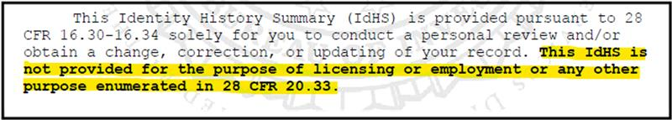
New Process for Background Checks
These changes are mandatory under Federal Bureau of Investigation (FBI) requirements and must be implemented to maintain compliance with federal regulations governing the use and distribution of Criminal History Record Information.
Effective July 1, 2026, the MSDH Background Check Unit will begin reviewing all healthcare rap sheets and making final employment eligibility determinations.
This updated process is designed to reduce the administrative burden on healthcare providers and ensure consistent, compliant decision-making across all facilities regarding healthcare rap sheets.
Background checks from the FBI which include the below statement may not be used for Employment purposes.
Notes:
Effective July 1, 2026, the MSDH Background Check Unit will begin reviewing all healthcare rap sheets and making final employment eligibility determinations.
If, after review of the rap sheet, the MSDH legal team identifies a disqualifying charge per the disqualifying events outlined in Miss Code §43-11-13 , the rap sheet will be mailed directly to the applicant. The applicant will be given 45 days to appeal the decision and submit any relevant legal documentation to the MSDH background check unit.
If legal documentation is provided proving the applicant was found not guilty, charges were dropped, and/or the case was dismissed, the MSDH Criminal History Fingerprint Unit will issue an “OK” letter in SAFER.
If the applicant is unable to provide sufficient legal documentation, the MSDH Background Check Unit will issue a “NO” letter in SAFER.
FBI checks which contain the statement “may not be used for employment purposes” may not be used.

Slide 50
Rap Sheet Review & Determination
If, after review of the rap sheet, the MSDH legal team identifies a disqualifying charge per the disqualifying events outlined in Miss Code §43-11-13,
the rap sheet will be mailed directly to the applicant.
The applicant will be given 45 days to appeal the decision and submit any relevant legal documentation to the MSDH background check unit.
  If legal documentation is provided proving the applicant was found not guilty, charges were dropped, and/or the case was dismissed, the MSDH Criminal History Fingerprint Unit will issue an “OK” letter in SAFER.
  If the applicant is unable to provide sufficient legal documentation, the MSDH Background Check Unit will issue a “NO” letter in SAFER.
Please note that the use and creation of waiver letters will be discontinued under this new process for any NEW healthcare rap sheets processed on or after July 1, 2026.
If you have any questions or require assistance with implementation, please review the FAQ included in this notice. If you still have questions, please contact our office. CHRCUnit@msdh.ms.gov

Slide 51
OIG & Nurse Aide Abuse Registry Checks
Must conduct registry checks before employment and monthly thereafter.
Maintain these records in the employee’s personnel file.
The provider must not employ individuals whose name appears on the registry lists.
Must include a printed copy with date of the check in employee’s and volunteer's personnel file for auditing purposes.
OIG Link: https://exclusions.oig.hhs.gov/
NAAR Link: https://ms.tmutest.com/search
Notes:
Providers must conduct monthly OIG and Nurse Aide Abuse Registry Checks for all staff and ensure not to hire or employ individuals whose name appears on the registry list. The results of these checks must be maintained in the employee’s personnel file.
Providers may maintain this information in a digital format so long as it is easily accessible for audit purposes.

Slide 52
Staff Training:
Incomplete Training (No documents found)
Staff Qualifications:
Resumes (Does Not Meeting Staff Requirements)
Annual First Aide/CPR Certification
No Staff Orientation Upon Hire
No Social Media Confidentiality Agreement
Education
Experience
Credentials
OIG and Nurse Aide Registry Checks
Background Checks
Frequent Issues of Non-Compliance, Staffing Requirements

Slide 53
Primary & Auxiliary Services
Food Service
Transportation
Social Health &
Recreational Activities

Slide 54
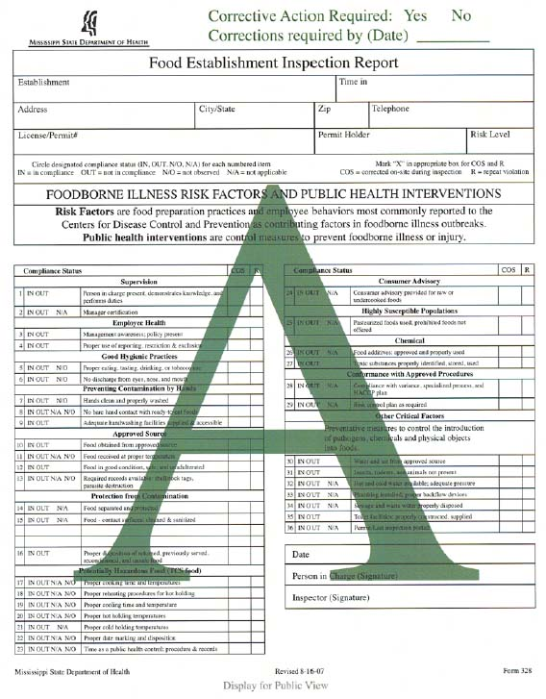
Food Services
Providers must maintain records of service utilization including receipts of purchase, catering contracts, and copies of agency or caterer’s MSDH grade.
Home Delivered Meals (HDMs), fast food, and other government funded meal programs cannot be served in lieu of one (1) meal and two (2) snacks included as a component of ADC food services.
If food is prepared on site, the facility must have a permit to operate a kitchen from MS State Dept of Health (MSDH).
If food is not prepared on site, the facility must contract with and utilize a food service provider/caterer licensed by MSDH to provide nutritionally well-balanced meals that address the dietary needs of beneficiaries.
As a reminder, if food is prepared on site, refer back to the staffing requirements for a ServSafe certified employee.
Notes:
As a reminder, if food is prepared on site, refer back to the staffing requirements for a servsafe certified employee.

Slide 55
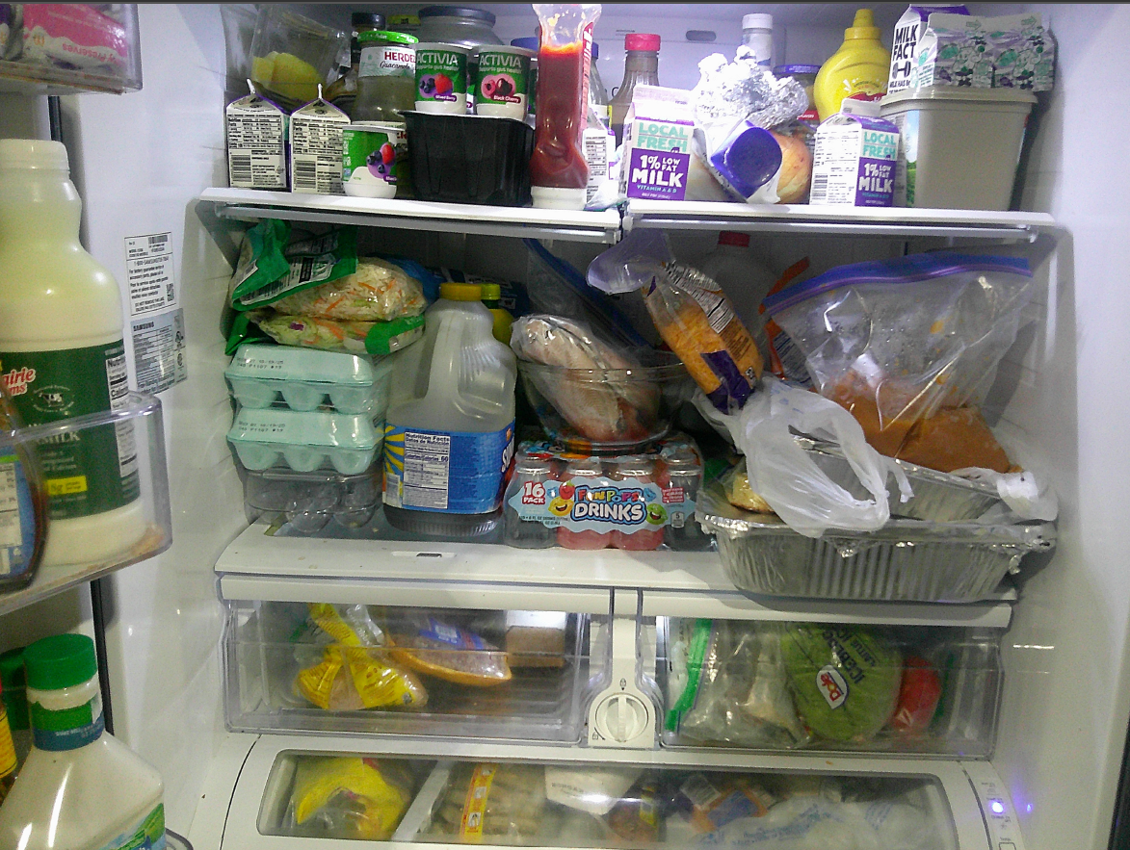
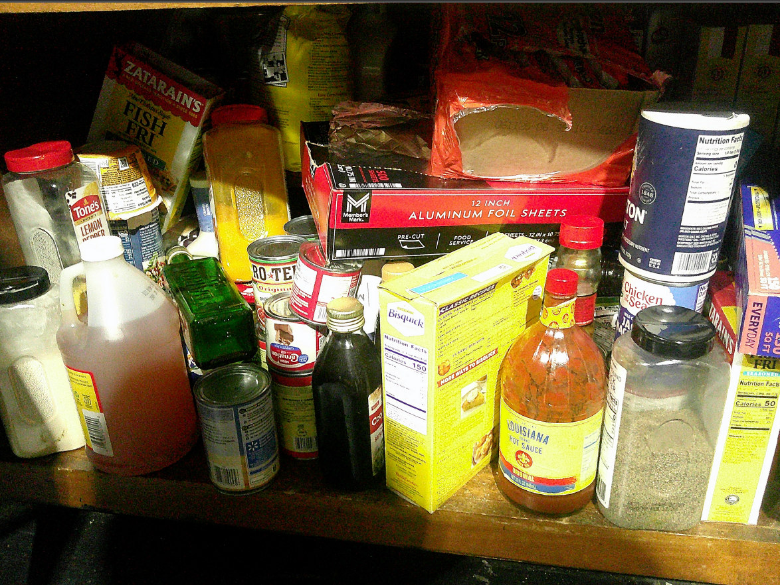

Food Storage
All foods & chemicals must be properly stored.
Foods should be frequently checked for expiration dates and expired foods must be disposed of.
Providers who do not have a kitchen permit from MSDH should not be storing food items other than condiments and snacks.
Notes:
All foods & chemicals must be properly stored.
Foods should be frequently checked for expiration dates and expired foods must be disposed of. Providers who do not have a kitchen permit from MSDH should not be storing food items other than condiments and snacks.
Chemicals must remain locked and out of reach of members.

Slide 56
Frequent Issues of Non-Compliance, Food Services
Administrative
No ServSafe Certified Staff
No current catering contract
No proof of food service in the form of receipts
On-site food prep with no MSDH kitchen permit
Missing nutritional assessments
Food
Failure to dispose expired food
Failure to provide nutritional food by serving fast food as meal and snack replacement

Slide 57
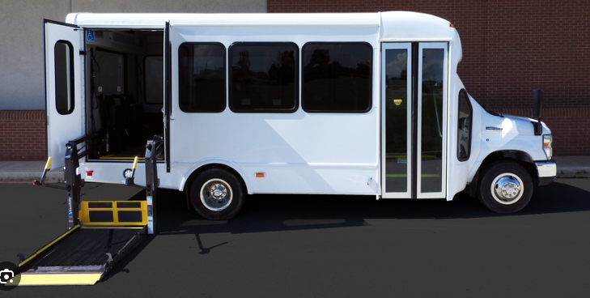
Transportation
The ADC must have a sufficient number of vehicles to transport beneficiaries between their residences and the facility, and to attend facility outings. Each vehicle must meet the requirements detailed in Administrative Code, Part 208.
If the facility contracts transportation services:
The facility must be able to show current use of the transportation contract from a licensed provider of ADA compliant transportation services.
The contracted entity must meet all Division of Medicaid ADC transportation, vehicle, and driver requirements.
Vehicles used for transportation must be ADA accessible, safe, clean and well maintained.
Full requirements can be found under Rule 1.3 of Medicaid Administrative Code Part 208.
Notes:
Vehicles used for transportation must be ADA accessible, safe, clean and well maintained. Full requirements can be found under Rule 1.3 of Medicaid Administrative Code Part 208.

Slide 58

ADCs that provide transportation, vehicles must:
  Be inspected by a certified mechanic prior to application, upon initial use, and bi-annually thereafter following enrollment,
  Ensure that records of the ADC scheduled bi-annual vehicle inspections are maintained and made available to the Division of Medicaid upon request, and
  Only be driven by authorized employees of the ADC provider who are compliant with these requirements or with any State or federal regulations.
  Serve counties as determined and approved by the Division of Medicaid based on location, distance, and time required for travel.

Slide 59
Interior
Lack of vehicle inspections & maintenance
Incomplete Information Packets
Insurance
Lack of Interior Postings
Non-Smoking
Agency Phone Number
VIN number
Seat Belt
Missing or inappropriate cutters
Missing Extenders
No Business Signs
Lack of Fire Extinguishers
Missing Spill Kits
Registration
Frequent Issues of Non-Compliance Transportation
Many of the non-compliance issues providers are cited for are due to a lack of appropriate documentation.
Additional issues include fire extinguishers that are not properly mounted, seat belt cutters that do not have safety blades, or a lack of overall cleanliness and maintenance.
https://www.transit.dot.gov/regulations-and-guidance/civil-rights-ada/ada-regulations
Notes:
Many of the non-compliance issues providers are cited for are due to a lack of appropriate documentation. Additional issues include fire extinguishers that are not properly mounted, seat belt cutters that do not have safety blades, or a lack of overall cleanliness and maintenance.

Slide 60



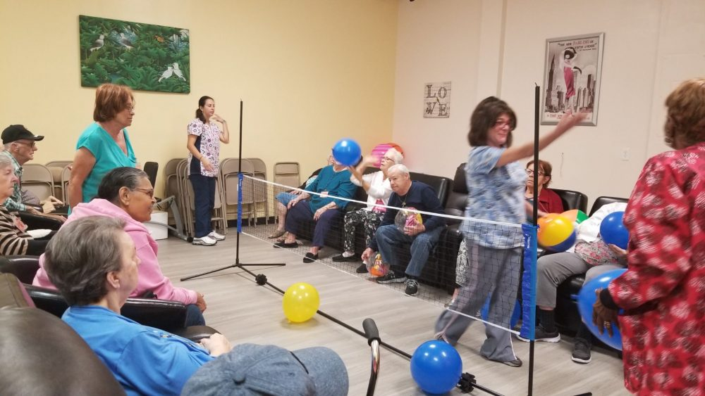

Activities offered must be reflected on the daily activities calendar and posted in an area visible to beneficiaries.
Social, Health and Recreational Activities
ADCs must meet the physical and social needs of each beneficiary and maintain compliance with the state and federal guidelines regarding services provided.
ADCs must provide social, health, and recreational activities which optimize, but not regiment, individual initiative, autonomy, and independence, including, but not limited to, daily activities, physical environment and personal preferences.
Notes:
Activities offered must be reflected on the daily activities calendar and posted in an area visible to beneficiaries.

Slide 61

If the provider chooses to have exercise equipment in the facility as part of recreational activities, the facility must meet ADA requirements for exercise equipment, including clear floor space and accessible routes.
Accessible Exercise Equipment:
At least one of each type of exercise equipment or machine must have clear floor space of at least 30 by 48 inches and be served by an accessible route.
If the clear space is enclosed on three sides (e.g., by walls or the equipment itself), the clear space must be at least 36 by 48 inches.
Key Safety Features of Equipment to Consider
Comfortable and Sturdy Seats - Ensure Seats accommodate various body types and offer secure support.
Leg or Foot Stabilizers - Provide extra support for participants with limited mobility in their legs or feet.
Large Footbeds and Foot Straps - Allow participants to comfortably and safely use pedals, especially for those with limited mobility or balance.
Self-Powered Machines - Equipment that maintains function at very low speeds, offering a range of exercise options.
Adaptive Accessories - Consider accessories that allow participants to adjust the equipment to their specific needs, such as arm handles and leg crank adjustments.

Slide 62
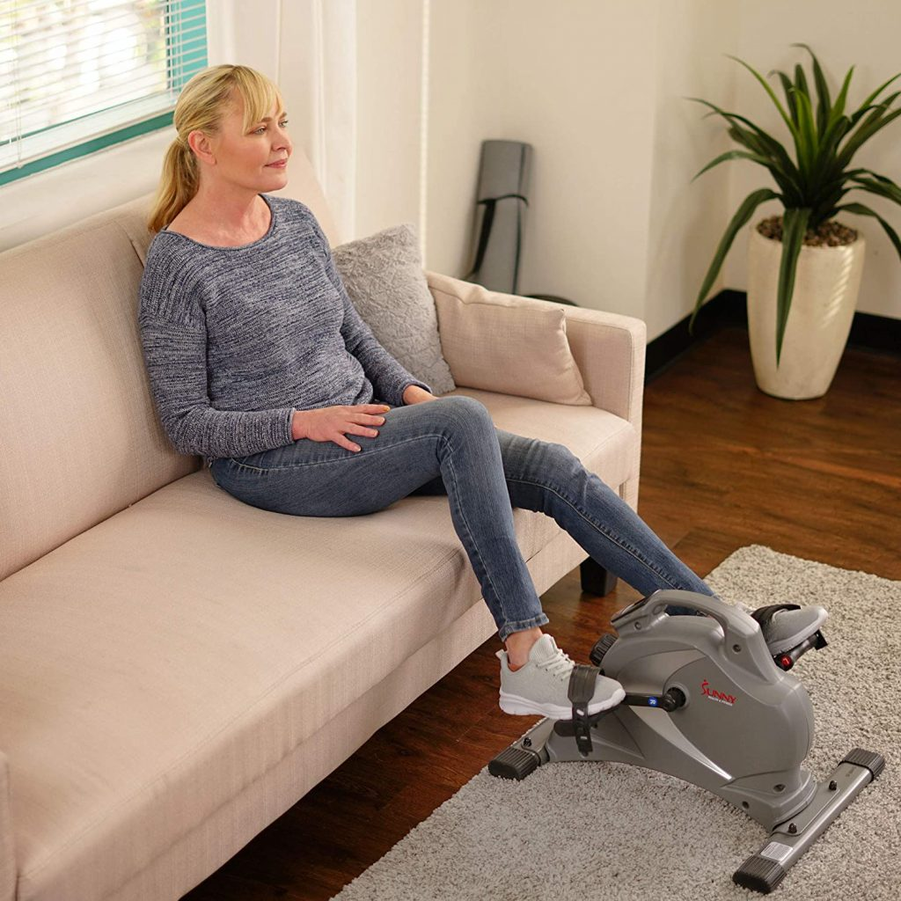
Types of Equipment to Consider:
Focus on features that accommodate a range of abilities. Look for slow-start treadmills and options for low-impact exercises such as:
Elliptical Machines – Provides low impact cardio exercise and minimal stress on joints
Recliners – Allow participants to exercise while seated, making it accessible for those with limited mobility
Low-Impact Exercise Bikes – Offer a variety of resistance levels and allows for seated exercise.
Slow-Start Treadmills – Can allow participants to begin walking at a very slow pace, making it easier to ger started and gradually increase pace with supervision.

Slide 63
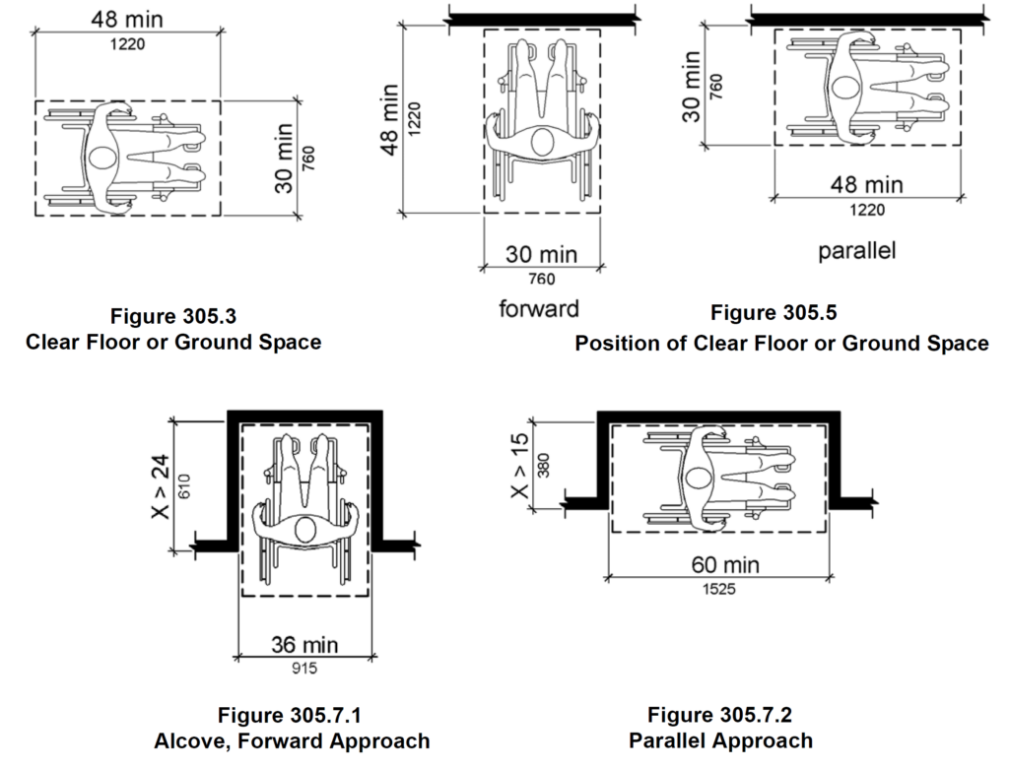
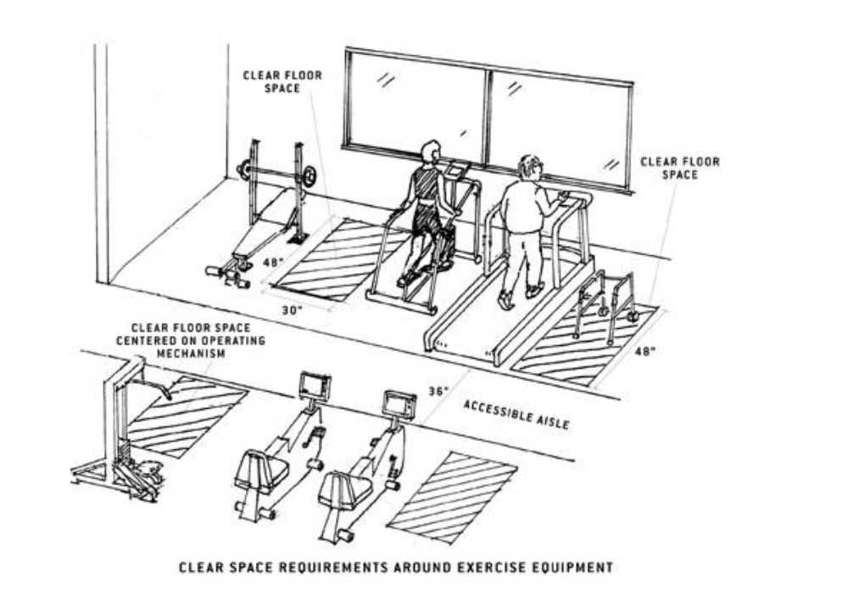

https://www.corada.com/documents/2010ADAStandards/305#:~:text=The%20clear%20floor%20or%20ground,inches%20(1220%20mm)%20minimum
Notes:
Section 1004.1 or the 2010 ADA Standards requires a clear floor space “positioned for transfer or for use by an individual seated in a wheelchair”.

Slide 64
Record Maintenance
The following slides will address requirements for record maintenance and give several templates providers may use to meet minimum standards.
Providers are not required to use templates provided, and may instead use their own, as long as minimum standards are met in accordance with Medicaid Administrative Code, Part 208.
Staff Files
BENEFICIARY Files
Proper Storage and Accessibility

Slide 65

ADC facility records should include, at minimum:
Documentation of maintenance and janitorial services including repairs, maintenance and pest control,
Documentation of quarterly drills for fire and inclement weather,
Annual fire safety inspection reports conducted by the fire department,
Records of quarterly advisory committee meetings,
Written criteria for service provision, including procedures for detailing with emergency service requests,
Policy and procedure manuals,
Written personnel policies including the process used in the recruitment, selection, training, retention, and termination of employees,
Current and historical organizational charts including the names and job titles of owners, operators, managers, administrators, and other supervisory staff,
Current and historical employee listing that captures names, staff/tax id numbers, employment hire and termination dates, and
Service records of licensed nurses which includes dates in the facility, arrival and departure times, services performed, and signature of administrator or program director.
Shown here is a list of all required documentation. This documentation is required to substantiate claims and without it you may be subject to claims recoupment.
It is very important that files be maintained and stored not only in a HIPAA compliant manner, and available for auditors immediately, but also protects the documents from water damage or pests.
Notes:
Shown here is a list of all required documentation. This documentation is required to substantiate claims and without it you may be subject to claims recoupment. It is very important that files be maintained and stored not only in a HIPAA compliant manner, and available for auditors immediately, but also protects the documents from water damage or pests.

Slide 66
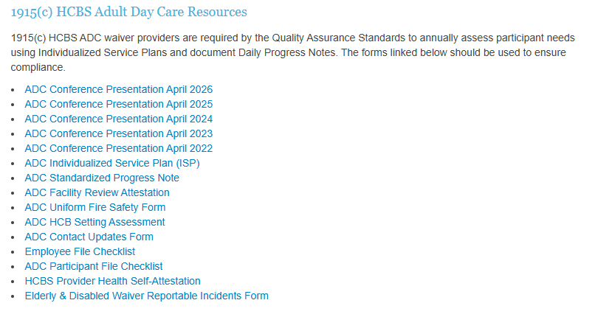
Resources for Compliant Records
  There are many resources available on the HCBS Waiver Providers Website to help you maintain compliance with DOM Records Requirements including:
    Employee File Checklist
    Individualized Service Plan (ISP)
    Standard Progress Note
    Facility Review Attestation
    Fire Safety Form
    Reportable Incidents Form
HCBS Waiver Providers Website: https://medicaid.ms.gov/hcbs-waiver-providers/
Notes:
Admin Code Part 208 Chapter 1 Rule 1.8: Documentation/Record Maintenance
DOM created the 1915(c) HCBS Personal Care & In Home Respite Resources section on our webpage to assist our providers in ensuring compliance for record maintenance and documentation in the Administrative Code.
The forms listed in this section are the most up-to-date forms for PCS-IHR providers. In case there is an audit by DOM, the agency will need to make sure that all files, including the employee file checklist, are easily accessible.

Slide 67

Proper Storage & Accessibility
Storage
Lockable file storage for the security and maintenance of all files in compliance with HIPAA standards.
Climate controlled storage safe from pests and weather damage.
Records documenting the provision of services must be maintained by the providers of waiver services for a minimum of five (5) years. If, at the conclusion of the five-year period, there is ongoing litigation or an open audit, the provider must maintain these records until the litigation or audit is concluded.
Accessibility
Ensuring immediate access to all beneficiary and employee records as required for audit purposes.
Filing system of storage of records to be more accessible for auditors.
Annual
Alphabetical
Numerical
Color Code
Providers must ensure that all records are stored in a secured manner and must be available for immediate access by auditors.
At all times, Monday – Friday 8am – 5pm, there must be a staff member on site that can grant auditors access to all records and represent the facility in an audit.
Notes:
Providers must ensure that all records are stored in a secured manner and must be available for immediate access by auditors. At all times, there should be a staff member on site that can grant auditors access to all records.

Slide 68
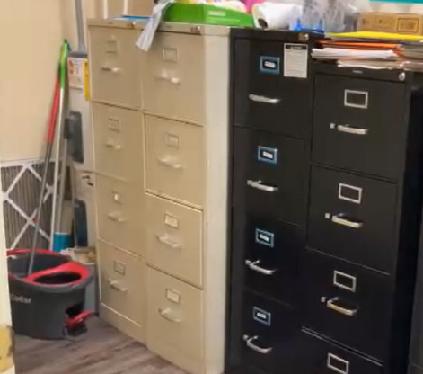
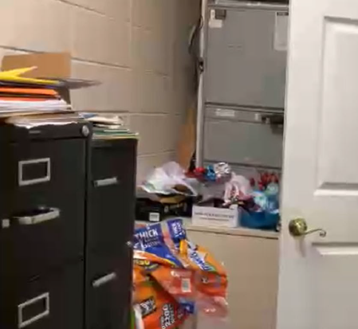
Placement of Filing Cabinets
Documentation and record maintenance for reimbursement purposes must, at a minimum, meet requirements set forth in the Elderly and Disabled (E&D) Waiver. [Refer to Miss. Admin. Code Part 200, Rule 1.3.]
https://medicaid.ms.gov/wp-content/uploads/2026/03/Title-23-Part-200-General-Provider-Information-eff-03.01.26.pdf
Medical records must be legible, appropriate, and correct. All entries within a medical record should be written legibly to ensure beneficiary safety and appropriate billing and/or reviewing.
Providers must retain medical records for a minimum of five (5) years or longer as required by federal or state law.

Slide 69
Frequent Issues of Non-Compliance
Record Maintenance
Administrative
Improper business operating hours
Improper staffing ratios
Inaccurate organizational charts
Lack of daily progress notes
Missing documents/procedures posted
  Fire procedures
  Evacuation plan
  Grievance policy
  Privilege Tax License
Missing Confidentiality Agreement
Missing/incomplete individualized service plan
Missing participants physical exam (6 months prior to admission)

Slide 70
Additional Resources

Slide 71

The process shown here has been created to ensure providers are following requirements, so all members have freedom of choice. The E&D waiver is not the only option for services, the MAC Center & PDD can help members navigate those choices.
Once a beneficiary chooses a waiver program, their name is placed on the local waitlist until a slot becomes available. Once a slot becomes available, an assessment is completed by the case managers at the PDD and financial eligibility is determined by the regional office. Once eligibility is established, the beneficiary then gets to choose a service provider approved for their area. This choice results in the submission of a referral and a Plan of Service.
When a referral is received, whether it be for an initial enrollment or recertification, compare the frequency on that referral to the frequency on the PSS and confirm that the Provider Number listed is correct. Notify the case managers of discrepancies.
Waiver providers should not be completing waiver intake referral forms and sending them to Case Managers. While performing marketing for your agency, if an individual shows interest in Home & Community Based Services, that individual should be provided with contact information for the Mississippi Access to Care Network, or the MAC Centers. The MAC Center in their area can be contacted by phone at 1-844-822-4622 or via the “Send a message to MAC Center” button on their webpage at https://www.mississippiaccesstocare.org/help-info/contact-us.
Once the individual contacts the MAC Center, they will receive information on available services as well as referrals to applicable programs to meet their needs.
After speaking with the MAC Center, if the individual is interested in applying for a Medicaid waiver, their name will be placed on a waiting list and will be evaluated for physical and financial eligibility when an open slot becomes available.
Waiver providers must keep in mind that not all individuals interested in services will qualify. Additionally, those who do qualify must be guaranteed the freedom to choose any qualified provider servicing their area.
Waiver providers are prohibited from any actions which would in any manner, deny or restrict that individual's free choice of a provider of any services for which the individual may be eligible. Providers cannot use any method of inducement, including free transportation, refreshments, cash or gifts, to influence a beneficiary to select a certain provider.
.
Notes:
The process shown here has been created to ensure providers are following requirements to ensure all members have freedom of choice. The E&D waiver is not the only option for services, the MAC Center & PDD can help members navigate those choices.
When you receive a referral, whether it be for an initial enrollment or recertification, compare the frequency there to the frequency on the PSS. Notify the case managers of discrepancies.
If you receive a referral, even for a recertification, and it’s for a member who does not attend ADC services, you have the right to decline the referral and have your agency removed from the PSS. Case managers are aware that ADCs are limited in the number of people you can serve and those spaces may be limited to individuals who attend.

Slide 72
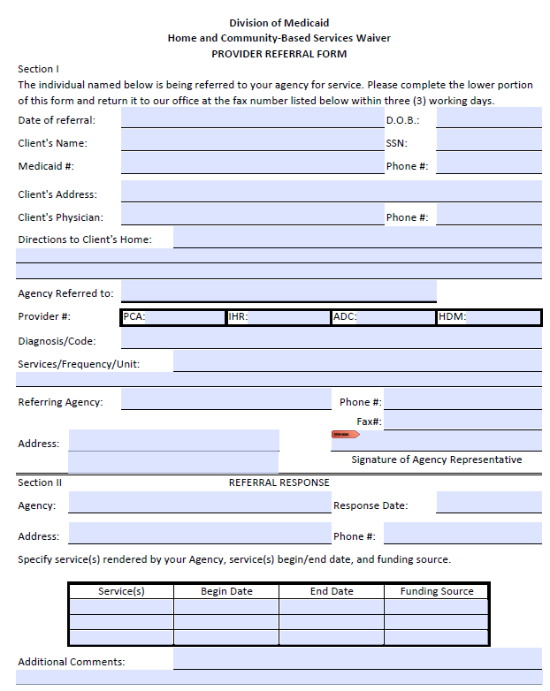
Referrals & PSS
The Referral is received from the PDD to notify Providers that a member is interested in receiving services.
Providers must review this information carefully to determine if they have space in their facility available, and appropriate number of staff to accept this referral.
Providers must confirm acceptance or decline the referral within three (3) working days.
If authorization starts or stops mid-week, claims submitted should accurately reflect authorization rather than span billing for the entire week or month.
Notes:
There have been some changes with the eLTSS system which are resulting in a more manual approval process for PSSs. DOM is working on a solution on this but until the issue is resolved, it has resulted in a temporary delay in processing these requests. Providers may now receive a PSS that indicates “No decision has been made yet.” but you should still be receiving a full copy of the PSS and the referral. For ADC providers billing once a month, this should not cause a delay in your ability to bill.

Slide 73
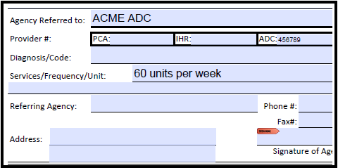
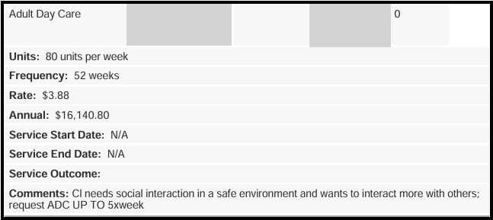
Referrals & PSS
When a PSS is received, Providers must confirm accuracy. If discrepancies are found, the Provider must notify the PDD immediately.
Compare the frequency on the referral to the frequency on the PSS,
Confirm provider numbers are accurate,
Ensure start/end date is appropriate based on date received.
(Day X Hour) X 4.5 = Hours per Month / HrMnth x 4 = Units per month
Can you identify the error(s) below between the Referral & PSS?
AKME ADC
543210
Notes:
When a PSS is received, Providers must confirm accuracy.
HrMnth x 4 (because there are 4 units in an hour)

Slide 74
Freedom of Choice
Waiver providers are prohibited from any actions which would in any manner, deny or restrict that individual's free choice of a provider of any services for which the individual may be eligible. Providers cannot use any method of inducement, including free transportation, refreshments, cash or gifts, to influence a beneficiary to select a certain provider.
Waiver providers must keep in mind that not all individuals interested in services will qualify. Additionally, those who do qualify must be guaranteed the freedom to choose any qualified provider servicing their area.
Notes:
Admin Code Part 208 Chapter 1 Rule 1.4: Freedom of Choice
An undeniable right for beneficiaries is that they have the right to have the Freedom of Choice of eligible providers for covered services. With this right, providers may not require beneficiaries to sign a statement restricting their free choice to a single provider or influence them by any method of inducement. This includes and is not limited to free transportation, refreshments, cash or gifts.
If DOM is notified of any solicitation, your agency will be reported to our Program Integrity Division for investigation.

Slide 75
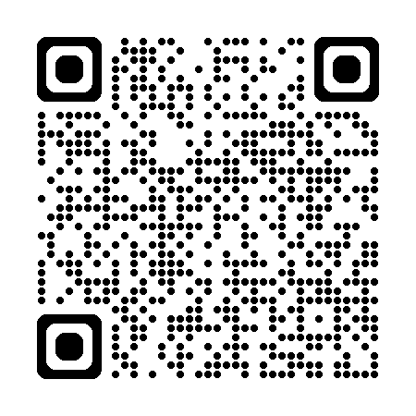
Reporting Medicaid Fraud & Abuse
Types of Provider Fraud Billing for services not rendered:
Inappropriate or lack of documentation to support services billed
Quality of care issues that fail to meet professionally recognized health care standards
Falsifying certificates of medical necessity, plans of treatment, and medical records to justify payment
Soliciting or receiving kickbacks
Violating Medicaid policies, procedures, rules, regulations, and/or statutes
There are multiple ways to report, which can be found at the following link: https://medicaid.ms.gov/contact/report-fraud-and-abuse/
Notes:
All providers must report any suspected instances of Fraud, Waste, or Abuse. This includes suspected or confirmed actions by employees of the provider agency.
For additional resources and toolkits to supply to your employees, you may visit the Medicaid Program Integrity Education page on the Centers for Medicare and Medicaid Services website.

Slide 76
Reporting Medicaid Fraud & Abuse
Program Integrity investigates activities relating to the prevention, detection and investigation of alleged provider and beneficiary fraud and/or abuse in the Medicaid program. Every dollar lost to the misuse of Medicaid benefits, is one less dollar available to fund programs providing essential medical services for vulnerable Mississippians. If we don’t work together to help stop fraud and abuse, the system might not be available for those whom the program was created to help.
You can contact the Mississippi Division of Medicaid (DOM) multiple ways as listed below. In accordance with the Health Insurance Portability and Accountability Act of 1996 (HIPAA) and to protect confidentiality, it is advised that you do not email protected health information or personally identifiable information.
Toll-free: 800-880-5920
Phone: 601-576-4162
Fax: 601-576-4161
Mailing address:
ATTN: Office of Program Integrity
550 High Street, Suite 1000
Jackson, MS 39201
Report fraud and abuse by submitting a secure online form

Slide 77

Reporting Abuse Neglect & Exploitation
The Vulnerable Persons Act mandates that any person who knows or suspects that a vulnerable person has been or is being abused, neglected or exploited, shall immediately file a report.
Every recipient of Medicaid Waiver Services is classified as a Vulnerable Adult.
After a report is made to APS, Providers must contact DOMs office of LTSS with the Report Intake Number.
Vulnerable Person Abuse Hotline: 844-437-6282
https://hssmsprod.wellsky.com/assessments/?WebIntake=1C7B078B-3596-4768-8DCE-40CBAF6690D3
Notes:
Waiver Providers are required reporters for any suspected Abuse, Neglect, Exploitation, or suspicious deaths.

Slide 78


Providers must report:
Critical incidences including all instances of abuse, neglect, and exploitation (including the unauthorized use of restraints, restrictive interventions, and/or seclusion) within twenty-four (24) hours of the occurrence or knowledge of the occurrence to the Division of Medicaid and other applicable agencies as required by law.
Any complaints not resolved within seven (7) days to DOM.
APS would receive reports of Abuse, Neglect, Exploitation, or suspicious death.
The PDD would receive reports of beneficiaries or their relatives acting inappropriately with Provider Staff.
DOM would receive all other complaints.
Adult Protective Services - Mississippi Department of Human Services
Notes:
APS would receive reports of Abuse, Neglect, Exploitation, or suspicious death.
The PDD would receive reports of beneficiaries or their relatives acting inappropriately with Provider Staff.
DOM would receive all other complaints.

Slide 79

Quality Management
If an E&D Waiver provider fails to respond to contact attempts timely or respond to requests for documentation/training verification in established timeframes, the Division of Medicaid may halt the acceptance of Medicaid referrals or waiver admissions until the E&D waiver provider establishes contact or demonstrates compliance with the regulatory agency.
Please ensure that DOM is listed as a safe sender for your agency email domain by utilizing the resources below:
Yahoo Safe Sender: https://help.yahoo.com/kb/add-edit-delete-contacts-yahoo-mail-sln28059.html
Gmail Safe Sender: https://support.google.com/contacts/answer/1069522?hl=en&co=GENIE.Platform%3DDesktop
AOL Safe Sender: https://help.aol.com/articles/add-edit-or-delete-contacts-in-aol-mail
AT&T Safe Sender: https://www.att.com/support/article/email-support/KM1049062/
Outlook Safe Sender: https://support.microsoft.com/en-us/outlook/mail/add-recipients-to-the-safe-senders-list-in-outlook
Please ensure that all contact information for your agency is accurate and true. The Division of Medicaid has the right to halt E&D Waiver referrals and admissions if your agency fails to respond to communications timely or if the Division of Medicaid is unable to contact your agency. Your agency will remain removed from the Freedom of Choice list until contact is reestablished.
The decision to halt Medicaid referrals or waiver admissions is at the discretion of the Division of Medicaid.
Notes:
Please ensure that all contact information for your agency is accurate and true. The Division of Medicaid has the right to halt E&D Waiver referrals and admissions if your agency fails to respond to communications timely or if the Division of Medicaid is unable to contact your agency. Your agency will remain removed from the Freedom of Choice list until contact is reestablished.

Slide 80

  All emails should include a signature. The signature should have the name of the person emailing, role in agency, agency’s name, provider ID(s), phone number, email, and fax number
  The topic should be in the email subject line.
  All messages should be clear and concise. This includes phone calls, voicemails and emails.
  All emails containing beneficiary specific information (names, Medicaid ID, Date of Birth, etc.) must be encrypted. This is to ensure that the privacy of the beneficiary is protected.
  Email addresses should be appropriate. This includes the following:
    Email domain should be able to be passed down
      Ex) Approved: Admin@HealthCareAgency.com or AdminHealthCareAgency@gmail.com
      Ex) Not Approved: CowgirlJane601@gmail.com
Professional Provider Etiquette
Professionalism from providers is key in helping improve effective communication with the Division of Medicaid. This guide should be beneficial to those providers interested in helping improve the etiquette of staff and streamlining the best response from DOM in answering your questions or concerns.
All emails should include a signature, topic, and, if PHI is used, they must be encrypted. This helps ensure that the privacy of the beneficiary is protected and that DOM has a contact plus the issue addressed within the same email. If in doubt about your ability to encrypt emails, send us a request for an encrypted email and we can assist you.
Another note is that email addresses should be appropriate. Having email domains that are able to be passed down will make it easier for providers in case there is an instance of the staff being removed from the position. The new staff that fills the position should have a seamless transition to the approved email domain.
Finally, please do not send the same email to multiple staff at DOM. Emailing HCBSProviders will get your request to our entire team. However, if you send that same email to multiple people, it can create confusion and additional work which slows down general response time.
Notes:
Professionalism from providers is key in helping improve effective communication with the Division of Medicaid. This guide should be beneficial to those providers interested in helping improve the etiquette of staff and streamlining the best response from DOM in answering your questions or concerns.
All emails should include a signature, topic, and be encrypted. This helps ensure that the privacy of the beneficiary is protected and that DOM has a contact plus the issue addressed within the same email. If in doubt about your ability to encrypt emails, the HHA Portal has a secure message feature that automatically protects PHI and allows you to communicate directly with our staff. Please limit the message portal to emails that require the use of PHI if not directly related to HHA.
Another note is that email addresses should be appropriate. Having email domains that are able to be passed down will make it easier for providers in case there is an instance of the staff being removed from the position. The new staff that fills the position should have a seamless transition to the approved email domain.
Finally, please do not send the same email to multiple staff at DOM. Emailing HCBSProviders will get your request to our entire team. However, if you send that same email to multiple people, it can create confusion and additional work which slows down general response time.

Slide 81
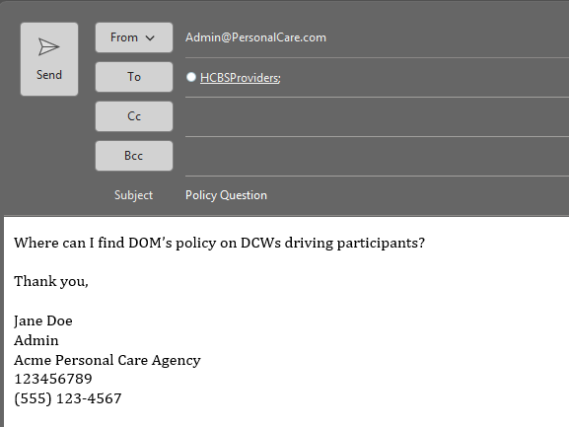
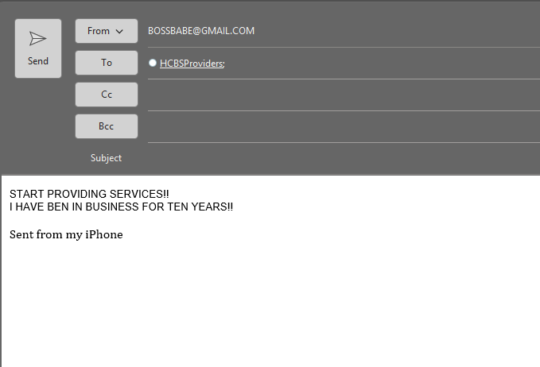
Professional Provider Etiquette
Do
Use appropriate email addresses
Include a subject
Include your contact information
Don’t
Use personal email addresses
Leave subject line blank
Forget your contact information
Please reach out to the HCBSProviders email for any policy, enrollment, education, or general inquiries.
In order to supply you with a sufficient response to a question, our team will need to know (1) who you are,
(2) how to contact you/your agency,
(3) the provider ID, and
(4) the actual question.
Remember to always include the subject line so that we may be able to know the topic at hand.
Notes:
Please reach out to the HCBSProviders email for any policy, enrollment, education, or general inquiries. In order to supply you with a sufficient response to a question, our team will need to know (1) who you are, (2) how to contact you/your agency, (3) the provider ID, and (4) the actual question. Remember to always include the subject line so that we may be able to know the topic at hand.

Slide 82
Professional Provider Etiquette
Providers are responsible for safeguarding the confidentiality of applicant and beneficiary information in all forms to prevent unauthorized disclosure. According to the HIPPA Security Rule, providers must also implement technical policies and procedures for electronic information systems that maintain electronic protected health information to allow access only to those persons or software programs that have been granted access rights as specified in the Code of Federal Regulations Title 45.
As a general reminder, the subject line of an email must never contain PHI as subject lines themselves cannot be encrypted. Also, do not share credentials when accessing any system for the MS Division of Medicaid. A unique ID must be used in order to track and uphold proper user management.
Sharing Credentials
When accessing any system for the MS Division of Medicaid, whether that be MESA, HHAX or other EVV systems, or any other system that may contain MS Medicaid Beneficiary data, each user must have their own unique Username and Password. Credentials are the equivalent to a digital signature for these systems and are never to be shared amongst multiple staff.
If you currently have staff which share credentials, new user accounts must be set up immediately and any shared passwords must be reset to ensure security. Credentials for staff who are no longer employed with your agency must be immediately deactivated.
Protecting PHI
Protected Health Information (PHI) must be secured at all times. PHI refers to any health data that identifies a specific individual, including Member Names, Medicaid IDs, Address, Medical History, PSS data, etc.
PHI must never be shared via emails which are not encrypted. It must never be shared on personal mobile devices, via text, especially in group chats which may include individuals not relevant to the member’s care.
Notes:
Providers are responsible for safeguarding the confidentiality of applicant and beneficiary information in all forms to prevent unauthorized disclosure. According to the HIPPA Security Rule, providers must also implement technical policies and procedures for electronic information systems that maintain electronic protected health information to allow access only to those persons or software programs that have been granted access rights as specified in the Code of Federal Regulations Title 45.
As a general reminder, the subject line of an email must never contain PHI as subject lines themselves cannot be encrypted. Also, do not share credentials when accessing any system for the MS Division of Medicaid. A unique ID must be used in order to track and uphold proper user management.

Slide 83

Resources for Success
Policy Updates: Get notified when new policies are announced, email a contact name, place of business and a contact number (optional) to DOMPolicy@medicaid.ms.Gov
Late Breaking News: To sign up to receive email alerts every time DOM posts a Late Breaking News update, just email a contact name, place of business and a contact number (optional) to LateBreakingNews@medicaid.ms.gov
If you have questions about background checks, please contact MS Department of Health Julie.Henderson@msdh.ms.gov
If you have questions about your responsibilities as an employer, please contact the U.S. Department of Labor https://www.dol.gov/agencies/whd/contact/local-offices
If you are interested in joining the MS Association of Adult Day Services, you can visit their website at https://www.missaads.org/

Slide 84

Contact Information
Mississippi Division of Medicaid
Office of Long Term Services & Supports
Phone: (601) 359-6141
Website: https://medicaid.ms.gov/hcbs-waiver-providers/
Email Address: HCBSProviders@medicaid.ms.gov
Address: Office of Long Term Services & Supports
Division of Medicaid
Walter Sillers Building
550 High Street
Jackson, MS 39201
Notes:
To stay in touch with the Division of Medicaid's Office of Long Term Services and Supports, you may reach us by phone, email, or mail.
To effectively communicate responses to inquires, emails sent to the HCBS email account will result in more timely response. We have multiple staff monitoring that account daily.
We also send out a quarterly newsletter called THE SCOOP, this newsletter is specifically for E&D Waiver Providers so be sure to read it when received. The last issue was distributed July 1st, that issue and the prior issue can be found on the HCBS Waiver Providers website.

Slide 85



Need Technical Assistance?
Gainwell
  Recredentialing applications
  Issues with MESA
  Updating agency contacts and address
  Requesting 1099 tax forms
DOM
  Expanding service area
  Relocating
  Change of Ownership
  Staffing changes
  Audits
PDD
  Requesting more hours for clients
  Any adjustments made to PSS
  Missing lock-in on PSS
  Beneficiaries needing transportation
https://medicaid.ms.gov/wp-content/uploads/2025/05/Q2-2025-PROVIDER-FIELD-REPRESENTATIVES_Map-and-By-County_v2.0.pdf
Notes:
Our office often receives questions as to who would be the most appropriate point of contact for certain issues. In an effort to give providers a greater understanding of the provision of technical services, we have divided the responsibilities of Gainwell, DOM, and PDDs.
Questions for recredentialing, MESA issues, updating agency contact, or requesting tax forms should be directed towards your local Gainwell Field Provider Representative. You may find their contact information on the linked PDF.
DOM should receive questions for expanding service areas, relocating, changing ownership, staffing changes, or audits. You may call or email us for any inquires.
PDDs work in hand with the beneficiary’s Case Manager. The Case Manager should always be contacted in requests more hours, PSS adjustments, and coordinating transportation.

Slide 86


To receive a training certificate, email HCBSProviders@Medicaid.MS.Gov to request next steps.

