Slide 1

Office of the Governor | Mississippi Division of Medicaid
The Division of Medicaid
Personal Care and In-Home Respite Provider Training
Office of Long Term Services and Supports
Updated July 21, 2026

Slide 2
Introduction

Slide 3
LTSS Team
Misty Jenkins
Senior Director
Long Term Services & Supports
Nancy Dampier
Director
HCBS Provider Relations
Gabrielle Grant
LTSS Solutions Manager
Paulette Johnson
Director
Long Term Care
Kenosha Williams
Lead Reviewer
E&D Provider Enrollment
Alexis Martin
Reviewer
E&D Provider Enrollment
Penelope Boyd
CSP Beneficiary Support
Terri Wilkerson
E&D Beneficiary Support
Estel Stringer
ID/DD Beneficiary Support

Slide 4

Who is this training for?
This training is for providers who are currently enrolled to provide Personal Care (PCS) Services or In-Home Respite (IHR) under the MS Division of Medicaid Elderly & Disabled (E&D) Waiver.
Training must be completed by:
  Agency Owner,
  Administrator, and/or
  Compliance Officer
If the individual completing this training exits the company, the training must be completed by the individual hired to fill that vacant role. If there is a change in ownership or partnership within your agency, those individuals must also complete and attest to this training.
Notes:
The Medicaid Administrative Code is one of the required training topics for all staff. Our objective here today is to train the staff who can represent the agency in an audit.
Providers may use these training materials to train other employees of their agency.

Slide 5

Throughout this presentation you will see the purple “MORE INFO” graphic. Click this graphic for a pop-up with additional information or helpful tips.
Click the pop-up box again to collapse the box and move to the next slide.

Slide 6


Overview of Training
This presentation is color coded with the corresponding colors shown under Training Topics. This will help you quickly locate the topics for future reference.
Please note the yellow “update” indicators. When you see this symbol know this indicates any changes or clarifications made in the Admin Code and updated made to the training materials.
Introduction
Training Topics
Additional Resources
DOM HCBS Team
Overview of the Waiver Program
Covered Services
Admin Code Changes
Organizational Changes
Organizational Responsibilities
MS Electronic Visit Verification
HHAeXchange (HHAX) Resources
Record Maintenance
Marketing, Referrals & PSS
Contact Updates for FOC List
Resources for Success
Notes:
This presentation is color coded with the corresponding colors shown under Training Topics. This will help you quickly locate the topics for future reference. Please note the “update” symbol on a few of the slides. When you see this symbol, that know this indicates any changes or clarifications made to this training to better educate our viewers.

Slide 7

LTSS
Long Term Services & Supports
High Risk Provider Revalidation
CMS is requiring “high risk” providers to complete off-cycle revalidation due to being in the high-risk category. This applies to all HCBS providers who have not already completed a revalidation in the past year.
Providers who do not submit their revalidation packet by the date noted on the letter Gainwell mails to them, which is 60 days from the date of the letter, will go into payment suspension until the revalidation is submitted.
Notes:
If you receive a revalidation notice, do not ignore it.

Slide 8
Elderly & Disabled Waiver:
Home and Community Based Services
The E&D Waiver is administered and operated by the Division of Medicaid.
Beneficiaries enrolled in the E&D Waiver must reside in a private residence that is fully integrated with opportunities for full access to the greater community and meets the requirements of a Home and Community-Based (HCB) setting in 42 C.F.R. § 441.301(c)(4) and (5).
Beneficiaries enrolled in the E&D Waiver are prohibited from receiving additional Medicaid services through another waiver program.
It is the responsibility of the Medicaid provider to verify a Medicaid beneficiary’s eligibility each time the beneficiary appears for a service.
Notes:
It is the responsibility of the Medicaid provider to verify a Medicaid beneficiary’s eligibility each time the beneficiary appears for a service.
Providers should not rely solely on information from the case managers. If a member loses eligibility, claims can not be paid and depending on the reason for the loss in eligibility, it may be that eligibility cannot be reestablished, and providers may not be reimbursed.

Slide 9

E&D Waiver Beneficiary Eligibility Criteria
Who is Eligible?
Must be twenty-one (21) years of age or older.
Must require nursing facility level of care as determined by a comprehensive long-term services and supports (LTSS) assessment.
Must meet the criteria in one (1) of the following Categories of Eligibility (COE):
Supplemental Security Income (SSI) eligible under 20 C.F.R. § 416.202, or
An aged, blind or disabled individual who meets all factors of institutional eligibility.
If income exceeds the current institutional limit, the individual must pay the Division of Medicaid the portion of their income that is due under the terms of an Income Trust to qualify.
Beneficiaries enrolled in the E&D Waiver cannot reside in a nursing facility or licensed or unlicensed personal care home.
In the event of imminent danger to the beneficiary, caregiver or service provider, the beneficiary may be discharged from the waiver immediately.
Beneficiaries must have BOTH financial eligibility, as determined by the Regional Office, and clinical eligibility, as determined by the Division of Medicaid Office of Long Term Services & Supports.
Notes:
Beneficiaries must have BOTH financial eligibility, as determined by the Regional Office, and clinical eligibility, as determined by the Division of Medicaid Office of Long Term Services & Supports.

Slide 10

Covered Services
  The Division of Medicaid covers certain home and community-based services as an alternative to institutionalization in a nursing facility through the Elderly and Disabled Waiver (E&D). These services are:
    Personal Care Services
    In-Home Respite Services
    Adult Day Care Services
    Case Management
    Environmental Safety Services
    Medication Management
    Home Delivered Meals
    Institutional Respite
    Extended Home Health
Environmental Safety Services. This service includes minor home maintenance and repair, heavy household cleaning, non-routine disposal of garbage posing a threat to the individual’s health and welfare, non-routine yard maintenance, pest control and related tasks to prevent, suppress, eradicate or remove pests posing a threat to the individual’s health and welfare.
Environmental safety services shall not exceed $500.00 per waiver year
Notes:
There are many services covered under the E&D Waiver, but this training covers Personal Care and In-Home Respite Services.
One additional service we want to highlight here is Environmental Safety Services. This service includes minor home maintenance and repair, heavy household cleaning, non-routine disposal of garbage posing a threat to the individual’s health and welfare, non-routine yard maintenance, pest control and related tasks to prevent, suppress, eradicate or remove pests posing a threat to the individual’s health and welfare.
As you are in the homes most often, please notify case managers if you see a need that ESS might fill.

Slide 11
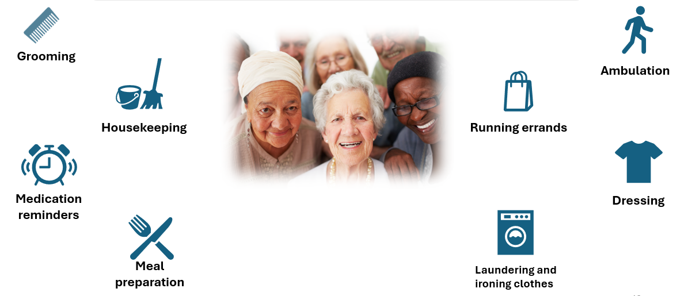
Personal Care and In-Home Respite Services are designed to meet the needs of aged and disabled individuals through:
Notes:
Personal Care and In Home Respite Services offer assistance with Activities of Daily Living (ADLs) such as bathing & hygiene, dressing, eating, toileting and Instrumental Activities of Daily Living (IADLs) such as housekeeping, meal preparation and errands.

Slide 12
Personal Care Services
Personal Care Services (PCS) are non-medical support services provided in the home of eligible persons by trained Direct Care Workers (DCWs) to assist participants in meeting daily living needs and ensure optimal functioning at home and/or in the community. Services include assistance with eating, bathing, dressing, personal hygiene, and other activities of daily living. Meal preparation and housekeeping chores may be provided if the care is essential to the participant’s health and welfare. These services may also involve accompanying and assisting the participant in accessing community resources and participating in community activities; supervision and monitoring in the home, during transportation, and in the community setting.
Personal Care Service may be furnished by family members if they are not legally responsible for the person. Family members must be employed by a Medicaid approved agency that provides Personal Care Services, must meet provider standards, and must be deemed competent to perform the required tasks.
DCWs may accompany persons during community activities but cannot drive the vehicle.
Notes:
Personal Care Services are non-medical services provided in the home of the participant or in the community. The Plan of Service should identify which ADLs and IADLs each member needs assistance with.
It's important to note that the Direct Care Worker is never allowed to drive a vehicle occupied by the participant.
Personal Care Service may be furnished by family members if they are not legally responsible for the person. Family members must be employed by a Medicaid approved agency that provides Personal Care Services, must meet provider standards, and must be deemed competent to perform the required tasks.

Slide 13
In-Home Respite Services
In-Home Respite Services (IHR) are non-medical support services provided in the home of eligible persons by trained Direct Care Workers (DCWs) to participants who cannot be left alone or unattended. These services provide non-medical care and supervision/assistance in the absence of a primary full-time, live-in caregiver(s) on a short-term basis. Services are rendered to provide assistance to the caregiver(s) during a crisis situation and/or scheduled relief to the primary caregiver(s) to prevent, delay or avoid premature institutionalization.
In-Home Respite Services may be furnished by family members if they are not legally responsible for the person. Family members must be employed by a Medicaid approved agency that provides Personal Care Services, must meet provider standards, and must be deemed competent to perform the required tasks.
Notes:
In-Home Respite Services are non-medical services provided in the home of participants that cannot be left alone, so be sure your staff understand that they cannot leave the home when providing IHR services. This service provides assistance in the absence of the primary caregiver during emergency situations or scheduled relief to the primary caregiver.
Occasionally a members living situation may change and case managers are not notified. If you are aware of a member who is receiving IHR services, but lives alone, notify the case manager immediately so services can be modified, usually by removing IHR and increasing PCS hours.
In-Home Respite Services may be furnished by family members if they are not legally responsible for the person. Family members must be employed by a Medicaid approved agency that provides In-Home Respite Services, must meet provider standards, and must be deemed competent to perform the required tasks

Slide 14
Service Specific Do’s & Don’ts
Do:
Provide services in accordance with the beneficiary’s PSS.
Maintain professionalism and respect.
Don’t:
Enter or remain in the home if the beneficiary is not there.
Bring friends, relatives, or other guests to the beneficiary’s home.
Use the participant’s car or transport the beneficiary.
Borrow money from or give money to the beneficiary or their caregivers.
Ask for or accept gifts or tips from the beneficiary or their caregivers.
Consume the beneficiary’s food, drink, or medications.
Administer medication/injections or providing any other medical care.
Engage in consumption of alcoholic beverages in the participant’s home or consumption of alcoholic beverages before or during service delivery to the beneficiary.
Smoke in the beneficiary’s home.
Use illegal drugs.
Complete tasks which would be considered “heavy duty” such as moving heavy furniture, laundering curtains, waxing floors, yard maintenance, household repairs, or pet grooming.
Notes:
Providers must provide services according to the member’s PSS. If for some reason that is not possible, the case managers must be notified.
Providers must ensure that Direct Care Workers know they must not provide services if the member is not home, and they should never bring anyone else with them when providing services.

Slide 15


Administrative Code Part 208, Chapter 1
Home and Community Based Services
Administrative Code Part 208, Chapter 1 is currently available for review on the website. Throughout this presentation will be several links to additional resources, this will all be available on the HCBS Providers webpage.
Administrative Code Link: https://medicaid.ms.gov/wp-content/uploads/2025/07/Title-23-Part-208-HCBS-LTC-eff.-7.1.2025.pdf
Notes:
Administrative Code Part 208, Chapter 1 is currently available for review on the website. Throughout this presentation will be several links to additional resources, this will all be available on the HCBS Providers webpage.

Slide 16
Training Topics

Slide 17
Organizational Changes
Change of Ownership
Relocations
Satellite Offices
Designated Worksites
Notes:
Our first round of training topics will be on different types of Organizational Changes. This includes changes in ownership or changes in office spaces.

Slide 18
Reporting Changes
Administrative Code, Part 208, Chapter 1 Rule 1.5 requires that Waiver providers must report: changes in contact information, administrative staffing, ownership and licensure within ten (10) calendar days to the Division of Medicaid.
Providers must be aware that reporting changes to Gainwell, or via the MESA Provider Portal, is not the same as reporting changes to the Medicaid Office of Long Term Services & Supports.
HCBS Providers must report all changes to LTSS first and receive approval for changes in location, then changes may be reported to Gainwell.
Notes:
Waiver providers must maintain compliance with all current waiver requirements, rules, regulations and administrative codes as specified by the Division of Medicaid. This especially includes reporting changes in contact information, administrative staffing, ownership, and licensure within ten (10) calendar days to the Division of Medicaid.
HCBS Providers must report all changes to LTSS first to ensure compliance standards have been met.

Slide 19
Changes of Ownership (CHOW)
Our Office frequently sees providers who are selling their business without notifying the Division of Medicaid timely. We’d like to remind everyone that there cannot be a transfer of ownership of your Medicaid issued provider ID without first notifying Medicaid. We must ensure that the new owners are qualified to provide the services and go through all required credentialing. As a reminder, the NEW owner is responsible for maintaining all files and documents from the previous owner for auditing purposes.
The new owner is assuming all responsibility and liability for all claims that were filed prior to the transfer. A provider/facility that undergoes a change of ownership must notify the Office of LTSS within ten (10) days, and the Office of Provider Enrollment within thirty-five (35) days after any change in ownership.
A CHOW packet must be received, reviewed, and approved by the Office of Long-Term Services & Supports before the provider can complete a Mississippi Medicaid Provider Application Packet.
The new provider must continue to maintain all Medicaid beneficiary records for at least six (5) years, unless an alternative method for maintaining the records has been established in writing and approved by the Division of Medicaid as required by Health Insurance Portability and Accountability Act of 1996 (HIPAA).
Notifying DOM of Change of Ownership within 35 days of change
Completing a CHOW packet with LTSS
New owner must maintain beneficiary file records for a minimum of five (5) years
Notes:
There cannot be a transfer of ownership of your Medicaid issued provider ID without first notifying Medicaid.
We must ensure that the new owners are qualified to provide the services and go through all required credentialing. As a reminder, the NEW owner is responsible for maintaining all files and documents from the previous owner for auditing purposes.
The new owner is assuming all responsibility and liability for all claims that were filed prior to the transfer. A provider/facility that undergoes a change of ownership must notify the Office of LTSS within ten (10) days, and the Office of Provider Enrollment within thirty-five (35) days after any change in ownership.
A CHOW packet must be received, reviewed, and approved by the Office of Long-Term Services & Supports before the provider can complete a Mississippi Medicaid Provider Application Packet.
The new provider must continue to maintain all Medicaid beneficiary records for at least six (5) years, unless an alternative method for maintaining the records has been established in writing and approved by the Division of Medicaid as required by Health Insurance Portability and Accountability Act of 1996 (HIPAA).

Slide 20
Transactions that constitute a CHOW are:
Partnership to limited liability company, or single proprietorship to organization
Mergers, when a new organization is formed, and the merging companies are non-surviving
Consolidation of two or more corporations resulting in a new corporate entity
Removal, addition, or substitution of one or more individuals as partners (under Mississippi law, these actions result in dissolution of an older partnership and creation of a new one)
Transfers between different levels of government, such as city to county, state to county, etc.
Transfer (sale, gift, exchange of stock) that results in a fifty (50) percent or more change.
These are examples of changes of ownership. This list is not exhaustive. A few things to consider here that we’ve seen impact providers: if you have a business partnership and one partner passes away, this is a change in ownership and must be reported. If you plan to pass your business to another business partner or relative in the event of your death or disability, we recommend having them added as a partner now, even with as little as 1% ownership, so that in those events, your business can continue providing care uninterrupted. Providers should contact the Division of Medicaid’s Office of Long Term Services & Supports to begin this process.
Notes:
The following are examples of changes of ownership. This list is not exhaustive. A few things to consider here that we’ve seen impact providers: if you have a business partnership and one partner passes away, this is a change in ownership and must be reported. If you plan to pass your business to another business partner or relative in the event of your death or disability, we recommend having them added as a partner now, even with as little as 1% ownership, so that in those events, your business can continue providing care uninterrupted. Providers should contact the Division of Medicaid’s Office of Long Term Services & Supports to begin this process.
If a CHOW is less than 5%, then a notification to LTSS and a submission in MESA should be completed.

Slide 21
CHOW
Change of Ownership
Sell
Transfer provider number with the sell.
New owner submits a CHOW packet with OLTSS.
Buy Out
Terminate provider number
New owner applies for a new provider number.
New owner must meet the requirement of being established and providing services for one (1) year for the service type applying for.
Begin the provider enrollment process through OLTSS.
Beneficiary files remain with the previous owner(s) who is responsible for any past or future audits findings.
Beneficiary files transfers with the provider number to the new owner(s). The new owner is responsible for any past (5 years) or future audit findings.
Notes:
This chart will help you determine whether or not a CHOW is required. If you are selling your business and transferring the Medicaid Provider Number to a new owner, then a CHOW is required.
If you are selling your business and the new owner is establishing a new Medicaid Provider ID, a CHOW is not required but DOM must still be notified.

Slide 22
Relocations
Providers must submit any proposed changes to location, supervisory staffing, or organizational contact information, to the Division of Medicaid Office of LTSS for approval prior to implementing the requested change within ten (10) business days.
If you’re planning to relocate, contact our office first. We are happy to do a virtual walk through with you of your new location.
Provider must complete a Relocation packet through the LTSS Office for review
The LTSS Office must complete a virtual site visit
Once the new location is approved, providers must submit a Change of Address form in MESA
If in the market to relocate, the LTSS Office can complete a virtual site visit to ensure that the new location meets the requirements for PCS-IHR before the owner signs a new lease agreement or purchase
Notes:
Please note that all providers must notify OLTSS first prior to a relocation of any office. Completing a Change of Address Form and undergoing a site visit with Gainwell does not equal an update nor an approval of the location to the Freedom of Choice list. Our office has its own set of criteria that Gainwell may not include to ensure compliance outlined in the Administrative Code.

Slide 23
E&D PCS/IHR Office Types
Main Offices are required for all providers and must meet all requirements in Administrative Code Part 208, Rule 1.13, including but not limited to:
Can not be located on the grounds of a personal residence,
Active Business Privilege Tax License,
Permanent External Signage that is visible from the road,
Must maintain open office hours Monday – Friday, 8am – 5pm,
Ability to store and make available all auditable documents for all locations.
Satellite Offices are “brick & mortar” office spaces that allow providers to extend their service area beyond the allowed 60-mile radius of their main office location. Satellite offices must meet all requirements in Administrative Code Part 208, Rule 1.13, including but not limited to:
Can not be located on the grounds of a personal residence,
Active Business Privilege Tax License,
Must maintain open office hours Monday – Friday, 8am – 5pm,
Ability to appropriately transmit all auditable documents to main office within ten (10) business days.
Designated Worksites are remote “work from home” positions that allow providers to extend their service area beyond the allowed 60-mile radius of their main office location by having a supervisor who resides in the area. Designated Worksites require:
Completion of Designated Worksite Form,
Verification of Supervisor’s address by agency’s Compliance Officer,
Ability to maintain HIPAA compliance by protecting all PHI while in the home or in the field,
Must be available to Direct Care Staff and clients during regular office hours Monday – Friday, 8am – 5pm,
Ability to appropriately transmit all auditable documents to main office within ten (10) business days.
Any request to extend service area will require review of current billing practices to confirm compliance with EVV billing requirements and any CAP on record. Providers must have been enrolled for a minimum of 6 months prior to requesting expansion.
PCS/IHR Supervisors or Direct Care staff are not authorized to submit requests to expand service areas.
Notes:
Any request to extend service area will require review of current billing practices to confirm compliance with EVV billing requirements and any CAP on record. Providers must have been enrolled for a minimum of 6 months prior to requesting expansion.
PCS/IHR Supervisors or Direct Care staff are not authorized to submit requests to expand service areas.
The Designated Worksite Form should only be completed for a designated worksite. Please do not submit this form for other office types

Slide 24
Satellite Offices
PCS/IHR Supervisors or Direct Care staff are not authorized to submit requests to expand service areas.
To open Satellite Offices, the provider must complete a Satellite Office packet through the LTSS office. Then, the LTSS office must complete a virtual site visit. Once the new location is approved, the addition of counties will be shared to the appropriate PDD and reflected on the next freedom of choice distribution.
All files originating at the satellite office must be securely transported and stored at the main office to be available for audit.
Also, if in the market of opening a brick and mortar, our office is happy to do a virtual visit of the new location. If seeking to add additional counties to an established Main Office or Satellite Office, fully submit an Office Location application, submit an organizational chart of staff at all locations, and the privilege tax license for the Main Office or Satellite Office referenced. A key change in the Administrative Code is that providers must not serve counties more than sixty (60) miles driving distance from the physical office.
Provider must complete a Satellite Office packet through the LTSS Office for review
The LTSS Office must complete a virtual site visit
Once the new location is approved, the LTSS Office must share added counties to the appropriate PDD
If in the market to open a brick & mortar, the LTSS Office can complete a virtual site visit to ensure that the new location meets the requirements for PCS-IHR before the owner signs a new lease agreement or purchase
Notes:
Satellite Offices Admin Code Part 208 Chapter 1 Rule 1.3: Provider Enrollment
The process for opening up a Satellite Office is a little similar to a Relocation. For Satellite Offices, the provider must complete a Satellite Office packet through the LTSS office. Then, the LTSS office must complete a virtual site visit. Once the new location is approved, the addition of counties will be shared to the appropriate PDD and reflected on the next freedom of choice distribution.
All files originating at the satellite office must be securely transported and stored at the main office within ten (10) business days to be available for audit.
Also, if in the market of opening a brick and mortar, our office is happy to do a virtual visit of the new location. If seeking to add additional counties to an established Main Office or Satellite Office, fully submit an Expansion Request application, submit an organizational chart of staff at all locations, and the privilege tax license for the Main Office or Satellite Office referenced. A key change in the Administrative Code is that providers must not serve counties more than sixty (60) miles driving distance from the physical office.

Slide 25
Designated Worksites
If deciding to forgo a physical space, a Supervisor may be assigned to a designated worksite in the requested area. The provider must complete a Designated Worksite packet and submit required documents. Once the application is approved, the worksite will be added to the Freedom of Choice List.
If any changes are to occur, the LTSS Office must be notified within 10 calendar days.
PCS/IHR Supervisors or Direct Care staff are not authorized to submit requests to expand service areas.
Designated Worksites should be used as a remote “work from home” position for providers to service areas not already approved. Providers should not have supervisors operating from more than one office.
Provider must complete a Designated Worksite packet through the LTSS Office for review
Provider must submit required documents to the LTSS Office for review
Once the application is approved, the LTSS Office must add the Designated Worksite to the Freedom of Choice (FOC) list
The Supervisor and Compliance Officer must attest the responsibilities of the Designated Worksite Supervisor and notify any changes to LTSS within ten (10) calendar days.
Designated Worksite Link: https://medicaid.ms.gov/wp-content/uploads/2026/03/Designated-Worksite-Form-3.12.26.pdf
Notes:
If deciding to forgo a physical space, a Supervisor may be assigned to a designated worksite in the requested area; however, the proper steps must be taken in order to achieve this. The provider must complete a Designated Worksite packet and submit required documents. Once the application is approved, the worksite will be added to the Freedom of Choice List. If any changes are to occur, the LTSS Office must be notified within 10 calendar days.
All files originating at the designated worksite must be securely transported and stored at the main office to be available for audit.

Slide 26
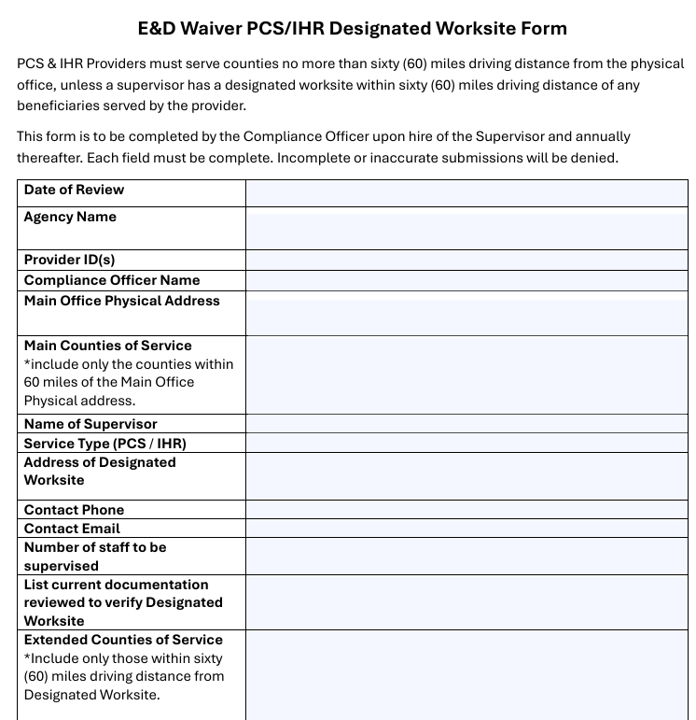
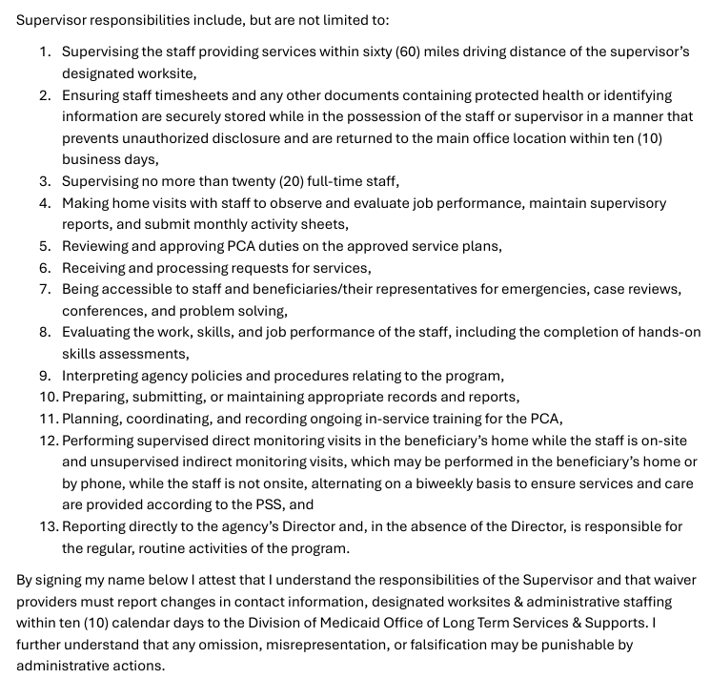
Designated Worksites
The Designated Worksite requires that the Compliance Officer complete the form with the supervisor stationed at this worksite.
The form must be filled out completely and must be resubmitted annually.
The compliance officer must verify the address and note the types of documents used to verify the address such as utility bill, photo id, etc.
By submitting this form, the Compliance Officer and Supervisor are attesting that they have read and understand the requirements, and will notify DOM within 10 days of any changes.
Notes:
The Designated Worksite requires that the Compliance Officer complete the form with the supervisor stationed at this worksite. The form must be filled out completely. The compliance officer must verify the address and note the types of documents used to verify the address such as utility bill, photo id, etc.
By submitting this form, the Compliance Officer and Supervisor are attesting that they have read and understand the requirements, and will notify DOM within 10 days of any changes.

Slide 27
Organizational Responsibilities
Background, Office of the Inspector General (OIG), and Nurse Aide Abuse Registry (NAAR) Checks
Business Line of Credit
Organizational Chart
Staffing
Notes:
This next round of training topics will be on some of the Organizational Responsibilities, including appropriate staff and credentialing.

Slide 28

National Fingerprint Criminal Background Check
1915(c) HCBS waiver providers are required to conduct a national criminal background check with fingerprints on all employees and volunteers participating in face-to-face interactions with beneficiaries prior to employment and every two (2) years thereafter. The provider must maintain these records in the employee’s and volunteer’s personnel file.
State only and name only background checks are insufficient. Full rap sheet must be included with results letter from MSDH and placed in employee’s and volunteer's personnel file for auditing purposes.
Providers are not authorized to offer a waiver of any kind to allow disqualified applicants to work in the waiver program.
The non-criminal justice form and the applicant authorization form are now auto generated through SAFER.
Disqualifying Events:
Not have been nor employ individuals or volunteers participating in face-to-face interactions with beneficiaries who have been convicted of or have pleaded guilty or nolo contendere to:
A felony of possession or sale of drugs,
Murder, manslaughter, armed robbery,
Rape, sexual battery, any sex offense listed in Miss. Code Ann. § 45-33-23(h),
Child abuse,
Arson,
Grand larceny, burglary,
Gratification of lust,
Aggravated assault, or
Felonious abuse and/or battery of a vulnerable adult,
Regardless of whether any such conviction or plea was reversed on appeal or a pardon was granted for the conviction or plea.
Link: https://msdh.ms.gov/page/30,0,206.html
Notes:
Prior to employment and every two (2) years thereafter, providers must conduct a national criminal background check with fingerprints on all employees participating in interactions with beneficiaries.
Those employees must not have been convicted or have pleaded guilty or nolo contendere to this list of disqualifying events.
State only and name only background checks are insufficient.
Providers are not authorized to offer a waiver of any kind to allow disqualified applicants to work in the waiver program.

Slide 29
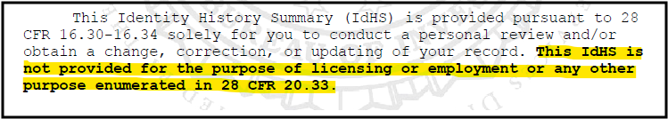
National Fingerprint Criminal Background Check
Effective July 1, 2026, the MSDH Background Check Unit will begin reviewing all healthcare rap sheets and making final employment eligibility determinations.
If, after review of the rap sheet, the MSDH legal team identifies a disqualifying charge per the disqualifying events outlined in Miss Code §43-11-13 , the rap sheet will be mailed directly to the applicant. The applicant will be given 45 days to appeal the decision and submit any relevant legal documentation to the MSDH background check unit.
If legal documentation is provided proving the applicant was found not guilty, charges were dropped, and/or the case was dismissed, the MSDH Criminal History Fingerprint Unit will issue an “OK” letter in SAFER.
If the applicant is unable to provide sufficient legal documentation, the MSDH Background Check Unit will issue a “NO” letter in SAFER.
Please note that the use and creation of waiver letters will be discontinued under this new process for any NEW healthcare rap sheets processed on or after July 1, 2026.
The Federal Bureau of Investigation (FBI) is requiring changes regarding the handling and distribution of Criminal History Record Information (CHRI), also referred to as healthcare rap sheets. The MSDH Background Check Unit will begin reviewing all healthcare rap sheets and making final employment eligibility determinations beginning July 1, 2026.
Once a background check results has been received from MSDH, use the following guidelines to determine if the applicant is disqualified.
Does the letter indicate the applicant is “okay”? If so, the NCBC does not disqualify them.
Does the letter indicate the applicant may have a disqualifying event?
  If so, you must review the full rap sheet.
  The results cannot have been run by any other agency. Letters indicating a possible disqualifying event are not transferrable.
Background checks from the FBI which include the below statement may not be used for employment purposes.
Link: https://msdh.ms.gov/page/30,0,206.html
Please note, this change is not retroactive and will apply only to healthcare rap sheets processed on or after July 1, 2026.
If you still have questions, please contact MSDH’s Criminal History Record Check Unit office CHRCUnit@msdh.ms.gov
Notes:
Effective July 1, 2026, the MSDH Background Check Unit will begin reviewing all healthcare rap sheets and making final employment eligibility determinations.
If, after review of the rap sheet, the MSDH legal team identifies a disqualifying charge per the disqualifying events outlined in Miss Code §43-11-13 , the rap sheet will be mailed directly to the applicant. The applicant will be given 45 days to appeal the decision and submit any relevant legal documentation to the MSDH background check unit.
If legal documentation is provided proving the applicant was found not guilty, charges were dropped, and/or the case was dismissed, the MSDH Criminal History Fingerprint Unit will issue an “OK” letter in SAFER.
If the applicant is unable to provide sufficient legal documentation, the MSDH Background Check Unit will issue a “NO” letter in SAFER.
FBI checks which contain the statement “may not be used for employment purposes” may not be used.

Slide 30
OIG & Nurse Aide Abuse Registry Checks
Must conduct registry checks before employment and monthly thereafter.
Maintain these records in the employee’s personnel file.
The provider must not employ individuals whose name appears on the registry list.
Must include a printed copy with date of the check in employee’s and volunteer's personnel file for auditing purposes.
OIG Link: https://exclusions.oig.hhs.gov/
NAAR Link: https://ms.tmutest.com/search
Notes:
Providers must conduct monthly OIG and Nurse Aide Abuse Registry Checks for all staff and ensure not to hire or employ individuals whose name appears on the registry list. The results of these checks must be maintained in the employee’s personnel file.
Providers may maintain this information in a digital format so long as it is easily accessible for audit purposes.

Slide 31
Business Line of Credit
Prior to the implementation of MESA, newly enrolling providers were required to establish a business line of credit.
With updates to the Administrative Code, all E&D providers are required to establish and now maintain a business line of credit for operations as proof of financial solvency.
To ensure continuity of business operations and member services, providers must maintain a line of credit available to use in the event that there are reimbursement delays in claims processing with the Division of Medicaid. The line of credit will ensure that your agency can continue payroll processes.
Establish and maintain a business line of credit for business operations from either a financial institution licensed to conduct banking or other Financial Deposit Insurance Corporation (FDIC) or National Credit Union Administration (NCUA) insured financial institutions.
The approval amount for the business line of credit must be enough to cover operational costs/expenditures for at least three (3) months at all branch locations.
Notes:
To ensure continuity of business operations and member services, providers must maintain a line of credit available to use in the event that there are reimbursement delays in claims processing with the Division of Medicaid. The line of credit will ensure that your agency can continue payroll processes.
While claims reimbursement is typically one week after the submission of payable claims, DOM does have up to one year following the submission of claims to complete reimbursement.

Slide 32
There are key differences of a business line of credit and a business loan. A loan is a one-time disbursement, whereas a line of credit is revolving and you only pay interest on the amount you draw.
Business Loan
Large, one-time expense like equipment purchases, property or expansion
A single lump sum is disbursed at the start
Business Line of Credit
Ongoing or short-term needs like inventory, payroll, or managing seasonal cash flow.
You can draw funds as needed up to your credit limit.
Fixed monthly payments of principal an interest over a set term.
Typically, lower interest rates, especially for large, long-term loans.
Less flexible, as the entire amount is disbursed upfront.
Planning major investments with predictable costs.
Pay interest only on the amount drawn. As you repay, the funds become available to borrow again
Variable interest rates; you only pay interest on what you use.
Highly flexible, allowing you to borrow and repay as needed.
Managing unpredictable cash flow fluctuations.
Business Loans does not meet the requirement for a business line of credit.
Some may confuse a business loan as a business line of credit. A business loan is a one-time disbursement with fixed month payments until the loan is paid back in full with interest. A line of credit is revolving. You can draw funds as needed and repay only the amount drawn. Once the amount drawn is repaid, the funds become available to borrow again. Business loans does not meet the requirement for business line of credit.
Notes:
Some may confuse a business loan as a business line of credit. A business loan is a one-time disbursement with fixed month payments until the loan is paid back in full with interest. A line of credit is revolving. You can draw funds as needed and repay only the amount drawn. Once the amount drawn is repaid, the funds become available to borrow again. Business loans does not meet the requirement for business line of credit.

Slide 33


Provider Responsibilities
Providers are responsible for ensuring their facility passes DOM inspection & maintain the facility’s physical address.
Providers must employ (as a W2 employee) all staff listed on the organizational chart shown. Contract staff (1099 self-employed) are not allowed by Federal Labor Law regulations.
To maintain compliance with HIPAA & FOC, providers should not share staff with other agencies providing E&D Waiver services.
Qualified personnel are defined as W2 employees who meet all credentialing requirements, have completed all required training detailed in Administrative Code, Part 208 Rule 1.3C, and have a clean National Fingerprint based background check prior to beginning services.
  Successfully pass a facility inspection by the Division of Medicaid.
  Maintain the office’s physical address until the provider agreement is terminated.
  Maintain a roster of qualified personnel necessary to provide authorized services.
  Have responsible personnel management.
  Be compliant with all federal and state regulations.
Notes:
Providers are responsible for ensuring their facility passes DOM inspection, maintain the facility’s physical address, maintain a roster of qualified staff, and remain compliant with all federal and state regulations. To maintain compliance with HIPAA & FOC, providers should not share staff with other agencies providing E&D Waiver services.
Providers must employ (as a W2 employee) all staff listed on the organizational chart. Contract staff (1099 self-employed) are not allowed by Federal Labor Law regulations.
Qualified personnel are defined as W2 employees who meet all credentialing requirements, have completed all required training detailed in Administrative Code, Part 208 Rule 1.3C, and have a clean National Fingerprint based background check prior to beginning services.

Slide 34
Organizational Chart
Main Office: Location
Administrator/CEO/President: Name
The Org Chart defines your agency’s Chain of Command, this is the formal, top-down hierarchy within an organization that defines reporting relationships, decision-making power, and lines of communication. It establishes a continuous line of authority from senior leadership down to frontline employees.
When sending updated organizational charts to DOM, please use the shown template and include the names, job titles, & office locations of the staff assigned to each role.
The Compliance Officer & PCS/IHR Supervisor roles may not be held by the same individual. To maintain the chain of command the Owner may serve as the Compliance Officer but cannot serve as a PCS/IHR Supervisor.
Supervisors may not be assigned to more than one location. Names of DCW staff do not need to be included.
Providers must employ (as a W2 employee) all staff listed on the organizational chart shown. Contract staff (1099 self-employed) are not allowed by Federal Labor Law regulations.
All staff must complete the training requirements detailed in Administrative Code, Part 208 Rule 1.3C
Main Office: Location
Compliance Officer: Name
Satellite Office: Location
Main Office: Location
Designated Worksite: Location
PCS Supervisor: Name
IHR Supervisor: Name
PCS Supervisor: Name
IHR Supervisor: Name
PCS Supervisor: Name
IHR Supervisor: Name
Notes:
The Org Chart defines your agency’s Chain of Command, this is the formal, top-down hierarchy within an organization that defines reporting relationships, decision-making power, and lines of communication. It establishes a continuous line of authority from senior leadership down to frontline employees
When sending organizational charts to our office, please be sure to use the format provided along with the names and location for the staff. Once again, let DOM know of any changes in organizational structure. This must be reported in writing to DOM within 10 business days.
All staff must complete the training requirements detailed in Administrative Code, Part 208 Rule 1.3C

Slide 35

Compliance Officer Responsibilities
  The Compliance Officer is an in-office role. They are responsible for representing your agency during an audit and ensuring overall program compliance with DOM policy as well as federal and state laws. When DOM contacts your agency, we will be looking to speak to the Compliance Officer.
  Responsibilities for the Compliance Officer include but are not limited to:
    Ensuring continuing compliance with the Medicaid Administrative Code, Medicaid provider agreement, all applicable state and federal laws, quality assurance standards, and the CMS approved waiver.
    Ensuring all mandatory training and certifications are completed timely.
    Ensuring all background checks are completed timely and maintained appropriately.
    Ensuring all OIG and Nursing Exclusion checks are completed timely and maintained appropriately.
    Ensuring all Corrective Action Plans are implemented appropriately if necessary.
    Ensuring immediate access to all participant and employee records as required for audit purposes
Compliance Officer Qualifications
At least two (2) years of supervisory experience in programs dealing with elderly and disabled individuals and meet one (1) of the following requirements:
A Bachelor's Degree in social work, home economics, or a related profession, with two (2) years of direct experience working with aged and disabled persons, or
A Licensed Registered Nurse (R.N.) or Licensed Practical Nurse (L.P.N.), with two (2) years of direct experience working with aged and disabled persons, or
Be a high school graduate with diploma or have a General Educational Development (GED) certificate, and four (4) years of direct experience working with aged and disabled persons.
Notes:
The Compliance Officer is responsible for ensuring overall program compliance with DOM policy as well as federal and state laws. This in-office role is tasked with making sure your agency is fully compliant and ready for an audit. When DOM contacts your agency with inquiries, this is who we are expecting to speak to.

Slide 36

Supervisor Responsibilities
  Supervisor qualifications are very similar to those in the role of Compliance Officer. However, the responsibilities are very different. The Supervisor is responsible for completing bi-weekly supervisory visits, going into the homes, reviewing Plans of Service, evaluating job performance and making sure your agency’s services are aligned with Person Centered Care.
  Responsibilities for the DCW Supervisor include but are not limited to:
    Supervising no more than twenty (20) full-time DCW Staff. If less than twenty PCA staff are working, only a pro rata share of a supervisor’s time is needed. For example, if four full-time PCA staff are employed, then 20% of a supervisor’s time would be required to meet this standard;
    Ensuring DCW staff timesheets and any other documents containing protected health or identifying information are securely stored while in the possession of the DCW staff or supervisor in a manner that prevents unauthorized disclosure and are returned to the main office location within ten (10) business days;
    Reviewing and approving duties on approved service plans;
    Receiving and processing requests for service;
    Evaluating the work, skills, and job performance of the DCW staff, including the completion of hands-on skills assessments;
    Making home visits with DCW staff to observe and evaluate job performance, maintain supervisory reports, and submit monthly activity sheets;
Supervisor Qualifications
At least two (2) years supervisory experience in programs dealing with elderly and disabled individuals and meet one (1) of the following requirements:
A Bachelor's Degree in social work, home economics, or a related profession, with two (2) years of direct experience working with aged and disabled persons,
A Licensed Registered Nurse (R.N.) or Licensed Practical Nurse (L.P.N.), with two (2) years of direct experience working with aged and disabled participants, and two years of supervisory experience, or
A high school graduate with a diploma or have a General Educational Development (GED) certificate, and four (4) years of direct experience working with the aged and disabled persons
Notes:
Supervisor requirements are very similar to those in the role of Compliance Officer. However, where so much of the Compliance Officers responsibilities are in-office, much of the Supervisor’s responsibilities are field work, outside of the office.
Supervisors are responsible for supervising all direct care staff and there must always be enough Supervisors to meet staffing ratios. Each one (1) Supervisor may supervise a max of twenty (20) Direct Care Staff and must always be accessible to DCWs in case of emergencies. Supervisors are going into the homes, reviewing Plans of Service, evaluating job performance and making sure your agency’s services are aligned with Person Centered Care.

Slide 37

Direct Care Worker (DCW) Responsibilities
  By definition, Direct Care Workers assist the beneficiary in meeting daily living needs and ensures optimal functioning at home and/or in the community.
  In practice, the direct care worker provides the care and companionship that allows the elderly and disabled to remain in their homes and community, rather than being forced to rely on institutional care. Therefore, providers must ensure that compassionate, qualified staff are providing this care.
  Be physically able to perform the job tasks required and assurance that communicable diseases of major public health concern are not present,;
  Have interest in and empathy for, people who are ill, elderly, or disabled;
  Be emotionally mature and able to respond to participants and situations in a responsible manner;
  Have good communication and interpersonal skills and the ability to deal effectively, assertively, and cooperatively with a variety of people;
  Successfully complete a mandatory training course upon hire covering each of the topics in Admin Code, Part 208, Rule 1.3C, and pass a scored examination prior to rendering services. This training course must also be attended annually for each year after hire.
  Must not have been convicted of a crime substantially related to the dependent population or any violent crime;
  Must be able to recognize the signs of abuse, neglect and/or exploitation and the procedures to follow as required in the Vulnerable Adult Act; and
  Must have knowledge of how to prevent burns, falls, fires; and emergency numbers to contact emergency personnel if required.
Direct Care Staff Qualifications
Must be a high school graduate or have a General Education Development (GED) certificate or must demonstrate the ability to read the written personal care services assignment and write adequately to complete required forms and reports of visits.
Be at least 18 years of age;
Must demonstrate the ability to work well with aged and disabled individuals who have limited functioning capacity;
Possess a valid state issued ID, and have access to reliable transportation;
Must maintain current and active first aid and CPR certification
Notes:
By definition, Direct Care Workers assist the beneficiary in meeting daily living needs and ensures optimal functioning at home and/or in the community. In practice, the direct care worker provides the care and companionship that allows the elderly and disabled to remain in their homes and community, rather than being forced to rely on institutional care. Therefore, providers must ensure that compassionate, qualified staff are providing this care.

Slide 38



MS Electronic Visit Verification (EVV)
The Division of Medicaid offers HHA Exchange for free to providers. This system is a way to ensure that beneficiaries are receiving the services provided as established in their plan of service and supports. If a provider chooses to pick their own DOM approved provider contracted EVV solution, the provider must (1) Ensure that electronic records reflect a clear audit trail for any edits/updates and (2) Grant system access to DOM, their contractors, and oversight entities for the purposes of auditing EVV data upon request.
  The CMS federal rule, Section 12006 of the 21st Century Cures Act, mandates that states require EVV use for all in-home HCBS services.
  States who fail to meet CMS compliance with EVV face a reduction in the Federal Medical Assistance Percentage (FMAP) matching for HCBS expenditures.
  Mississippi relies on FMAP to cover 76.9% of the funding for HCBS Services.
  By 8/1/2023, providers had the option to either utilize the state provided EVV system through HHAeXchange or integrate their own provider selected EVV system with the HHAeXchange aggregator. Effective 1/1/2026 providers must bill claims via EVV for all members.
  For additional information on EVV in Mississippi, please visit the HHAeXchange’s Mississippi Information Center webpage at https://www.hhaexchange.com/info-hub/mississippi or email DOM at evv@medicaid.ms.gov.
Notes:
As of August 1, 2023, Providers must ensure that all personal care and in home respite services are electronically visit verified as required by the 21st Century Cures Act. This is a Federal Mandate.
States who fail to meet CMS compliance with EVV face a reduction in the Federal Medical Assistance Percentage or FMAP for HCBS Expenditures.
MS currently relies on that federal funding to cover 76.9% of the cost for our HCBS Programs.
Non-compliance = Loss of Funding = Reduction in services.
The Division of Medicaid offers HHA Exchange for free to providers. This system is a way to ensure that beneficiaries are receiving the services provided as established in their plan of service and supports. If a provider chooses to pick their own DOM approved provider contracted EVV solution, the provider must (1) Ensure that electronic records reflect a clear audit trail for any edits/updates and (2) Grant system access to DOM, their contractors, and oversight entities for the purposes of auditing EVV data upon request.
If there is an instance of the EVV system being unavailable for usage to providers and their staff, manual entry of the visit data may be utilized. Justification documentation must be submitted along with the date, time, reason for entry, and the identification of the person making the entry. Please keep in mind that any repeated human errors are subject to audit.
If EVV visit data does not include GPS coordinates or signature and/or tasks completed, then a paper timesheet is required.

Slide 39
MS Electronic Visit Verification (EVV)
Why EVV Is Required
Federally mandated requirement for Medicaid-funded services
Ensures services are accurately documented
Helps protect beneficiaries, caregivers, providers, and the Medicaid program
Why Clocking In and Out Matters
Verifies when services begin and end
Confirms that services were actually provided in the authorized location
Helps ensure compliance with Medicaid & CMS requirements
What To Do When There Is a Technical Issue
Utilize approved alternatives such as offline mode, airplane mode, telephony, or other agency-approved processes
Report issues immediately so they can be addressed while still in the home
Documentation should be completed in real time rather than recreated later from memory
Family Caregiver Expectations
Family caregivers are subject to the same EVV requirements as all other caregivers
Living in the home does not change documentation requirements
EVV should reflect actual service delivery times
Providers who find or suspect any DCW of inaccurate EVV use must report them to Program Integrity
EVV, Program Integrity, and the Prevention of Waste, Fraud, and Abuse
Small inaccuracies can create larger compliance concerns
Accurate documentation protects everyone involved
EVV helps ensure that documented time reflects the actual time services were provided
Notes:
Many providers often wonder exactly what is the importance of EVV usage.
Federally mandated & ensures compliance with Medicaid & CMS requirements.
Clocking in/out confirms that services were provided at the authorized location and is mandated by CMS.
Family Caregivers must also use EVV.
Providers are required to report fraud and waste.
Any technical issues experienced by DCWs should be reported immediately to the office or supervisors. The office should then follow up with their EVV vendor and/or DOM for assistance.

Slide 40
CMS Requirements for EVV - Manual Entries
Manual entry of visit data will only be utilized when the EVV system is unavailable or when exigent circumstances, documented by the provider agency, make usage of the system impossible. The provider agency will:
Provide justification documentation to support any instance of human error in EVV use and such errors must be readily identifiable. Repeated instances of human error are subject to audit.
Enter justification documentation into the EVV system.
Include the date and time of the manual entry, the reason for the entry, and the identification of the person making the entry.
DCW failure to use the EVV system should not be considered an exigent circumstance. DCWs failing to use the system should be educated on the requirements and continued non-compliance should result in disciplinary action.
Manual entries in the EVV must be verified with time sheet documentation prior to the submission of the claim. Providers should not need to edit shift information after the claim has been submitted.
Excessive use of manual entries may result in more extensive audits and claims recoupments.
The CMS federal rule, Section 12006 of the 21st Century Cures Act, mandates that EVV data be captured for all in-home HCBS services.
Medicaid Administrative Code, Part 200, Rule 1.14 Electronic Visit Verification defines requirements for reimbursement of Personal Care and In Home Respite Claims.
https://medicaid.ms.gov/wp-content/uploads/2026/04/Title-23-Part-200-General-Provider-Information-eff-04.01.26.pdf
Notes:
Manual entries must only be utilized when the EVV system is unavailable or under exigent circumstances that make usage of the system impossible. In those cases, documentation must be recorded by the provider.
DCWs should be trained and educated on the EVV system. Continued non-compliance should result in disciplinary action.
Excessive use of manual entries may result in more extensive audits and claim recoupments.
There are several trainings available on the HHAX website which give suggestions & solutions to many of the common issues providers experience. Be sure you’re utilizing this tool.

Slide 41
Requesting EVV Assistance
Issues with Office Setup, Claim Denials, and Other Technical Issues?
  Please contact the HHAX Support Desk.
  Hours: 6:30 a.m. - 6:30 p.m. CST, Monday-Friday.
  Phone: 1-855-400-4429
Web: https://knowledge.hhaexchange.com/enterprise/Content/Support/Client-Support-Portal.htm
EVV Policy Questions or Unresolved Support Ticket ID After 48 Hours?
Please email EVV@Medicaid.MS.Gov.
When emailing, please be sure to include the following to expedite your request:
    Provider Name:
    Provider ID number(s):
    EVV System: HHAX or other. If other, please include the name of the system you are using.
    Your name, a phone number and email address where you can be contacted.
  **It is very important that you do not include protected health information (PHI) in these emails. This includes beneficiary name and Medicaid ID numbers.**
Missing Member Authorizations or Reporting Issues with PHI Involved?
  Please use the secure HHAX linked communication center.
More info on accessing and using the message center is in the knowledge base linked here: https://knowledge.hhaexchange.com/enterprise/Content/Documentation/Patient/FAQ-Pat-N-Comm-Msg-Ctr-S.htm?Highlight=message%20center
Notes:
When requesting EVV assistance, please be sure to submit your questions to the appropriate contact listed on the chart. There are three primary points of contact.
HHAx Support Desk for technical issues. You’ll be issued a Ticked ID and you’ll need to go back into the portal to check the status.
DOM through the EVV email account for unresolved support tickets. Do not send PHI via email.
DOM through the HHAX secure message center for missing authorizations or other issues that require you to share PHI.

Slide 42

HHAeXchange (HHAX) Resources
How do I access the HHAeXchange Provider Portal/Message Center/Knowledge Base/Learning Management System/Help Desk/Client Support Portal/State Info Hub?
HHAX Provider Portal & Message Center:
https://www.hhaexchange.com/info-hub/mississippi
https://app.hhaexchange.com/identity/account/login
HHAX Knowledge Base: https://knowledge.hhaexchange.com/enterprise/Content/Home/Home-N.htm
HHAX Learning Management System (LMS):
HHAX State Info Hub for Mississippi:
https://knowledge.hhaexchange.com/enterprise/Content/Support/Client-Support-Portal.htm
HHAX Client Support Portal:
https://accounts.skilljar.com/accounts/login/?next=%2Fauth%2Fendpoint%2Flogin%2Fresult%3Fnext%3D%252F%26d%3D1it6x3m0xnpye&t=2q37ibffm5o9h&d=1it6x3m0xnpye
The HHAX Support Desk operates from 6:30 a.m. - 6:30 p.m. CST, Monday-Friday.
Phone: 1-855-400-4429
Notes:
For those providers utilizing HHAeXchange, you may use the listed resources to help troubleshoot any questions and train your staff on the basics of EVV. The more you and your staff are trained, the risk of non-compliant manual entries are greatly minimized.

Slide 43
Record Maintenance
The following slides will address requirements for record maintenance and give several templates providers may use to meet minimum standards.
Providers are not required to use templates provided, and may instead use their own, as long as minimum standards are met in accordance with Medicaid Administrative Code, Part 208.
Beneficiary Files
Proper Storage and Accessibility
Staff Files
Notes:
The following slides will address requirements for record maintenance and give several templates providers may use to meet minimum standards.

Slide 44
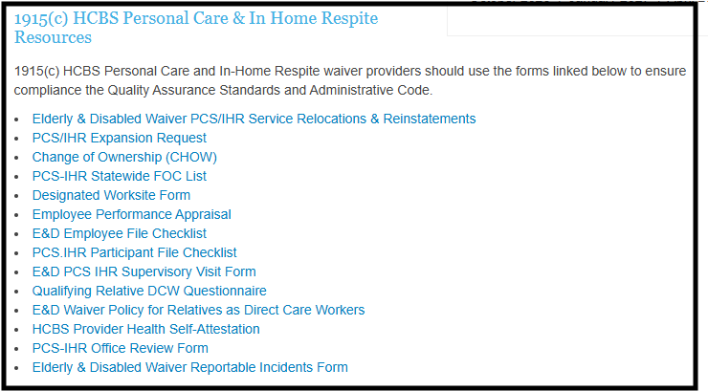
Resources for Compliant Records
  There are many resources available on the HCBS Waiver Providers Website to help you maintain compliance with DOM Records Requirements including:
    Employee File Checklist
    Employee Performance Appraisal
    Qualifying Relative DCW Questionnaire
    Participant File Checklist
    Supervisory Visit Form
    Reportable Incidents Forms
HCBS Waiver Providers Website: https://medicaid.ms.gov/hcbs-waiver-providers/
Notes:
DOM created the 1915(c) HCBS Personal Care & In Home Respite Resources section on our webpage to assist our providers in ensuring compliance for record maintenance and documentation in the Administrative Code.
The forms listed in this section are the most up-to-date forms for PCS-IHR providers. When providers face an audit, the agency will need to make sure that all files, are easily accessible.

Slide 45

Agency Files: Office Documentation
  Records for PCS/IHR offices should include at minimum:
  Written criteria for service provision, including procedures for dealing with emergency service requests,
  Policy and procedure manuals,
  Records of quarterly advisory committee meetings,
  Written personnel policies including the process used in the recruitment, selection, retention, and termination of employees,
  Organizational chart including the names and job titles of owners, operators, managers, administrators, and other supervisory staff., and
  Current and historical employee listing that captures names, staff/tax id numbers, and employment hire and termination dates.
Proper office documentation must consist of procedures, policies, records of quarterly advisory committee meetings, organizational charts, and both current and historical employee listings.
The purpose of the Advisory Board is to ensure providers are actively soliciting feedback on their services and operations from applicable stakeholders in the local community in order to facilitate ongoing quality improvements. For documentation, DOM would expect to see an agenda, sign in sheets/attendees list, and minutes from the meeting itself.
Notes:
Admin Code Part 208 Chapter 1 Rule 1.8: Documentation/Record Maintenance
Proper office documentation must consist of procedures, policies, records of quarterly advisory committee meetings, organizational charts, and both current and historical employee listings.

Slide 46

Proper Storage and Accessibility
  Storage
  Lockable file storage for the security and maintenance of all files in compliance with HIPAA standards.
  Climate controlled storage safe from pests and weather damage.
  Records documenting the provision of services must be maintained by the providers of waiver services for a minimum of five (5) years. If, at the conclusion of the five-year period, there is ongoing litigation or an open audit, the provider must maintain these records until the litigation or audit is concluded.
  Accessibility
  Ensuring immediate access to all beneficiary and employee records as required for audit purposes.
  Filing system of storage of records to be more accessible for auditors.
  Annual
  Alphabetical
  Numerical
  Color Code
Providers must have proper storage and accessibility for all files. More specifically, a lockable file storage that is away from pests and weather damage. All records must be maintained for a minimum of five years for auditing purposes. If there is ongoing audit, these records must be maintained until the audit has concluded.
These records for beneficiaries and staff must also be available for immediate access to DOM’s audit team. The filing should be organized by annual, alphabetical, numerical, or color coded.
Notes:
According to the Administrative Code, Providers must have proper storage and accessibility. More specifically, a lockable file storage that is away from pests, weather damage, and interior damage such as busted water pipes. All records must be maintained for a minimum of five years for auditing purposes. If there is ongoing audit, these records must be maintained until the audit has concluded.
These records for beneficiaries and staff must also be available for immediate access to DOM’s audit team. The filing should be organized by annual, alphabetical, numerical, or color coded.

Slide 47

Agency Files: Common Compliance Issues
Agency
  Improper File Storage
  Missing/Incomplete Files or Records
  Appropriate Signage Not Visible
  Business Line of Credit Not Maintained
  Registration with MS Secretary of State Not Maintained
  Operational Hours Not Open Between 8AM – 5PM

Slide 48
Common Compliance Issues - Files
Staff
Beneficiary
  Resumes (Does Not Meet Minimum Requirements)
  OIG and Nurse Aide Registry Checks Expired
  Background Checks Expired
  Incomplete Training
  No Staff Orientation Upon Hire
  No Social Media Confidentiality Agreement
  Inappropriate Ratio of Supervisors to DCWs
  Missing Valid State IDs
  PSS (Current and Previous) Not on File
  Missing Documentation of Bi-weekly Supervisory Visits
  Incident Reports Not Recorded
Common compliance issues for files may be easily fixed by ensuring that the Employee File Checklist or Participant File Checklist has been updated by the Compliance Officer.
The Employee File Checklist has a section specifically for listing dates that the files submitted by the employees have been completed. If the Employee File Checklist has accurately been maintained, common issues of incomplete resumes, expired OIG/NAAR check, expired background check and the like will be non-existent.
Notes:
Common compliance issues for files may be easily fixed by ensuring that the Employee File Checklist or Participant File Checklist has been updated by the Compliance Officer.
The Employee File Checklist has a section specifically for listing dates that the files submitted by the employees have been completed. If the Employee File Checklist has accurately been maintained, common issues of incomplete resumes, expired OIG/NAAR check, expired background check and the like will be non-existent.

Slide 49
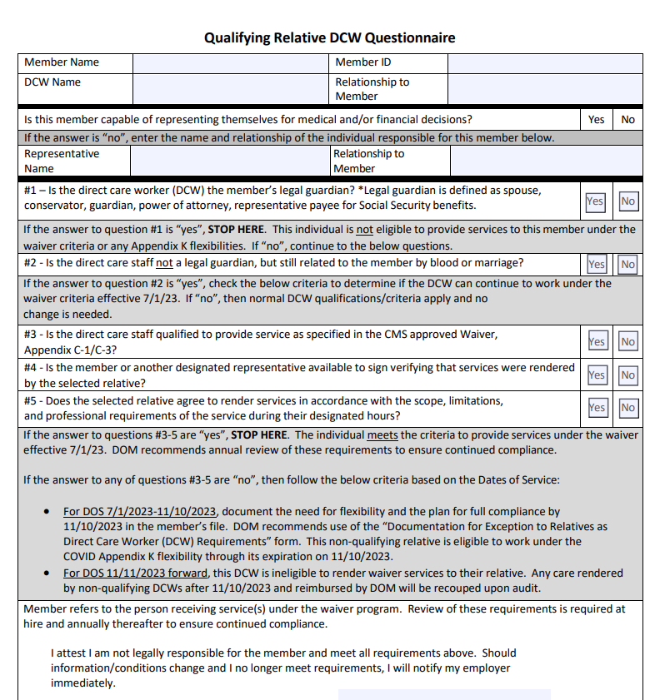
Agency Files: Qualifying Relative DCW Questionnaire
The Qualifying Relative Direct Care Worker Questionnaire was created to help providers screen staff for beneficiaries receiving services from a qualifying relative. DOM recommends that this questionnaire be completed as part of the new-hire onboarding process and annually thereafter. It must be maintained in the employee file to substantiate compliance with Administrative Code requirements. The notice regarding this policy is available on the HCBS Providers website.
Spouses are automatically disqualified from being the paid caregiver. The marriage license is a legally binding document. This is true even if the member has an alternative POA.
If providers become aware that DCW staff have misrepresented themselves in order to qualify to provide care, that staff should be reported to the DOM Office of Program Integrity.
  The Division of Medicaid may allow payments for furnishing waiver services to non-legally responsible relatives only when the following criteria are met:
  The selected relative is a non-legally responsible relative who is at least 18,
  The selected relative must be qualified to provide services as specified in Appendix C-1/C-3 of the CMS approved waiver application
  The beneficiary or a designated representative signs verification that services were rendered by the selected relative, and
  The selected relative must agree in writing, signed prior to providing services, to render services in accordance with the scope, limitations, and professional requirements of the service during their designated hours
  The Division of Medicaid reserves the right to remove a selected relative from the provision of services. If the Division of Medicaid removes a selected relative from the provision of services, the beneficiary will be asked to select an alternate qualified provider
Questionnaire Memo Link: https://medicaid.ms.gov/wp-content/uploads/2023/06/Notice-Regarding-Relatives-as-DCWs-Updated-6.20.23.pdf
Questionnaire Link: Qualifying-Relative-DCW-Questionnaire-Updated-8.8.25.pdf
Notes:
The Qualifying Relative Direct Care Worker Questionnaire was created to help providers screen staff for beneficiaries receiving services from a qualifying relative. DOM recommends that this questionnaire be completed be completed as part of the new-hire onboarding process and annually thereafter. It must be maintained in the employee file to substantiate compliance with Administrative Code requirements.
This form was updated August 2025 to include a signature line for the DCW to attest that they understand these requirements. If you are not currently using this version of the form, please update them.
If providers become aware that DCW staff have misrepresented themselves in order to qualify to provide care, that staff must be reported to the DOM Office of Program Integrity.

Slide 50
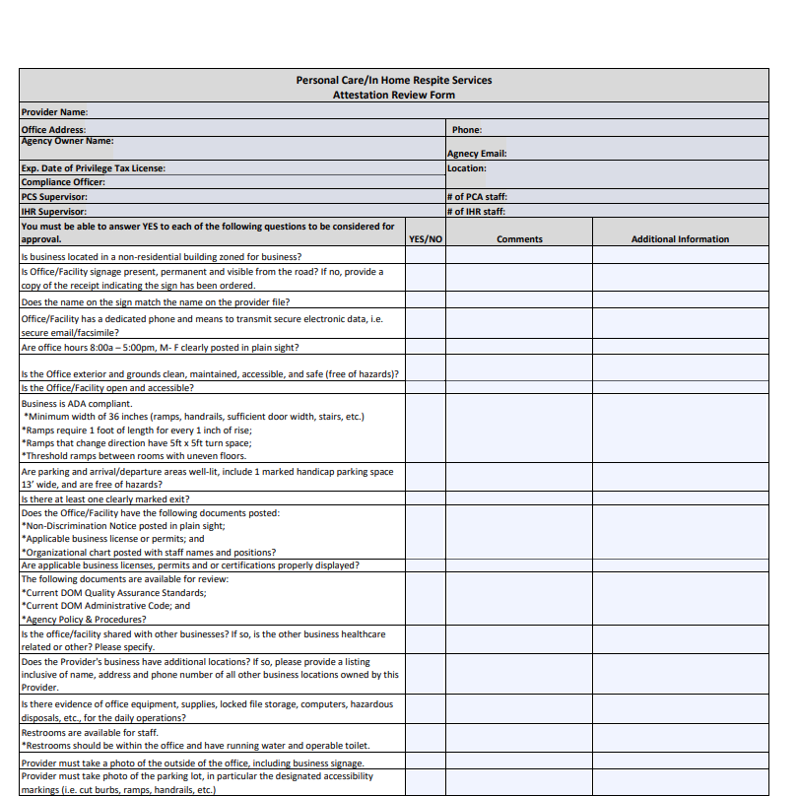
Agency Files: Attestation Review Form
This Facility Review Attestation was created to help PCS-IHR providers properly address and understand regulations for ADA compliance, proper file storage, and building requirements. Keeping this form up to date will allow providers to make sure that their facility meets the standards for accessibility and auditing.
  Addresses compliance of:
    ADA Regulations
    Proper File Storage
    Non-Discrimination Notice
    Business Licenses/Permits
    Organizational Chart
    Administrative Code
    Building Requirements
Facility Attestation Link: https://medicaid.ms.gov/wp-content/uploads/2025/07/PCS-IHR-Office-Review-Form-7.23.25.pdf
Notes:
This Facility Review Attestation was created to help PCS-IHR providers properly address and understand regulations for ADA compliance, proper file storage, and building requirements. Keeping this form up to date will allow providers to make sure that their facility meets the standards for accessibility and auditing.

Slide 51
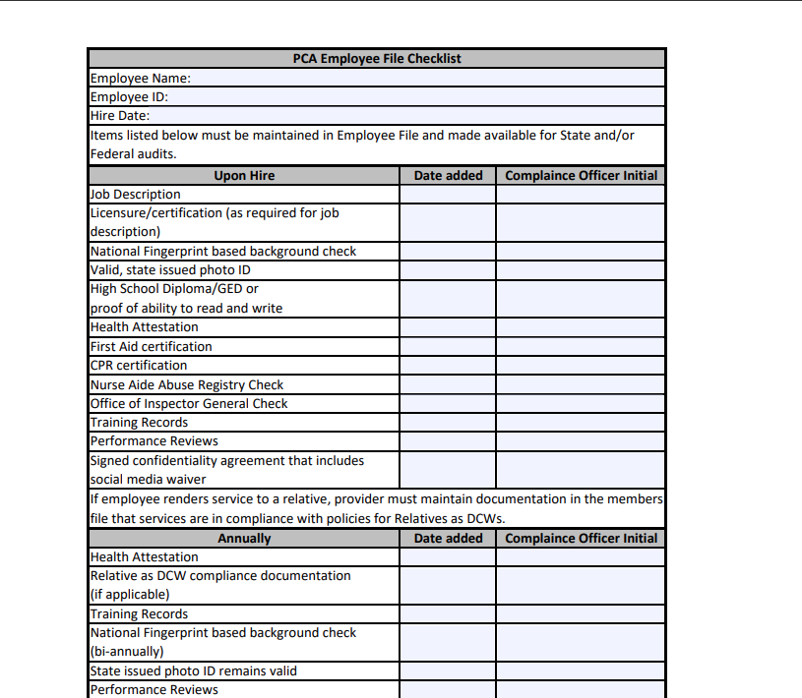
Staff Files: Employee File Checklist
This checklist for staff files is available on the HCBS Providers Webpage to help track that all credentialing requirements are addressed timely.
If providers do not have proof that all staff are fully and appropriately credentialed, claims may be subject to claims recoupments.
All staff records should include, at a minimum, the following required credentialing and qualification documents:
Copy of valid, state issued ID,
Job description,
Application and date of hire,
High school diploma, General Educational Development (GED) certificate, other educational degrees, or proof of ability to read and write accurately,
Any licensure and/or certifications as required by the Division of Medicaid for job description,
Results of fingerprint-based National Criminal Background check(s),
Results of monthly Nurse Aide Abuse Registry checks,
Results of monthly Office of Inspector General (OIG) checks,
Annual attestation of health,
Signed confidentiality agreement that includes social media waiver, and
Proof of training/evaluations, required professional certifications, and credentials including CPR and First Aid.
Employee File Checklist Link: https://medicaid.ms.gov/wp-content/uploads/2023/05/Employee-File-Checklist-5.17.23.pdf
Notes:
DOM has created the Employee File Checklist to simplify the process of maintaining staff records. This list includes, at a minimum, the required credentialing and qualification documents. Upkeeping this list will help Compliance Officers ensure overall program compliance. In case there is an audit by DOM, the agency will need to make sure that all files, including the employee file checklist, are easily accessible.

Slide 52
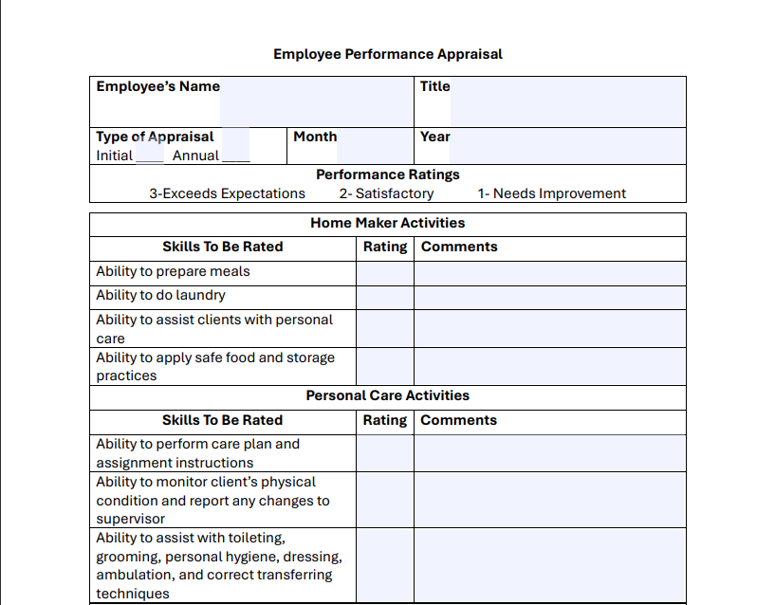
Staff Files: Employee Performance Appraisal
The Employee Performance Appraisal Form should be completed by the DCW Supervisor, but may also be completed by an Administrator, CEO, Manager, or Compliance Officer. With the completion of the appraisal, the performance of care provided to the beneficiary will be rated and scored to a certain accountability of the direct care worker. This appraisal should be completed at hire and annually thereafter.
Information gathered on the Supervised Visit forms should be used when completing the Annual Employee Performance Appraisal.
  Employee Performance Appraisals should be completed at hire and annually thereafter.
  Addresses the performance of:
  Home Maker Activities
  Personal Care Activities
  Service Delivery
  Technical Skills and Communication
  Health and Safety Activities
  Work Habits
  Personal Attributes
  Accountability
  Overall Performance
Performance Appraisal Link: https://medicaid.ms.gov/wp-content/uploads/2025/06/Employee-Performance-Appraisal.pdf
Notes:
The Employee Performance Appraisal Form should be completed by the PCA Supervisor, but may also be completed by an Administrator, CEO, Manager, or Compliance Officer. With the completion of the appraisal, the performance of care provided to the beneficiary will be rated and scored to a certain accountability of the direct care worker. This appraisal should be completed at hire and annually thereafter.

Slide 53
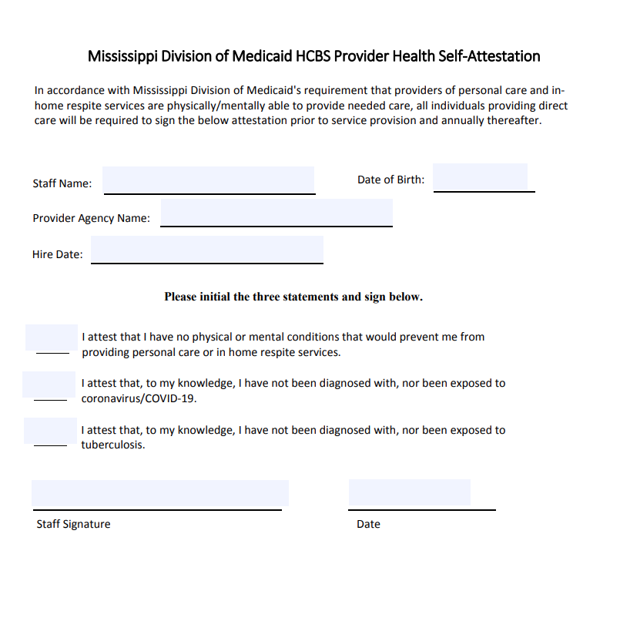
Staff Files: Health Attestation
  Health Self-Attestation forms should be completed at hire and annually thereafter.
  Addresses accountability of:
  Being physically/mentally able to provide care
  Not being diagnosed/exposed to COVID-19
  Not being diagnosed/exposed to tuberculosis
Annual TB skin testing is not recommended by the CDC unless there is a known exposure or ongoing transmission at a health care facility. All Health Care Personnel are required to complete LTSS Annual Health Self Attestation, including the TB Risk Assessment from the CDC, which is available on the CDC website, or from the HCBS Provider Team by request.
Health Attestation Link: https://medicaid.ms.gov/wp-content/uploads/2023/06/HCBS-Provider-Health-Self-Attestation.pdf
Notes:
The Health Self-Attestation should be completed at hire and annually thereafter. Please keep in mind that annual TB skin testing is not recommended by the CDC unless there is a known exposure or ongoing transmission at a health care facility. All Health Care Personnel are required to complete LTSS Annual Health Self Attestation, including the TB Risk Assessment from the CDC, which is available on the CDC website, or from the HCBS Provider Team by request.

Slide 54
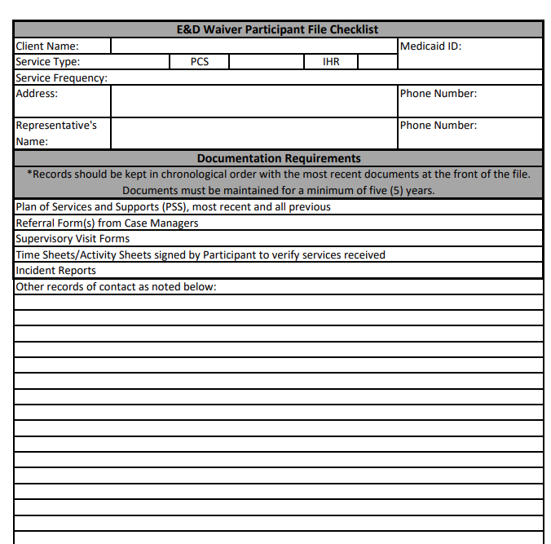
Personal Care and In-Home Respite providers must maintain all files required in the Participant File Checklist for a minimum of five (5) years. This includes the beneficiary’s most recent and all previous PSSs, referral forms from the Case Managers, time sheets, activity sheets, incident reports, and documentation of bi-weekly supervisory visits. If the daily activity or time sheets aren’t captured on HHAX’s EVV service, please make sure that paper timesheets are updated with the duties performed. As a reminder, each PSS must be reviewed to make sure the information on the PSS matches the service referral.
Beneficiary Files: Participant File Checklist
  Records for beneficiaries receiving Personal Care Services (PCS) & In-Home Respite (IHR) should include, at minimum:
  Referral form/authorization,
  Approve Plan of Services and Supports (PSS)
  Daily activity or time sheets capturing tasks completed and the beneficiary/representative’s signature verifying the provision of services, if task and global positioning system (GPS) information is not captured electronically in the state approved electronic visit verification system.
  Service note indicating the causes of any significant variation in the case management recommended/agreed upon schedule of service provision.
  Documentation of bi-weekly supervisory visits.
Participant File Checklist Link: https://medicaid.ms.gov/wp-content/uploads/2022/12/PCS.IHR-Participant-File-Checklist.pdf
Notes:
Personal Care and In-Home Respite providers must maintain all files required in the Participant File Checklist for a minimum of five (5) years. This includes the beneficiary’s most recent and all previous PSSs, referral forms from the Case Managers, time sheets, activity sheets, incident reports, and documentation of bi-weekly supervisory visits. If the daily activity or time sheets aren’t captured on HHA’s EVV service, please make sure that paper timesheets are updated with the duties performed. As a reminder, each PSS must be reviewed to make sure the information on the PSS matches the service referral.

Slide 55
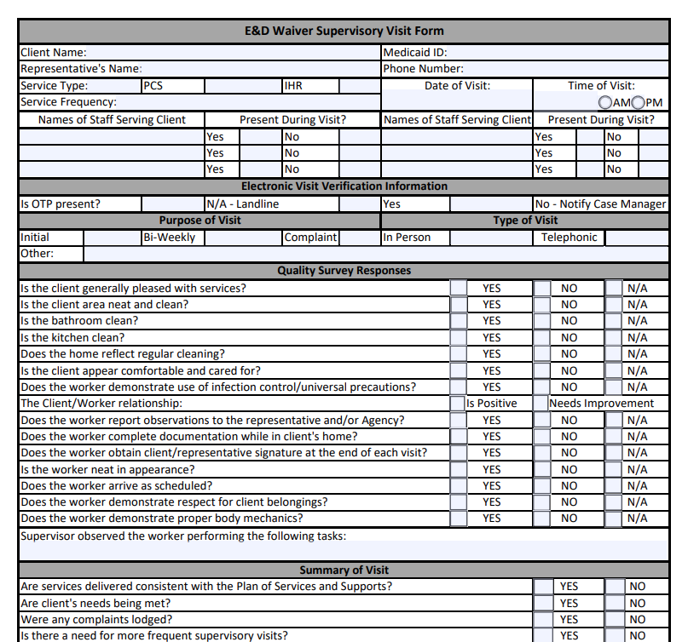
Beneficiary Files: Supervisory Visit Form
The Supervisory Visit Forms are to be completed by the Supervisor that performs the alternating supervisory visits on a bi-weekly basis.
This form is to ensure that the services and care have been provided to the beneficiaries by the direct care workers according to the PSS.
The visits performed should be both supervised visits (in the home with DCW staff present) and unsupervised (by phone with DCW staff not present).
  Supervisory visits should be alternating on a bi-weekly basis to assure services and care are provided according to the PSS. Supervisors should perform following:
  Supervised direct monitoring visits in the beneficiary’s home while the PCA staff is on-site.
  Unsupervised indirect monitoring visits, which may be performed in the beneficiary’s home or by phone while the PCA staff is not on-site.
Supervisory Visit Form Link: https://medicaid.ms.gov/wp-content/uploads/2022/05/PCS-IHR-Supervisory-Visit-Form-1.pdf
Notes:
Admin Code Part 208 Chapter 1 Rule 1.3: Provider Enrollment
The Supervisory Visit Forms should be completed by the Supervisor that performs the alternating supervisory visits on a bi-weekly basis. This form is to ensure that the services and care have been provided to the beneficiaries by the direct care workers according to the PSS. The visits performed should be both supervised visits (with DCW staff present) and unsupervised (with DCW staff not present).

Slide 56
Additional Resources

Slide 57

Marketing, Referrals, & PSS
The following slides will address common compliance issues with DOM regulations for marketing and referrals for potential waiver beneficiaries. This process helps protect health information and allows beneficiaries full freedom of choice, not only to choose a provider agency, but to choose which waiver program best suits their needs.
In order to ensure that waiver providers are in compliance with DOM regulations regarding freedom of choice, solicitation, and protection of Protected Health Information (PHI), please refer to the following guidance for appropriate marketing and referrals of potential waiver beneficiaries.
Notes:
The following slides will address common compliance issues with DOM regulations for marketing and referrals for potential waiver beneficiaries. This process helps protect health information and allows beneficiaries full freedom of choice, not only to choose a provider agency, but to choose which waiver program best suits their needs.

Slide 58

Freedom of Choice
  Waiver providers must keep in mind that not all individuals interested in services will qualify. Additionally, those who do qualify must be guaranteed the freedom to choose any qualified provider servicing their area.
  Waiver providers are prohibited from any actions which would in any manner, deny or restrict that individual's free choice of a provider of any services for which the individual may be eligible. Providers cannot use any method of inducement, including free transportation, refreshments, cash or gifts, to influence a beneficiary to select a certain provider.
Notes:
Admin Code Part 208 Chapter 1 Rule 1.4: Freedom of Choice
An undeniable right for beneficiaries is that they have the right to have the Freedom of Choice of eligible providers for covered services. With this right, providers may not require beneficiaries to sign a statement restricting their free choice to a single provider or influence them by any method of inducement. This includes and is not limited to free transportation, refreshments, cash or gifts.
If DOM is notified of any solicitation, your agency will be reported to our Program Integrity Division for investigation.

Slide 59


Referrals & PSS
The process shown here has been created to ensure providers are following requirements, so all members have freedom of choice. The E&D waiver is not the only option for services, the MAC Center & PDD can help members navigate those choices.
Once a beneficiary chooses a waiver program, their name is placed on the local waitlist until a slot becomes available. Once a slot becomes available, an assessment is completed by the case managers at the PDD and financial eligibility is determined by the regional office. Once eligibility is established, the beneficiary then gets to choose a service provider approved for their area. This choice results in the submission of a referral and a Plan of Service.
Waiver providers should not be completing waiver intake referral forms and sending them to Case Managers. While performing marketing for your agency, if an individual shows interest in Home & Community Based Services, that individual should be provided with contact information for the Mississippi Access to Care Network, or the MAC Centers. The MAC Center in their area can be contacted by phone at 1-844-822-4622 or via the “Send a message to MAC Center” button on their webpage.
Once the individual contacts the MAC Center, they will receive information on available services as well as referrals to applicable programs to meet their needs. After speaking with the MAC Center, if the individual is interested in applying for a Medicaid waiver, their name will be placed on a waiting list and will be evaluated for physical and financial eligibility when an open slot becomes available.
When a referral is received whether it be for an initial enrollment or recertification, compare the frequency on that referral to the frequency on the PSS and confirm that the Provider Number listed is correct. Notify the case managers of discrepancies.
Link: https://www.mississippiaccesstocare.org/HelpInfo/ContactUs
Link: http://mspdds.org/pdd-services/
Notes:
The process shown here has been created to ensure providers are following requirements, so all members have freedom of choice. The E&D waiver is not the only option for services, the MAC Center & PDD can help members navigate those choices.
Once a beneficiary chooses a waiver program, their name is placed on the local waitlist until a slot becomes available. Once a slot becomes available, an assessment is completed by the case managers at the PDD and financial eligibility is determined by the regional office. Once eligibility is established, the beneficiary then gets to choose a service provider approved for their area. This choice results in the submission of a referral and a Plan of Service.
When you receive a referral, whether it be for an initial enrollment or recertification, compare the frequency on that referral to the frequency on the PSS and confirm that the Provider Number on the PSS is accurate. Notify the case managers of discrepancies.

Slide 60
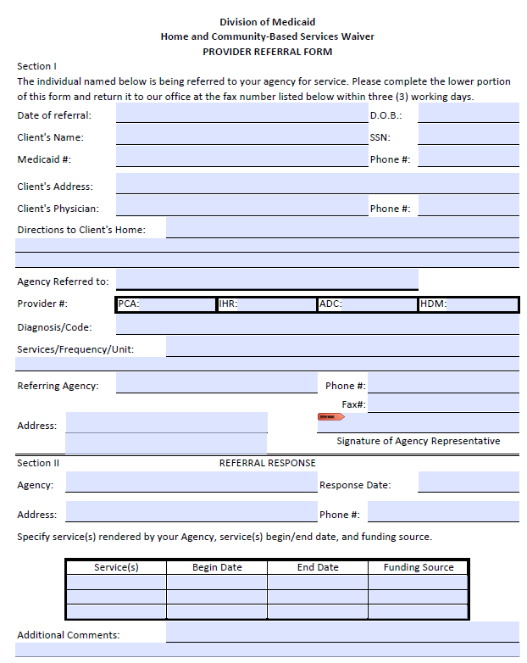
Referrals & PSS
The Referral is received from the PDD to notify a Provider that a member is interested in receiving services.
Providers must review this information carefully to determine if they have DCW available to staff this referral.
Providers must confirm acceptance or decline the referral within three (3) working days.
If authorization starts or stops mid-week, claims submitted should accurately reflect authorization rather than span billing for the entire week or month.
Once the PSS is approved, the auth will be loaded into HHAX within 72 hours. Providers may use paper timesheets and manually enter the service information once the auth is received.
Providers should be reaching out to DOM via the HHAX Linked Communications Message Center if authorizations are missing.
Notes:
There have been some changes with the eLTSS system which are resulting in a more manual approval process for PSSs. DOM is working on a solution on this but until the issue is resolved, it has resulted in a temporary delay in processing these requests. Providers may now receive a PSS that indicates “No decision has been made yet.” This means that there will be a delay in the authorization being loaded into HHAX. Providers should still be receiving a full copy of the PSS and the referral. Until providers have the auth in HHAX, they can use a hard copy referral form and a copy of the PSS and capture information on paper timesheets. Once the auth is received in HHAX, they can go in and manually enter shift data from the timesheet for the first week or two and submit claims at that point.

Slide 61
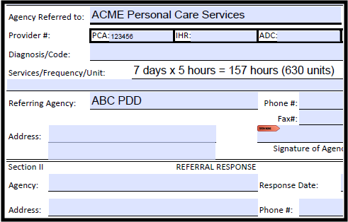
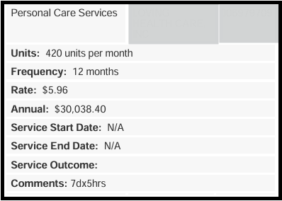
Referrals & PSS
When a PSS is received, Providers must confirm accuracy. If discrepancies are found, the Provider must notify the PDD immediately.
Confirm provider numbers are accurate,
Ensure start/end date is appropriate based on date received,
Compare the frequency on the referral to the frequency on the PSS.
(Day X Hour) X 4.5 = Hours per Month | HrMnth x 4 = Units per month
Can you identify the error(s) below between the Referral & PSS?
AKME PCS
543210
Notes:
When a PSS is received, Providers must confirm accuracy.
HrMnth x 4 (because there are 4 units in an hour)

Slide 62

Elderly & Disabled Waiver
PCS-IHR Reimbursement
Waiver claims are billed with a unique modifier to assist with identifying the source of coverage for services, for the E&D waiver that modifier is U1.
The chart reflected here outlines the rates and information needed for billing E&D services. To note, while ADC bills directly through our fiscal agent Gainwell, Personal Care and In-Home Respite providers are required to utilize an Electronic Visit Verification software.
Modifier | Procedure Code | Service Name | Rate | Maximum Allowable Units and Ages | Provider Taxonomy and Place of Service (POS)
(U1 Modifier) | T1019 | Personal Care Services | $6.24 per 15 minute unit | Ages: 21-999 Maximum: Individualized | Taxonomy: 3747P1801X POS: 12
(U1 Modifier) | S5150 | In Home Respite | $6.24 per 15 minute unit | Ages: 21-999 Maximum: Individualized | Taxonomy: 253Z00000X POS: 12
The Division of Medicaid requires providers to submit claims no later than three hundred sixty-five (365) calendar days from the date of service.
The Division of Medicaid has three hundred sixty-five (365) calendar days from the date of receipt to process all claims.
Notes:
Waiver claims are billed with a unique modifier to assist with identifying the source of coverage for services, for the E&D waiver that modifier is U1.
The chart reflected here outlines the rates and information needed for billing E&D services. To note, while ADC bills directly through our fiscal agent Gainwell, Personal Care and In-Home Respite providers are required to utilize an Electronic Visit Verification software.

Slide 63

Billing Requirements
Personal Care Services (PCS) & In-Home Respite (IHR)
  Services are billed weekly
  Documentation required to substantiate claims
  EVV use required
All waiver services require documentation, which must include signatures of the beneficiary or their caregiver and/or GPS data captured in EVV at clock-in & out. Employees of the provider agency are never authorized to sign for the beneficiary.
Notes:
All waiver services require documentation, which must include signatures of the beneficiary or their caregiver and/or GPS data captured in EVV at clock in & clock out.
Employees of the provider agency are never authorized to sign for the beneficiary.
Personal Care & In-Home Respite services can be billed weekly and require use of an Electronic Visit Verification system.

Slide 64

Remittance Advice
Personal Care Services (PCS) & In-Home Respite (IHR)
It is the responsibility of the Medicaid provider to verify a Medicaid beneficiary’s eligibility each time the beneficiary appears for a service. Providers should not just rely on information from Case Managers. Instructions for verifying member eligibility and other insurance coverage is included in the below linked video. https://www.youtube.com/watch?v=DbQtKgLNy5M
Providers must review/reconcile their Remittance Advice (RA), available in MESA, with billed claims to ensure that all claims billed have been reimbursed or determine the reason for the denial. Providers should not assume that just because they received a deposit, that all claims were paid. You can access this information by following the instructions in the below linked video (beginning at minute 19:05). https://www.youtube.com/watch?v=lLeapclHFHs
Notes:
Are you getting paid? How do you know for sure?
Providers should be routinely reviewing the Remittance Advice in the MESA Provider Portal to confirm that all claims submitted have been paid, or identify errors causing denials.

Slide 65
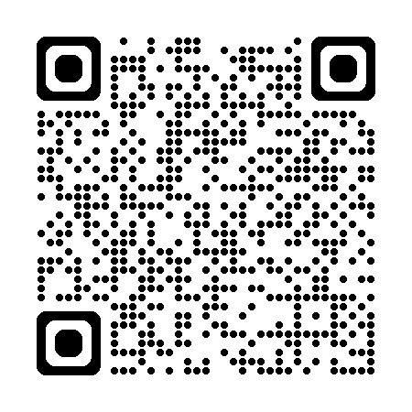
Contact Updates
LTSS is now utilizing SmartSheets to gather Contact Updates from PCS-IHR Providers. You can scan the QR code and fill out the form to ensure our office has the most current information for your agency.
The Freedom of Choice list and provider contact information are maintained separately, outside of MESA, in our office. Changes in contact info submitted via the MESA portal do not get reported to our office. Any updates needed should start by contacting LTSS and if further actions are required, we will assist with that process.
Providers are required to report changes in contact information, administrative staffing, ownership and licensure within ten (10) calendar days to the Division of Medicaid. You may also use the SmartSheet to report such changes.
LTSS uses the information from this annual update to ensure that the Case Managers have accurate contact information for the Freedom of Choice list so you can continue to receive referrals.
LTSS also uses this information to confirm that your facility is still at the address we have on file.
PCS-IHR Freedom of Choice List: https://app.smartsheet.com/b/form/224d528a39a34cef97236ac6fc01ccee
Notes:
The LTSS office uses SmartSheets to update contact information for Personal Care and In-Home Respite providers. This information is used to ensure that your agency has an accurate address and contact for the Freedom of Choice list so that you may continue to receive referrals. You’ll get an automatic reminder when your Privilege Tax License is expiring to remind you it is time to update. If you allow your information to expire, your location will be pulled from the FOC list and will no longer receive referrals until updated. These changes cause disruptions in services so please monitor your emails for these requests and respond timely.
Once again, Providers are required to report any changes in contact information, staffing, ownership, and licensure within 10 calendar days to the Division of Medicaid. Providers are able to use this Contact Form to report any changes.
The Freedom of Choice list and provider contact information is maintained separately, outside of MESA, in our office. Changes in contact info submitted via the MESA portal do not get reported to our office. Any updates needed should start by contacting LTSS and if further actions are required, we will assist with that process.

Slide 66
Resources for Success
PCS & IHR Frequently Asked Questions
Professional Provider Etiquette
Quality Management
Reporting Guides
Helpful Links

Slide 67

PCS & IHR Frequently Asked Questions
Can family members serve as Direct Care Workers (DCWs)?
Personal Care Service and In-Home Respite Service may be furnished by family members if they are not legally responsible for the person. Family members must be employed by a Medicaid approved agency that provides PCS/IHR, must meet provider standards, and must be deemed competent to perform the required tasks.
Can DCWs transport Medicaid beneficiaries?
Staff may accompany persons during community activities but cannot drive the vehicle. Beneficiaries have access to Non-Emergency Transportation services, and their Case Managers can assist them with coordinating those services.
Can the Owner or Compliance Officer also serve as a Supervisor?
No. Owners and Compliance Officers cannot serve as Supervisors or DCWs. The organizational chart defines your agency’s chain of command, this is the formal, top-down hierarchy within an organization that defines reporting relationships, decision-making power, and lines of communication. It establishes a continuous line of authority from senior leadership down to frontline employees.
How do I expand my service area or relocate my business?
Send an email to HCBSProviders@medicaid.ms.gov with your inquiry and we will send the appropriate SmartSheet for your agency to complete.
How much should DCWs be paid?
Our office requires providers to comply with all state and federal laws and regulations and labor laws. You can contact the Department of Labor concerning basic wage standards. https://www.dol.gov/agencies/whd

Slide 68
PCS & IHR Frequently Asked Questions
Will a DCW need to clock out if running errands with a beneficiary?
  A DCW can provide services both in the home and in the community. Usually if a participant needs assistance with running errands, the Case Manager will add CAT hours to the PSS, however this is not required. Services provided in the community are billed the same way as services provided inside the home. For example, if the DCW is on the clock, and the participant wants to run some errands, the DCW would remain on the clock and travel with (but not drive) the participant during the errands. If the beneficiary leaves the home without the DCW, the DCW must clock out and leave.
I am looking to provide services for Medicare. How do I do that?
  Information on Medicare provider enrollment can be found on the CMS website linked here. https://www.cms.gov/medicare/enrollment-renewal/providers-suppliers
Are there state-approved training programs?
  Many providers choose to use the Arc of Mississippi for their training, but this is not a requirement. Please refer to the Administrative Code for appropriate procedures regarding for training staff.
Are DCWs able to service E&D beneficiaries traveling out of state?
  As long as the provider allows it, then it is still a MS Medicaid provider rendering a MS Medicaid approved service to a MS Medicaid beneficiary even if it happens out of state on a short-term basis (i.e. a vacation, etc.). There is no enhanced reimbursement for it. Providers concerned about any liabilities for out of state provision, may address this in their own Policies & Procedures.

Slide 69
PCS & IHR Frequently Asked Questions
Will the DCW need to clock out if additional services are being rendered by hospice to the beneficiary?
  If the hospice staff are providing non-medical care, such as bathing, those services cannot be provided while the E&D DCW is in the home. The best solution is to contact the hospice agency and determine what their planned schedule is, so that your DCW staff can come before or after the hospice staff. The case managers should be able to assist you with this if you have issues getting their contact information. If the hospice care provided is medical, such as wound care, then those services can be provided while the E&D DCW is in the home.
Are providers responsible for checking eligibility prior to rendering services?
  The Administrative Code does require that providers verify eligibility prior to rending services. Providers checking eligibility must confirm that the member has both active eligibility and an active E&D lock-in.
May services be rendered once a beneficiary has been discharged from the hospital?
  In home services, such as personal care and in-home respite, may be provided on the date of admission or discharge, but cannot be provided while the beneficiary is at the hospital.
Does DOM reimburse supplies and materials such a gloves?
  E&D Waiver services do not specifically cover gloves; however, most waiver members do have coverage for Durable Medical Equipment (DME), which includes things like gloves, pull-ups, blue pads, etc. To receive these items, the beneficiary’s physician would have to write a prescription and send it to a DME supplier.
Is it okay for the DCW to run errands for the beneficiary while providing IHR services?
  No. Members receiving IHR services cannot be left alone.

Slide 70

  All emails should include a signature. The signature should have the name of the person emailing, role in agency, agency’s name, provider ID(s), phone number, email, and fax number
  The topic should be in the email subject line.
  All messages should be clear and concise. This includes phone calls, voicemails and emails.
  Email addresses should be appropriate. This includes the following:
    Email domain should be able to be passed down as staff roles change.
      Ex) Approved: Admin@HealthCareAgency.com or AdminHealthCareAgency@gmail.com
      Ex) Not Approved: CowgirlJane601@gmail.com
Professionalism from providers is key in helping improve effective communication with the Division of Medicaid. This guide should be beneficial to those providers interested in helping improve the etiquette of staff and streamlining the best response from DOM in answering your questions or concerns.
All emails should include a signature, topic, and, if PHI is used, they must be encrypted. This helps ensure that the privacy of the beneficiary is protected and that DOM has a contact plus the issue addressed within the same email. If in doubt about your ability to encrypt emails, send us a request for an encrypted email and we can assist you.
The HHAX Portal has a secure message feature that automatically protects PHI and allows you to communicate directly with our staff. Please limit the message portal to emails that require the use of PHI if not directly related to HHAX.
Finally, please do not send the same email to multiple staff at DOM. Emailing HCBSProviders will get your request to our entire team. However, if you send that same email to multiple people, it can create confusion and additional work which slows down general response time.
Professional Provider Etiquette
Notes:
Professionalism from providers is key in helping improve effective communication with the Division of Medicaid. This guide should be beneficial to those providers interested in helping improve the etiquette of staff and streamlining the best response from DOM in answering your questions or concerns.
All emails should include a signature, topic, and be encrypted. This helps ensure that the privacy of the beneficiary is protected and that DOM has a contact plus the issue addressed within the same email. If in doubt about your ability to encrypt emails, the HHA Portal has a secure message feature that automatically protects PHI and allows you to communicate directly with our staff. Please limit the message portal to emails that require the use of PHI if not directly related to HHA.
Another note is that email addresses should be appropriate. Having email domains that are able to be passed down will make it easier for providers in case there is an instance of the staff being removed from the position. The new staff that fills the position should have a seamless transition to the approved email domain.
Finally, please do not send the same email to multiple staff at DOM. Emailing HCBSProviders will get your request to our entire team. However, if you send that same email to multiple people, it can create confusion and additional work which slows down general response time.

Slide 71
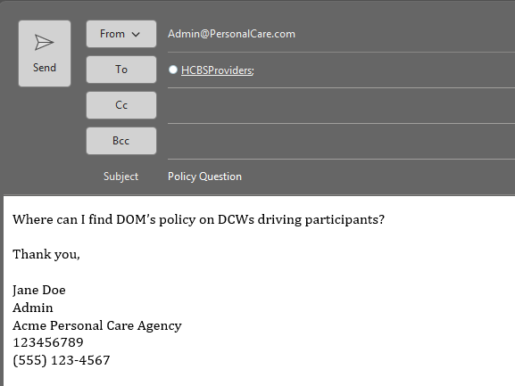
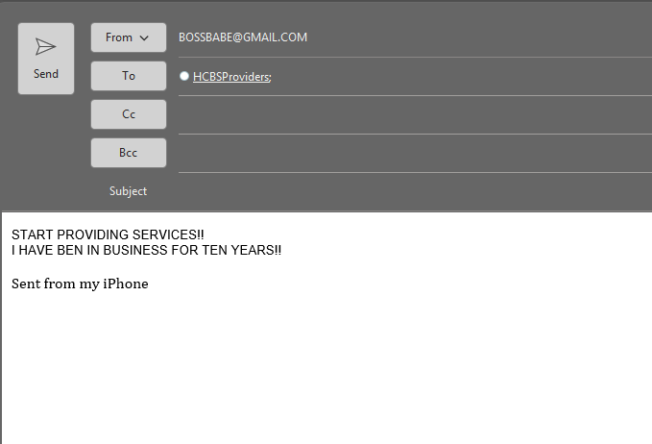
Professional Provider Etiquette
Do
Use appropriate email addresses
Include a subject
Include your contact information
Don’t
Use personal email addresses
Leave subject line blank
Forget your contact information
Please reach out to the HCBSProviders email for any policy, enrollment, education, or general inquiries. In order to supply you with a sufficient response to a question, our team will need to know
who you are,
how to contact you/your agency,
the provider ID, and
the actual question.
Remember to always include the subject line so that we may be able to know the topic at hand, and for continuing conversations, please Reply to the email rather than starting a new one.
Notes:
Please reach out to the HCBSProviders email for any policy, enrollment, education, or general inquiries. In order to supply you with a sufficient response to a question, our team will need to know (1) who you are, (2) how to contact you/your agency, (3) the provider ID, and (4) the actual question. Remember to always include the subject line so that we may be able to know the topic at hand and for continuing conversations, please Reply to the email rather than starting a new one.

Slide 72
Professional Provider Etiquette
Providers are responsible for safeguarding the confidentiality of applicant and beneficiary information in all forms to prevent unauthorized disclosure. According to the HIPPA Security Rule, providers must also implement technical policies and procedures for electronic information systems that maintain electronic protected health information to allow access only to those persons or software programs that have been granted access rights as specified in the Code of Federal Regulations Title 45.
As a general reminder, the subject line of an email must never contain PHI as subject lines themselves cannot be encrypted. Also, do not share credentials when accessing any system for the MS Division of Medicaid. A unique ID must be used in order to track and uphold proper user management.
Sharing Credentials
When accessing any system for the MS Division of Medicaid, whether that be MESA, HHAX or other EVV systems, or any other system that may contain MS Medicaid Beneficiary data, each user must have their own unique Username and Password. Credentials are the equivalent to a digital signature for these systems and are never to be shared amongst multiple staff.
If you currently have staff which share credentials, new user accounts must be set up immediately and any shared passwords must be reset to ensure security. Credentials for staff who are no longer employed with your agency must be immediately deactivated.
Protecting PHI
Protected Health Information (PHI) must be secured at all times. PHI refers to any health data that identifies a specific individual, including Member Names, Medicaid IDs, Address, Medical History, PSS data, etc.
PHI must never be shared via emails which are not encrypted. It must never be shared on personal mobile devices, via text, especially in group chats which may include individuals not relevant to the member’s care.
To protect PHI, providers should use the HHAX Secure Message Portal when possible to communicate to DOM.
Notes:
Providers are responsible for safeguarding the confidentiality of applicant and beneficiary information in all forms to prevent unauthorized disclosure. According to the HIPPA Security Rule, providers must also implement technical policies and procedures for electronic information systems that maintain electronic protected health information to allow access only to those persons or software programs that have been granted access rights as specified in the Code of Federal Regulations Title 45.
As a general reminder, the subject line of an email must never contain PHI as subject lines themselves cannot be encrypted. Also, do not share credentials when accessing any system for the MS Division of Medicaid. A unique ID must be used in order to track and uphold proper user management.

Slide 73

Quality Management
If an E&D Waiver provider fails to respond to contact attempts timely or respond to requests for documentation/training verification in established timeframes, the Division of Medicaid may halt the acceptance of Medicaid referrals or waiver admissions until the E&D waiver provider establishes contact or demonstrates compliance with the regulatory agency.
Please ensure that DOM is listed as a safe sender for your agency email domain by utilizing the resources below:
Yahoo Safe Sender: https://help.yahoo.com/kb/add-edit-delete-contacts-yahoo-mail-sln28059.html
Gmail Safe Sender: https://support.google.com/contacts/answer/1069522?hl=en&co=GENIE.Platform%3DDesktop
AOL Safe Sender: https://help.aol.com/articles/add-edit-or-delete-contacts-in-aol-mail
AT&T Safe Sender: https://www.att.com/support/article/email-support/KM1049062/
Outlook Safe Sender: https://support.microsoft.com/en-us/outlook/mail/add-recipients-to-the-safe-senders-list-in-outlook
Please ensure that all contact information for your agency is accurate and true. The Division of Medicaid has the right to halt E&D Waiver referrals and admissions if your agency fails to respond to communications timely or if the Division of Medicaid is unable to contact your agency. Your agency will remain removed from the Freedom of Choice list until contact is reestablished.
The decision to halt Medicaid referrals or waiver admissions is at the discretion of the Division of Medicaid.
Notes:
Please ensure that all contact information for your agency is accurate and true.
The Division of Medicaid has the right to halt E&D Waiver referrals and admissions if your agency fails to respond to communications timely or if the Division of Medicaid is unable to contact your agency. This slide offers some resources for adding DOM emails to your safe sender lists, so our emails do not get sent to your junk/spam folders.
Your agency will remain removed from the Freedom of Choice list until contact is reestablished. Again, this is disruptive to member services and creates more work for everyone involved so be sure someone at your agency is monitoring emails daily and responding timely.

Slide 74

Provider Monitoring & Audits
All waiver providers are audited annually by staff from the DOM Office of Financial and Performance Auditing. Additionally, providers may be audited by other DOM contractors as well as state and federal entities such as the Centers for Medicare and Medicaid Services, or CMS, or the Office of the Inspector General, or OIG.
Providers must maintain auditable records to substantiate claims submitted to Medicaid and provide immediate access to their offices, facilities or records during regular business hours 8 AM to 5 PM Monday through Friday and all other hours when employees of the provider are normally available in conducting the business of the provider. If a provider's office is not open during the required hours and DOM is unable to complete an audit, the agency may be cited for abandonment of audit and all claims paid for the audit period may be recouped. As compliance audits are unannounced, it is very important that your office be open and that someone on site has access to all of your records daily, so that audit teams have immediate access.
DOM audits all waiver providers annually. Additionally, providers may be audited by other DOM contractors, as well as State and Federal entities such as the Centers for Medicare and Medicaid Services (CMS) or the Office of the Inspector General (OIG).
The provider must maintain auditable records to substantiate claims submitted to Medicaid and provide immediate access to the provider’s physical services location, facilities, or any records relating to licensure, medical care, and services rendered to beneficiaries, and billings/claims during regular business hours (8 a.m. to 5 p.m., Monday – Friday) and all other hours when employees of the provider are normally available and conducting the business of the provider.
Records documenting the provision of services must be maintained by the providers of waiver services for a minimum of five (5) years. If, at the conclusion of the five-year period, there is ongoing litigation or an open audit, the provider must maintain these records until the litigation or audit is concluded.
Based on OIG and CMS guidance, DOM audits are unannounced.
Notes:
All waiver providers are audited annually by staff from the DOM Office of Financial and Performance Auditing. Additionally, providers may be audited by other DOM contractors as well as state and federal entities such as the Centers for Medicare and Medicaid Services, or CMS, or the Office of the Inspector General, or OIG.
Providers must maintain auditable records to substantiate claims submitted to Medicaid and provide immediate access to their offices, facilities or records during regular business hours 8 AM to 5 PM Monday through Friday and all other hours when employees of the provider are normally available in conducting the business of the provider. If a provider's office is not open during the required hours and DOM is unable to complete an audit, the agency may be cited for abandonment of audit and all claims paid for the audit period may be recouped. As compliance audits are unannounced, it is very important that your office be open and that someone on site has access to all of your records daily, so that audit teams have immediate access.

Slide 75



Reporting Critical Incidents & Complaints
Division of Medicaid
Mississippi Planning and Development District
Phone: 844-822-4622
Email: mail@mspdds.com
Adult Protective Services
Phone: (601) 359-6141
Phone: 844-437-6282
Email: HCBSProviders@medicaid.ms.gov
Report Online: https://www.mdhs.ms.gov/aging/adult-protective-services/
Notes:
APS would receive reports of Abuse, Neglect, Exploitation, or suspicious death. Providers making reports will receive a Report ID number.
The PDD would receive reports of beneficiaries or their relatives acting inappropriately with Provider Staff.
DOM would receive all other complaints and copies of any reports made to APS.

Slide 76


Reporting Abuse, Neglect, and Exploitation
APS would receive reports of Abuse, Neglect, Exploitation, or suspicious death.
The PDD would receive reports of beneficiaries or their relatives acting inappropriately with Provider Staff.
DOM would receive all other complaints.
Providers who need to report Critical Incidences should first make a report to Adult Protective Services (APS) and include that report number on the Reportable Incidents Form when sending to DOM & the PDD case manager.
Providers must report:
Critical incidences including all instances of abuse, neglect, exploitation and suspicious death (including the unauthorized use of restraints, restrictive interventions, and/or seclusion) within twenty (24) hours of the occurrence or knowledge of the occurrence to the Division of Medicaid and other applicable agencies as required by law.
To DOM any complaints which are not resolved within seven (7) days.
APS Website: https://www.mdhs.ms.gov/aging/adult-protective-services/
Reportable Incidents Form: https://medicaid.ms.gov/wp-content/uploads/2026/02/ED-Reportable-Incidents-Fillable-Form-2.26.21.pdf
Notes:
Any type of critical incidents, especially instances of abuse, neglect, exploitation, or suspicious death must be reported to the Mississippi Department of Human Service’s Division of Aging and Adult Services within 24 hours of knowledge of occurrence.
Providers must report any complaints which are not resolved within 7 days to the Division of Medicaid. A specific example of this is if a member is unsatisfied with their PCA, and your agency has been unable to staff a new PCA with them within 7 days.

Slide 77

Reporting Labor Law Violations
Providers are required to comply with all applicable federal and state regulations including but not limited to tax and labor laws.
Any reports the Division of Medicaid receives regarding labor law violations are referred to the U.S. Department of Labor.
To ensure providers can sustain payroll processes in instances where claims reimbursement is delayed, providers are required to have and maintain a business line of credit equal to three (3) months operating costs.
Any questions about your payroll responsibilities as an employer, please call the U.S. Department of Labor at 601-965-4347.

Slide 78

Reporting Fraud, Waste, and/or Abuse
Providers must report any suspected instances of Fraud, Waste, or Abuse. This includes suspected or confirmed actions by employees of the provider agency. Every dollar lost to the misuse of Medicaid benefits, is one less dollar available to fund programs providing essential medical services for vulnerable Mississippians. If we do not work together to help stop fraud and abuse, the system might not be available for those whom the program was created to help. There are multiple ways to report, which can be found at the following link: https://medicaid.ms.gov/contact/report-fraud-and-abuse/
All providers must report any suspected instances of Fraud, Waste, or Abuse.
Types of Provider Fraud Billing for services not rendered:
Inappropriate or lack of documentation to support services billed
Quality of care issues that fail to meet professionally recognized health care standards
Falsifying certificates of medical necessity, plans of treatment, and medical records to justify payment
Soliciting or receiving kickbacks
Violating Medicaid policies, procedures, rules, regulations, and/or statutes
To access educational booklets, fact sheets and provider checklist resources and tools which promote efforts to prevent Medicaid fraud, waste and improper payments, visit the https://www.cms.gov/medicare/medicaid-coordination/states/education on the Centers for Medicare and Medicaid Services website.
Notes:
All providers must report any suspected instances of Fraud, Waste, or Abuse. This includes suspected or confirmed actions by employees of the provider agency.
For additional resources and toolkits to supply to your employees, you may visit the Medicaid Program Integrity Education page on the Centers for Medicare and Medicaid Services website.

Slide 79



Mississippi Planning & Development Districts (PDDs)
Central Mississippi (CMPDD)
Phone: (601) 981-1511
Counties Served:
East Central (ECPDD)
Phone: (601) 683-7409
Counties Served:
Golden Triangle (GTPDD)
Phone: (662) 324-7860
Copiah
Clarke
Counties Served:
Choctaw
Hinds
Madison
Rankin
Simpson
Warren
Yazoo
Clay
Lowndes
Noxubee
Oktibbeha
Webster
Winston
Jasper
Kemper
Lauderdale
Leake
Neshoba
Newton
Scott
Smith
Notes:
The following slides will have a list of counties and the contact number for each respective PDD.

Slide 80




Mississippi Planning & Development Districts (PDDs)
North Central (NCPDD)
Phone: (662) 283-2675
Counties Served:
North Delta (NDPDD)
Phone: (662) 561-4100
Counties Served:
North East (NEMPDD)
Phone: (661) 728-7038
Counties Served:
Attala
Carroll
Grenada
Holmes
Leflore
Montgomery
Yalobusha
Coahoma
Desoto
Panola
Quitman
Tallahatchie
Tate
Tunica
Alcorn
Benton
Marshall
Prentiss
Tippah
Tishomingo
South Delta (SDPDD)
Phone: (662) 378-3831
Counties Served:
Boliver
Humphreys
Issaquena
Sharkey
Sunflower
Washington

Slide 81



Mississippi Planning & Development Districts (PDDs)
Southern MS (SMPDD)
Phone: (228) 868-2311
Counties Served:
Southwest MS (SWMPDD)
Phone: (601) 446-6044
Counties Served:
Three Rivers (TRPDD)
Phone: (662) 489-2415
Covington
Adams
Counties Served:
Calhoun
Forrest
George
Greene
Hancock
Harrison
Jackson
Jefferson Davis
Chickasaw
Itawamba
Lafayette
Lee
Monroe
Pontotoc
Union
Amite
Claiborne
Franklin
Jefferson
Lawrence
Lincoln
Pike
Walthall
Jones
Lamar
Marion
Pearl River
Perry
Stone
Wayne
Wilkinson

Slide 82
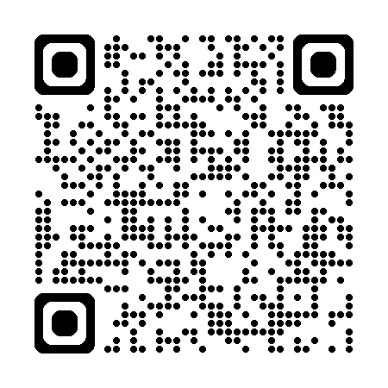
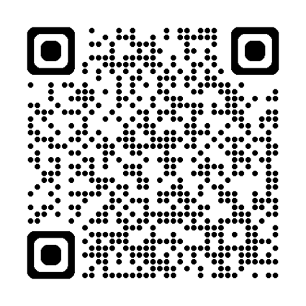
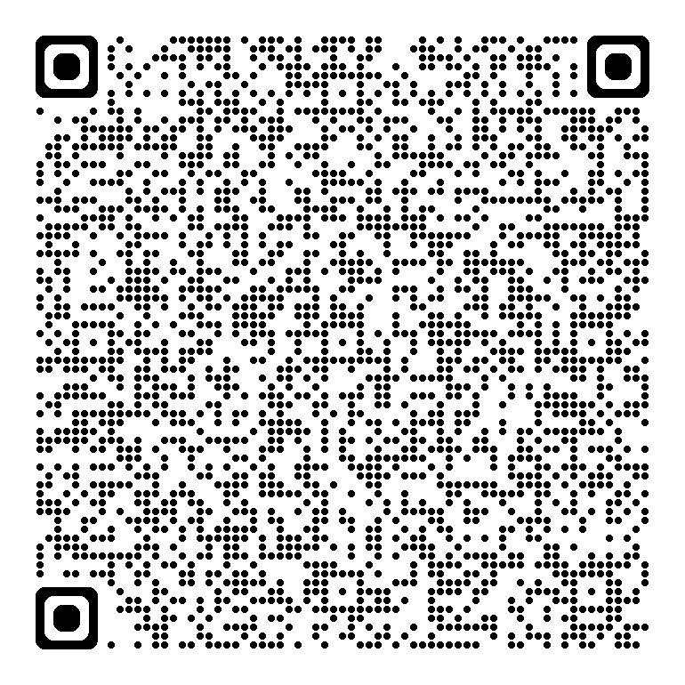
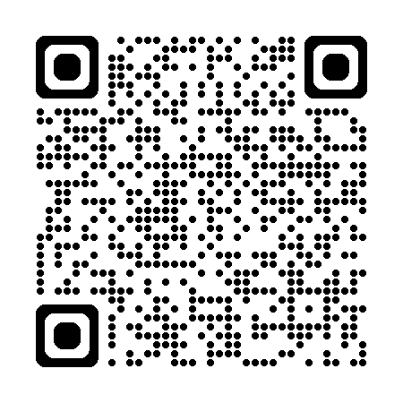
Helpful Links
HCBS Providers Site
Department of Labor
HHAX Resources Library
HHAX Knowledge Base
The links and QR Codes displayed offers Providers a multitude of resources as they pertain to general E&D provider knowledge and properly filing claims.
The HCBS Providers website is where you can find all forms, trainings, and the Administrative Code.
The Department of Labor link directs you to their regulations for paying minimum wage and overtime for your staff of home care workers.
The HHAX Resources Library hosts a series of webinars that may be beneficial to providers seeking to learn more about EVV, training videos, and guides to help grow your homecare agency. This should be your first resource for any issues with HHAX, prior to seeking assistance from their Help Desk, or DOM.
HHAX Knowledge Base also provides training videos, access to HHAX frequently asked questions, a glossary for homecare terms, and troubleshooting guides.
https://medicaid.ms.gov/hcbs-waiver-providers/
https://www.dol.gov/sites/dolgov/files/WHD/legacy/files/homecare_guide.pdf
https://www.hhaexchange.com/resources
https://knowledge.hhaexchange.com/provider/Content/Home/Home-C.htm
Notes:
The links and QR Codes displayed offers Providers a multitude of resources as they pertain to general E&D provider knowledge and properly filing claims.
The HCBS Providers website is where you can find all forms, trainings, and the Administrative Code.
The Department of Labor link directs you to their regulations for paying minimum wage and overtime for your staff of home care workers.
The HHA Resources Library hosts a series of webinars that may be beneficial to providers seeking to learn more about EVV, training videos, and guides to help grow your homecare agency. This should be your first resource for any issues with HHA, prior to seeking assistance from their Help Desk, or DOM.
HHA Knowledge Base also provides training videos, access to HHA frequently asked questions, a glossary for homecare terms, and troubleshooting guides.

Slide 83




Need Technical Assistance?
HHAX
  Billing issues
  Staff unable to clock in/out
  Removing beneficiaries off roster
  Beneficiaries under wrong contract
Gainwell
  Recredentialing applications
  Issues with MESA
  Updating agency contacts and address
  Requesting 1099 tax forms
DOM
  Expanding service area
  Relocating
  Change of Ownership
  Staffing changes
  Audits
  Policy
PDD
  Requesting more hours for clients
  Any adjustments made to PSS
  Missing lock-in on PSS
  Beneficiaries needing transportation
Gainwell Representative Link: Q2-2026-PROVIDER-FIELD-REPRESENTATIVES_Map-and-By-County_v1.0.pdf
Notes:
Our office often receives questions as to who would be the most appropriate point of contact for certain issues. In an effort to give providers a greater understanding of the provision of technical services, we have divided the responsibilities of HHA, Gainwell, DOM, and PDDs.
Any questions relating to HHAX missing authorizations, staff clocking in or out, or discharging beneficiaries will need to be directed towards the HHA Communications Portal or email evv@medicaid.ms.gov
Questions for recredentialing, MESA issues, updating agency contact, or requesting tax forms should be directed towards your local Gainwell Field Provider Representative. You may find their contact information on the linked PDF.
DOM should receive questions for expanding service areas, relocating, changing ownership, staffing changes, or audits. You may call or email us for any inquires.
PDDs work in hand with the beneficiary’s Case Manager. The Case Manager should always be contacted in requests more hours, PSS adjustments, and coordinating transportation.

Slide 84
Staying Informed
  Policy Updates: Get notified when new policies are announced, email a contact name, place of business and a contact number (optional) to DOMPolicy@medicaid.ms.gov
  Late Breaking News: To sign up to receive email alerts every time DOM posts a Late Breaking News update, just email a contact name, place of business and a contact number (optional) to LateBreakingNews@medicaid.ms.gov
  If you have questions about background checks, please contact MS Department of Health CHRCUnit@msdh.ms.gov
  If you have questions about MESA, please contact your Gainwell Regional Field Representative https://medicaid.ms.gov/wp-content/uploads/2026/06/Q2-2026-PROVIDER-FIELD-REPRESENTATIVES_Map-and-By-County_v1.0.pdf
  If you have questions about your responsibilities as an employer, please contact Mississippi’s Department of Labor at 601-965-4347
  If you have policy questions about HHAX or EVV please contact EVV@medicaid.ms.gov
  If you are interested in joining the MS Homecare Provider Association, you can visit their website at https://mshcpa.org/
Notes:
A variety of helpful links have been provided to keep you updated on related policy and regulations.
We encourage all providers to sign up for our policy distribution list and Late Breaking newsletters by contacting the email listed onscreen. Once signed up, you will receive email notifications of all proposed or implemented changes to the Medicaid State Plan, Administrative Code or the any of the Waiver Programs.
If you have any questions regarding background checks, MESA, or your responsibilities as an employer, you may click on the links above to be routed to the appropriate resource.

Slide 85

Staying in Touch
Mississippi Division of Medicaid, Office of Long Term Services & Supports
Phone: (601) 359-6141
Website: https://medicaid.ms.gov/hcbs-waiver-providers/
Email Address: HCBSProviders@medicaid.ms.gov
Address: Office of Long Term Services & Supports
Division of Medicaid
Walter Sillers Building
PO BOX 2222
Jackson, MS 39225
Notes:
To stay in touch with the Division of Medicaid's Office of Long Term Services and Supports, you may reach us by phone, email, or mail.
To effectively communicate responses to inquires, emails sent to the HCBS email account will result in more timely response. We have multiple staff monitoring that account daily.
We also send out a quarterly newsletter called THE SCOOP, this newsletter is specifically for E&D Waiver Providers so be sure to read it when received. The last issue was distributed July 1st, that issue and the prior issue can be found on the HCBS Waiver Providers website.

Slide 86


We want to hear from you!
Currently enrolled providers please share with us your agency’s success and highlight what makes your program unique in servicing your community.
Had a recent activity that participants really enjoyed? Share a few photos and a description of the activity. (If participants are included in photos a signed release form must be submitted to DOM to give authorization for their image to be shared.)
Remodeled or made improvements to your facility? Share the before and after and how it has improved services.
Did you have a really great turnout at your last quarterly advisory committee meeting? Tell us how you did it!
Simply email HCBSProviders@medicaid.ms.gov with a brief description of your success or highlights and attach any photos or videos you’d like to share. We’d love the opportunity to show off the hard work and dedication of DOM’s PCS-IHR Providers!
Notes:
We want to hear your success stories! Let us know what’s going really well for your agency and we’ll feature your business in the next issue of THE SCOOP.

Slide 87


Any Questions?
E&D FAQ Link: https://app.smartsheet.com/b/form/857d8057557a4693a06cb00130302f4c
To receive a training certificate, email HCBSProviders@Medicaid.MS.Gov to request next steps.
Notes:
If you have any questions regarding the topics covered in this presentation, please scan the QR Code and submit any questions/concerns to our E&D Frequently Asked Questions Smartsheet form.

