Slide 1
CIVIL MONEY PENALTY (CMP) GRANT TRAINING
April 10, 2025
Hosted by:
Mississippi Division of Medicaid (DOM) &
Mississippi State Department of Health (MSDH)

Slide 2
What is Civil Money Penalty (CMP)
A CMP is a monetary penalty the Centers for Medicare & Medicaid Services (CMS) may impose against nursing homes for either the number of days or for each instance a nursing home is not in substantial compliance with one or more Medicare and Medicaid participation requirements for long-term care facilities.
A portion of CMPs collected from nursing homes are returned to the states in which CMPs are imposed. State CMP funds may be reinvested to support activities that benefit nursing home residents and that protect or improve their quality of care or quality of life.

Slide 3
How Can CMP Funds Be Used
CMP funds can be used for (but not limited to) the following:
Assistance to support and protect residents of a facility that closes or is decertified.
Time-limited expenses incurred in the process of relocating residents to home and community-based settings or another facility when it closed or downsized pursuant to an agreement with Medicaid
Projects that support resident and family councils and other consumer involvement in assuring quality care in facilities.
Facility improvement initiatives, such as joint training of facility staff and surveyors
Technical assistance for facilities implementing quality assurance and performance improvement programs.

Slide 4
FACTS WORTH KNOWING
As of March 31, 2025 there is $15,716,355.97 in Mississippi’s CMP trust fund.
CMP Funds Spent During CY 2024 on CMP Projects: $40,226.67
CMP Funds Added During CY 2024:
$1,154,295.52

Slide 5
Who Can Apply For CMP Funds
Funds may be granted to any entity for proper use of Centers for Medicare & Medicaid Services (CMS) approved CMP projects to protect or improve the quality of life or quality of care for long-term care (LTC) facility residents - provided the responsible receiving entity is:
Qualified and capable of carrying out the intended project or use;
Not in any conflict-of-interest relationship (or the appearance of conflict-of-interest) with the entity or entities that will benefit from the intended project or use;
Not paid by a State or Federal source to perform the same function as the CMP project or use. CMP funds may not be used to enlarge or enhance an existing appropriation or statutory purpose.

Slide 6
Non-Allowable Uses of CMP Funds
Conflict of Interest Prohibitions
Duplication
Capital Improvements
Nursing Home Services or Supplies
Supplementary Funding of Federally Required Services
Complex Technology
Research
Charging for Nursing Home Employee Salary
Palliative Care Services
Dental, Vision, Hearing Services
Incentives
Telemedicine Services & Equipment

Slide 7
Allowable Uses of CMP Funds
Resident or Family Councils: CMP funds may be used for projects by not-for-profit resident advocacy organizations that: Assist in the development of new independent family councils;
Assist resident and family councils in effective advocacy on their family member’s behalf;
Develop materials and training sessions for resident and family councils on state implementation of new federal or state legislation.
Maximum project funding per nursing home-$5,000 (one-time funding)
Consumer Information: CMP funds may be used to develop and disseminate information that is directly useful to nursing home residents and their families in becoming knowledgeable about their rights, nursing home care processes, and other information useful to a resident. For example, developing educational materials (e.g., flyers, brochures, booklets, web-based materials, etc.)
Maximum project funding per nursing home-$5,000 (one-time funding)

Slide 8
Allowable Uses of CMP Funds
Training to Improve Quality of Care: CMP funds may be considered for training in facility improvement initiatives that are approved by CMS. Training topics include, but are not limited to:
Alzheimer’s Disease and Dementia, Cultural Change
Wound Care, Person-Centered Care
Patient Safety, Safe Medication Management
Trauma Centered Care, Oral Health
Pain Management, Non-Pharmaceutical Solutions
Cultural Sensitivity, Fall Education
Maximum Project Funding Per Nursing Home Per Year -$5,000, (max of $15,000 for a three-year project).

Slide 9
Allowable Uses of CMP Funds
Activities to Improve Quality of Life: CMP funds can be used for projects to foster social interaction, movement, and minimize loneliness. Projects include, but are not limited to:
Horticulture/Gardening
Music Therapy
Animal Therapy Including Robotic Pets
Activities and games fostering movement and function- This may include activities (e.g., Tai Chi), group games (e.g., bingo with movement components).
Reading and Memory Interventions
Crafting
Maximum Project Funding Per Nursing Home Per Year for each topic -$5,000, (max of $15,000 for a three-year project)

Slide 10
Overview of the Process
Get all involved parties onboard with the project.
Obtain letters of support from all participating nursing facilities.
Develop and write the grant.
Submit the grant application to the CMP grant mailbox (CMPGrants@medicaid.ms.gov).
State review team reviews your application – within 30 days of receipt to mailbox.
Submission to CMS by MSDH.

Slide 11
Overview of the Process
CMS determination letter – within 45 days of receipt.
Grantee sets up MAGIC account – upon grant approval.
Sub-grant by DOM Office of Procurement and Contracts to be signed by Executive Director and grantee’s signatory.
Grantee Submits invoice(s) to DOM through the CMP grant mailbox.
Grantee submits Quarterly, Follow Up, and Final reports through the CMP grant mailbox. All communication to Medicaid should be submitted to CMPGrants@medicaid.ms.gov.

Slide 12
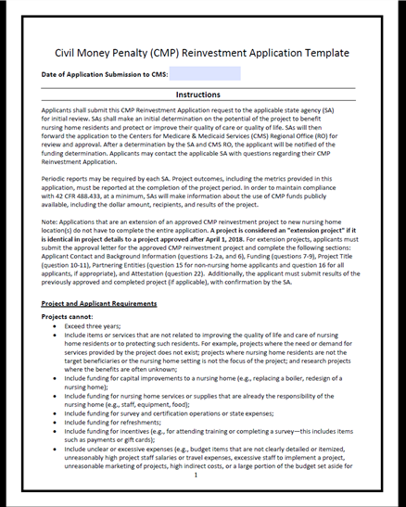
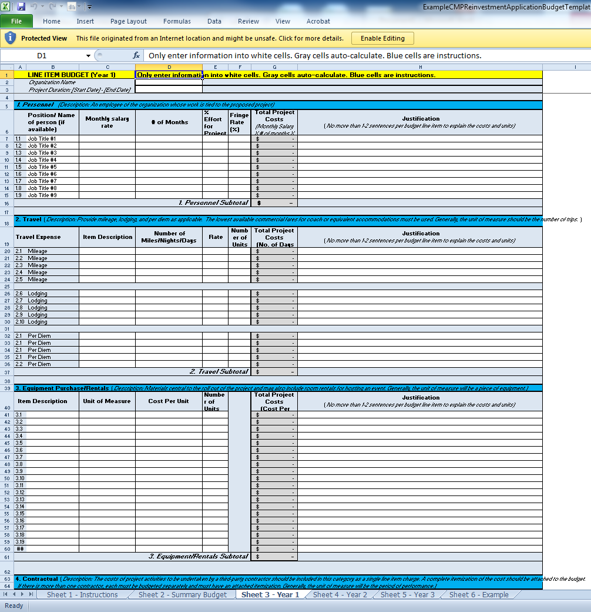
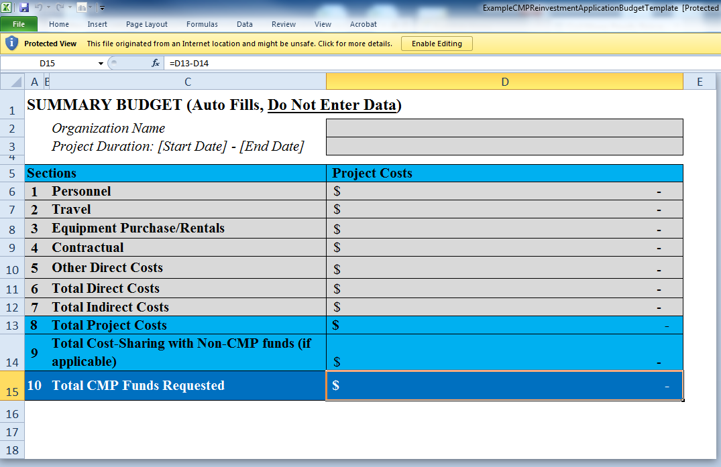
Civil Money Penalty Reinvestment Application Template
Notes:
CMS and the CMPRP have made a new application template available. It also includes a budget , which the older application did not have.
Many of the times, request for additional information at the State and CMS level, is regarding budget items, so this is a great change.
We feel this is going to help applications to be processed faster at the State and CMS level.
Effective January 1, 2020, all grant applications are required to be on the new application with the new budget.
There is an Application Resource Guide with helpful information. The new application, budget, and resource guide are posted to the Medicaid CMP webpage under Resources.

Slide 13
State Specific Information For Application and Process
  The same project leader is not allowed for more than one project at a time for the project’s length, unless this is the project leader’s only job.
  A secondary or back up point of contact (project leader) is required.
  Applicant should project the start of the project 8 months out to account for the State, Federal, and Subgrant approval process.
  The budget should not include any sales tax.
  The Subgrant process is completed after the grant is approved and before any funds are disbursed.
  The grant payee must set up a MAGIC account to receive payment.
  Medicaid Long Term Care staff will send a survey or make an on-site visit within their grant period timeframe.

Slide 14
Application Completion Tips
#1. Applicant Contact Information: Mississippi requires both a Primary and Secondary Point of Contact. The Primary Point of Contact is responsible for the project implementation. Identify both the Primary and Secondary Points of Contact .
#10. Project Title: Name your project well. Your grant project will be listed by its name on State and Federal Reports and posted on Medicaid and CMS websites.
#11. Project Time Period: In deciding your project’s length, give an adequate amount of time to implement your project, collect data and analyze the effectiveness of the project. However, consider the commitment of reporting for the project’s duration.

Slide 15
Application Completion Tips
#13. Summary of the project and its purpose is a very important section. What problem or gap are you trying to improve? What is your quantifiable goal? Include your plan and timeline for implementation. Your goal or objective with metrics must be reflected in both Quarterly and Final Reports.
If the point of contact (project leader) did not write the grant application, they must be knowledgeable of its contents. If the point of contact changes within the time period, the secondary or back up point of contact must be knowledgeable of the project’s goals and objectives and responsible to carry out the project.
It is the responsibility of the grantee to notify Medicaid and CMS of any changes in the Point of Contact.

Slide 16
Application Completion Tips
#16. Other Partnering Entities: If there are any other entities, individuals, organizations, associations, or facilities that will receive funds through this project, you will need to list contact names, addresses, email addresses, and telephone numbers for each entity. This is in addition to how much funding they will receive and their specific deliverable. This information will facilitate the approval of invoices.

Slide 17
Quarterly Report Template
Each report shall include a cover letter in addition to the Civil Money Penalty Grant Quarterly Report Template.
Each report page must include the following:
    Project Title
    CMP Request Number
    Project Leader or Primary Point of Contact’s name
    Project Leader or Primary Point of Contact’s email address
    Project Leader or Primary Point of Contact’s phone number
CMS award date (The quarter begins with the award letter date)
This quarterly report’s three-month time period
Sub grant (state contract) terms
Project’s goals to include metrics if applicable

Slide 18
Quarterly Report Template
Quarterly narrative should include new findings, project updates, progress toward implementation timeline, deliverables and goals, successes, pitfalls, and adherence to the budget. Quarterly reports must comply with the CMS Award Letter and contain the following:
    Progress made on the project during the past quarter
    Progress made toward stated goals
    Any difficulties encountered
    Plans to address difficulties
    Goals for the next quarter
    How the project has benefited the residents over the past quarter
    Quarterly reports are due within thirty (30) days of the quarter’s end.
Submit report to CMPGrants@medicaid.ms.gov and Stephanie Davis at Stephanie.Davis@CMS.hhs.gov.

Slide 19
Final Report Template
Each report shall include a cover letter in addition to the Civil Money Penalty Grant Final Report Template.
Each report page must include the following:
    Project Title
    CMP Request Number
    Project Leader or Primary Point of Contact’s name
    Project Leader or Primary Point of Contact’s email address
    Project Leader or Primary Point of Contact’s phone number
CMS Award Letter date.
Sub grant (state contract) terms.

Slide 20
Final Report Template
Final Report narrative shall include:
    The purpose of the project;
    The expected outcomes;
    The project’s quantifiable goal(s)/objective(s)
    The actual outcomes;
    The project’s results including the specific goals met/not met
    The number of residents that benefited from the project;
    The status of the action plan for sustainability if the project will continue beyond the grant funding period; and
    All other requested information described in the Award Letter.
Final report is due within fifteen days of the project conclusion.
Submit report to CMPGrants@medicaid.ms.gov and Stephanie Davis at Stephanie.Davis@CMS.hhs.gov.

Slide 21
Follow-Up Report
Follow-Up Report: The report will include a financial statement accounting for the use of all CMP funds. The statement shall be certified as true, complete, and accurate by the Chief Executive Officer or the Chief Financial Officer of the organization.
Follow-Up Report is due within five (5) days of the project’s completion.
Submit report to CMPGrants@medicaid.ms.gov and Stephanie Davis at Stephanie.Davis@CMS.hhs.gov.

Slide 22
Grant Monitoring
Timely submission of Quarterly, Follow Up, and Final Reports.
The Quarterly Reports are reviewed for addressing progress towards your goals and must include data per CMS and State Agency requirements. For example: include the number of nursing facility residents, facility staff and/or facilities affected.
The Final Report must also include your project’s results with data. In addition, include any lessons learned or challenges.
Failure to submit reports could impact receiving a future award.

Slide 23
Grant Monitoring
It is the Project Leader’s responsibility to submit all reports to both CMS and Medicaid.
DOM will send a survey or make an on-site visit to recipients of grant funds within the grant period timeframe.
Invoices must have supportive documentation such as receipts of equipment, supplies, travel and time records and be submitted on facility or company letterhead.
DOM Office of Accounting reports the CMP account balance quarterly to CMS.

Slide 24
CMP Medicaid Resources
Civil Money Penalty Grant Awards Program - Mississippi Division of Medicaid
2025 Civil Money Penalty Reinvestment State Plan
Civil Money Penalty Grant Training
Civil Money Penalty Grant Final Report Template
Civil Money Penalty Grant Application Announcement
Civil Money Penalty Grant Frequently Asked Questions
Civil Money Penalty Sub-Grant Template
Civil Money Penalty Grant Quarterly Report Template
Civil Money Penalty Reinvestment Application Template – effective September 2023
Civil Money Penalty Reinvestment Application Resource Guide
Civil Money Penalty Reinvestment Application Budget Template – effective September 2023
State CMP Reinvestment Projects
https://medicaid.ms.gov/programs/civil-money-penalty-cmp-grant-awards-program/

Slide 25
CMS CMP Resources
Civil Money Penalty Reinvestment Program | CMS
CMP Reinvestment FAQs - https://www.cms.gov/files/zip/cmp-reinvestment-website-frequently-asked-questions-updated-september-2023.zip
CMP Application Resources - https://www.cms.gov/medicare/provider-enrollment-and-certification/surveycertificationgeninfo/downloads/cmp-reinvestment-application-resources.zip
Allowable and Non-Allowable Uses of CMP Funds - https://www.cms.gov/files/zip/allowable-and-non-allowable-uses-cmp-funds.zip
Mental & Behavioral Health Support CMP Applications - http://www.nursinghomebehavioralhealth.org/
If you have CMPRP questions email the CMPRP Team at - CMP-info@cms.hhs.gov.

