Slide 1

Office of the Governor | Mississippi Division of Medicaid
The Division of Medicaid
Adult Day Care Services
Provider Training
Office of Long Term Services and Support
June 27, 2025

Slide 2

Who is this training for?
This training is for providers who are currently enrolled to provide Adult Daycare (ADC) Services under the MS Division of Medicaid Elderly & Disabled (E&D) Waiver.
Training should be completed by:
  Agency Owner
  Administrator and/or
  Program Director
  If the individual completing this training exits the company, the training must be completed by the individual hired to fill that vacant role. If there is a new owner or partnership is with to the agency, they must also complete and attest to this training.

Slide 3
New Provider Orientation
If you are not yet enrolled as a Medicaid Waiver Provider of E&D Adult Day Care Services, you may continue to review the following training materials; however, you will also be required to complete the New Provider Orientation as part of the enrollment process.
HCBS Waiver Providers - Mississippi Division of Medicaid

Slide 4

Throughout this presentation you will see the purple “MORE INFO” graphic. Click this graphic for a pop-up with additional information or helpful tips.
Click the pop-up box again to collapse the box and move to the next slide.

Slide 5

Overview of Training
DOM HCBS Team
Overview of the Waiver Program
Covered Services
Admin Code Changes
Training Topics
Organizational Changes
Facility Requirements
Staffing Requirements
Primary & Auxiliary Services
Records Maintenance
Additional Resources
Marketing, Referrals & PSS
Annual Updates for FOC List
Quality Management
Resources for Success
Introduction
This presentation is color coded with the corresponding colors shown under Training Topics. This will help you quickly locate the topics for future reference.
Please note the blue “changes” symbol beside Admin Code Changes. When you see this symbol know this indicates any changes or clarifications made in the Admin Code.
Notes:
This presentation is color coded with the corresponding colors shown under Training Topics. This will help you quickly locate the topics for future reference. Please note the “changes” symbol beside Admin Code Changes. When you see this symbol know this indicates any changes or clarifications made in the Admin Code.

Slide 6

Introduction

Slide 7

LTSS
Long Term Services & Support
Organizational restructuring at the Division of Medicaid has resulted in HCBS Provider Relations being moved under the Office of Long Term Services and Supports (LTSS). As we continue to work in collaboration with the Office of Long Term Care, we also provide supports to Waiver Providers under the Intellectual Disabilities/Developmental Disabilities (ID/DD) & Community Support Programs (CSP).

Slide 8
LTSS Team
Misty Jenkins
Senior Director
Long Term Services & Supports
Nancy Dampier
Director
HCBS Provider Relations
Gabrielle Grant
LTSS Solutions Manager
Paulette Johnson
Director
Long Term Care
Kenosha Williams
Lead Reviewer
E&D Provider Enrollment
Alexis Martin
Reviewer
E&D Provider Enrollment
Penelope Boyd
CSP Beneficiary Support
Terri Wilkerson
E&D Beneficiary Support
Estel Stringer
ID/DD Beneficiary Support
8

Slide 9
Elderly & Disabled Waiver:
Home and Community Based Services
The E&D Waiver is administered and operated by the Division of Medicaid.
Beneficiaries enrolled in the E&D Waiver must reside in a private residence that is fully integrated with opportunities for full access to the greater community and meets the requirements of a Home and Community-Based (HCB) setting in 42 C.F.R. § 441.301(c)(4) and (5).
Beneficiaries enrolled in the E&D Waiver are prohibited from receiving additional Medicaid services through another waiver program.

Slide 10
E&D Waiver Beneficiary Eligibility Criteria
Beneficiaries must have BOTH financial eligibility, as determined by the Regional Office, and clinical eligibility, as determined by the Division of Medicaid office of Long Term Services & Supports.
Who is Eligible?
Must be twenty-one (21) years of age or older.
Must require nursing facility level of care as determined by a comprehensive long-term services and supports (LTSS) assessment.
Must meet the criteria in one (1) of the following Categories of Eligibility (COE):
Supplemental Security Income (SSI) eligible under 20 C.F.R. § 416.202, or
An aged, blind or disabled individual who meets all factors of institutional eligibility.
If income exceeds the current institutional limit, the individual must pay the Division of Medicaid the portion of their income that is due under the terms of an Income Trust to qualify.
Beneficiaries enrolled in the E&D Waiver cannot reside in a nursing facility or licensed or unlicensed personal care home.
In the event of imminent danger to the beneficiary, caregiver or service provider, the beneficiary may be discharged from the waiver immediately.
Notes:
Beneficiaries must have BOTH financial eligibility, as determined by the Regional Office, and clinical eligibility, as determined by the Division of Medicaid office of Long Term Services & Supports.

Slide 11

Covered Services
  The Division of Medicaid covers certain home and community-based services as an alternative to institutionalization in a nursing facility through the Elderly and Disabled Waiver (E&D). These services are:
    Adult Day Care Services
    Personal Care Services
    In-Home Respite Services
    Case Management
    Environmental Safety Services
    Medication Management
    Home Delivered Meals
    Institutional Respite
    Extended Home Health
Notes:
There are many services covered under the E&D Waiver, but this training covers Adult Day Services.

Slide 12

Adult Day Care Service is designed to meet the needs of aged and disabled individuals through:
Individualized Care Plan
Provision of meals
Transportation to and from the site
Social, health and recreational activities
Information on and referral to vocational services

Slide 13

Administrative Code Part 208, Chapter 1
Home and Community Based Services
Administrative Code Part 208, Chapter 1 is currently available for review on the website. Throughout this presentation will be several links to additional resources, this will all be available on the HCBS Providers webpage.
Link: Administrative Code
Notes:
Administrative Code Part 208, chapter 1 is currently available for review on the website. Throughout this presentation will be several links to additional resources, this will all be available on the HCBS Providers webpage.

Slide 14
Administrative Code Part 208, Chapter 1
Adult Day Care Services
When you see the blue “changes” sign, that indicates a change or clarification made in the admin code.
Some of the most impactful changes for ADC providers in the updated Admin Code, effective June 1, 2025, are:
  Mandatory staffing changes
  Clarification in the requirements for food service
  Updated transportation requirements
  Required reporting
  Updates to organizational requirements
Notes:
When you see the “changes” picture, that indicates a change or clarification made in the admin code.

Slide 15

Training Topics

Slide 16
Organizational Changes
Change of Ownership
Relocations
Business Line of Credit
Billing

Slide 17
Changes of Ownership (CHOW)
Our Office frequently sees providers who are selling their business without notifying the Division of Medicaid timely. We’d like to remind everyone that there cannot be a transfer of ownership of your Medicaid issued provider ID without first notifying Medicaid. We must ensure that the new owners are qualified to provide the services and go through all required credentialing. As a reminder, the NEW owner is responsible for maintaining all files and documents from the previous owner for auditing purposes.
The new owner is assuming all responsibility and liability for all claims that were filed prior to the transfer. A provider/facility that undergoes a change of ownership must notify the Office of LTSS within ten (10) days, and the Office of Provider Enrollment within thirty-five (35) days after any change in ownership.
A CHOW packet must be received, reviewed, and approved by the Office of Long-Term Services & Supports before the provider can complete a Mississippi Medicaid Provider Application Packet.
The new provider must continue to maintain all Medicaid beneficiary records for at least five (5) years, unless an alternative method for maintaining the records has been established in writing and approved by the Division of Medicaid as required by Health Insurance Portability and Accountability Act of 1996 (HIPAA).
Notifying DOM of Change of Ownership within 35 days of change
Completing a CHOW application with LTSS
New owner must maintain beneficiary file records for a minimum of five (5) years
Notes:
Our Office frequently sees providers who are selling their business without notifying the Division of Medicaid timely. We’d like to remind everyone that there cannot be a transfer of ownership of your Medicaid issued provider ID without first notifying Medicaid. We must ensure that the new owners are qualified to provide the services and go through all required credentialing. As a reminder, the NEW owner is responsible for maintaining all files and documents from the previous owner for auditing purposes.
The new owner is assuming all responsibility and liability for all claims that were filed prior to the transfer. A provider/facility that undergoes a change of ownership must notify the Office of LTSS within ten (10) days, and the Office of Provider Enrollment within thirty-five (35) days after any change in ownership.
A CHOW packet must be received, reviewed, and approved by the Office of Long-Term Services & Supports before the provider can complete a Mississippi Medicaid Provider Application Packet.
The new provider must continue to maintain all Medicaid beneficiary records for at least six (5) years, unless an alternative method for maintaining the records has been established in writing and approved by the Division of Medicaid as required by Health Insurance Portability and Accountability Act of 1996 (HIPAA).

Slide 18
Transactions that constitutes a CHOW are:
Partnership to limited liability company, or single proprietorship to organization)
Mergers, when a new organization is formed, and the merging companies are non surviving
Consolidation of two or more corporations resulting in a new corporate entity
Removal, addition, or substitution of one or more individuals as partners (under Mississippi law, these actions result in dissolution of an older partnership and creation of a new one)
Transfers between different levels of government, such as city to county, state to county, etc.
Transfer (sale, gift, exchange of stock) that results in a fifty (50) percent or more change.
These are examples of changes of ownership. This list is not exhaustive. A few things to consider here that we’ve seen impact providers: if you have a business partnership and one partner passes away, this is a change in ownership and must be reported. If you plan to pass your business to another business partner or relative in the event of your death or disability, we recommend having them added as a partner now, even with as little as 1% ownership, so that in those events, your business can continue providing care uninterrupted. Providers should contact the Division of Medicaid’s Office of Long Term Services & Supports to begin this process.
Notes:
The following are examples of changes of ownership. This list is not exhaustive. A few things to consider here that we’ve seen impact providers: if you have a business partnership and one partner passes away, this is a change in ownership and must be reported. If you plan to pass your business to another business partner or relative in the event of your death or disability, we recommend having them added as a partner now, even with as little as 1% ownership, so that in those events, your business can continue providing care uninterrupted. Providers should contact the Division of Medicaid’s Office of Long Term Services & Supports to begin this process.

Slide 19
Relocations
Providers must submit any proposed changes to location, supervisory staffing, or organizational contact information, to the Division of Medicaid Office of LTSS for approval prior to implementing the requested change.
If you’re planning to relocate, contact our office first. We are happy to do a virtual walk though with you of your new location.
The Office of Long Term Services & Supports must complete a virtual site visit to ensure that the new location meets the requirements of an ADC facility before owner signs a new lease agreement or purchase.
Provider must complete a relocation packet through the LTSS Office for review and an onsite visit will be completed for final approval.
Once the new location is approved, providers must submit a Change of Address form in MESA.
Notes:
Providers must submit any proposed changes to location, supervisory staffing, or organizational contact information, to the Division of Medicaid Office of LTSS for approval prior to implementing the requested change.
If you’re planning to relocate, contact our office first. We are happy to do a virtual walk though with you of your new location.

Slide 20
Business Line of Credit
Establish and maintain a business line of credit for business operations from either a financial institution licensed to conduct banking or other Financial Deposit Insurance Corporation (FDIC) or National Credit Union Administration (NCUA) insured financial institutions.
The approval amount for the business line of credit must be enough to cover operational costs/expenditures for at least three (3) months at all branch locations.
Prior to the implementation of MESA, newly enrolling providers were required to establish a business line of credit.
With updates to the Administrative Code, all E&D providers are required to establish and now maintain a business line of credit for operations as proof of financial solvency.
To ensure continuity of business operations and member services, providers must maintain a line of credit available to use in the event that there are reimbursement delays in claims processing with the Division of Medicaid. The line of credit will ensure that your agency can continue payroll processes.
Notes:
Prior to the implementation of MESA, newly enrolling providers were required to establish a business line of credit.
With updates to the Administrative Code, all E&D providers are required to establish and now maintain a business line of credit for operations as proof of financial solvency.
To ensure continuity of business operations and member services, providers must maintain a line of credit available to use in the event that there are reimbursement delays in claims processing with the Division of Medicaid. The line of credit will ensure that your agency can continue payroll processes.

Slide 21
Billing
Providers must bill for Elderly and Disabled (E&D) Waiver services no sooner than the first (1st) day of the month following the month in which services were rendered.
Claims must be based on services that have been rendered to beneficiaries as authorized by the Plan of Services and Supports (PSS), accurately billed by qualified waiver providers, and in accordance with the approved waiver.
Providers must submit claims billed in fifteen (15) minute increments for the duration of time the services were provided, and the provider will be reimbursed by the Division of Medicaid the lessor of the maximum daily cap or the total amount of the fifteen
(15) minute increment units billed for that day.
Providers must submit claims billed in fifteen (15) minute increments for the duration of time the services were provided.
The provider will be reimbursed by the Division of Medicaid the lessor of the maximum daily cap or the total amount of the fifteen (15) minute increment units billed for that day.
Notes:
Providers must submit claims billed in fifteen (15) minute increments for the duration of time the services were provided. The claims must reflect actual time in and actual time out each day.
The provider will be reimbursed by the Division of Medicaid the lessor of the maximum daily cap or the total amount of the fifteen (15) minute increment units billed for that day. In simpler terms, providers bill for the full time of services rendered and the system will cap the claim at the allowed maximum.

Slide 22
The Division of Medicaid conducts post-payment utilization reviews to ensure the services provided were on the beneficiary’s approved PSS.
Records documenting the provision of services must be maintained by the providers of waiver services for a minimum of five (5) years.
If, at the conclusion of the five-year period, there is ongoing litigation or an open audit, the provider must maintain these records until the litigation or audit is concluded.
Billing Documentation
Billing documentation must include beneficiary or representative signature to substantiate services.
Representatives cannot own or be employed by the provider agency.
If additional guidance is needed, reach out to our office.
Notes:
Admin Code Rule 1.10 Reimbursement
Later in this presentation there is more information on the types of documentation required, and some tips on appropriate storage and retention of those records.

Slide 23

Change of Ownership
Relocations
Business Line of Credit
Billing
Failing to notify LTSS of organizational changes in ownership and/or partnership within required time frame.
Failing to receive building approval from LTSS prior to relocating.
Failing to maintain a business line of credit after approval and receiving a provider number.
Failing to bill for total units of service provided to beneficiary.
Frequent Issues of Non-Compliance
Organizational Changes

Slide 24
Facility Requirements
Building
Facility Maintenance

Slide 25

Building Requirements
ADC facility must have a well-maintained facility which includes:
Safe, home like environment
Activity space
ADA compliant restroom
ADA Parking
Rest area
Employee space
Locked storage
Two main ADA compliant exit doors
Adequate seating
ADC facilities require on-site review by the Office of Long Term Service & Supports prior to Waiver services being rendered. The facility must be well maintained, both inside and out.
As previously covered, providers are prohibited from relocating without prior approval from our office.
The following slides will help you ensure you obtain and maintain compliance with physical site requirements.
Notes:
ADC facilities require on-site review by the Office of Long Term Service & Supports prior to Waiver services being rendered. The facility must be well maintained, both inside and out. As discussed earlier, providers are prohibited from relocating without prior approval from our office. The following slides will help you ensure you obtain and maintain compliance with physical site requirements.

Slide 26
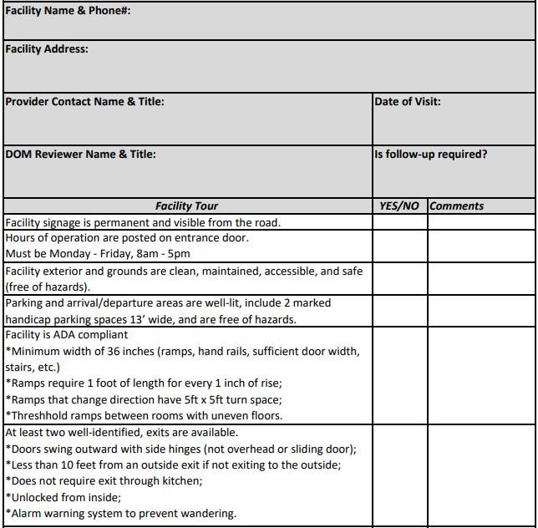
ADC Facility Review Attestation
The 3-page ADC Facility Review Attestation was designed to help ADC providers understand site requirements, including but not limited to ADA compliance, fire safety, food service, and transportation. ADC providers can use this tool to identify areas that need to be addressed in their current facility, or to identify if a potential new facility is appropriate for use as an ADC.
Addresses:
  Building requirements
  ADA regulations
  Interior furnishing
  Fire safety
  Food service
  Transportation
Link: ADC Initial Facility Review.xlsx
Notes:
The 3-page ADC Facility Review Attestation was designed to help ADC providers understand site requirements, including but not limited to ADA compliance, fire safety, food service, and transportation. ADC providers can use this tool to identify areas that need to be addressed in their current facility, or to identify if a potential new facility is appropriate for use as an ADC.

Slide 27
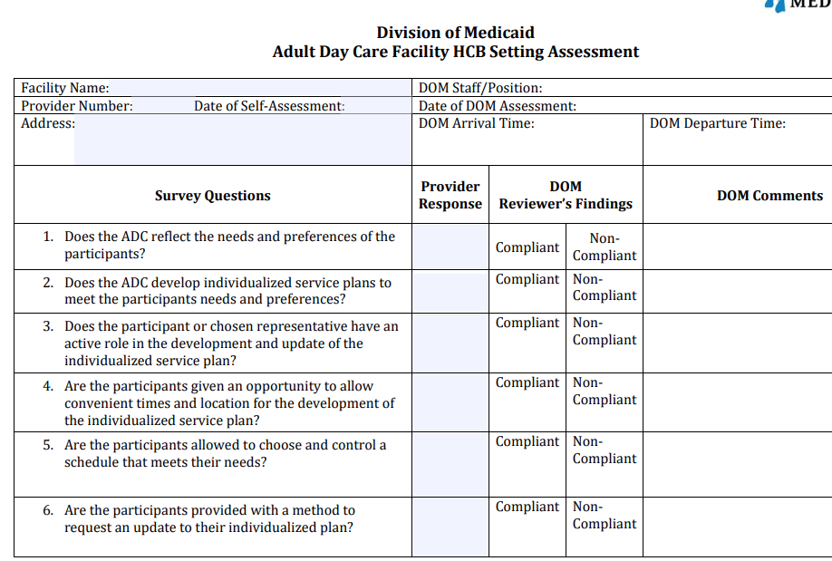
ADC Facility Setting Annual Assessment
CMS issued a final rule in 2014 to address the settings requirements for all ADC providers to ensure they are safe and homelike. Providers should be completing this annually and going over it with your staff so they are aware of the requirements.
This 4-page self-assessment tool helps ADC providers ensure they are in compliance with regulations set by CMS final rule in 2014.
The requirements reflect CMS’ intent that all waiver beneficiaries receive services in settings that are integrated in and support full access to the community.
Link: Adult Day Care HCB Assessment Fillable Form 9.2021
Notes:
CMS issued a final rule in 2014 to address the settings requirements for all ADC providers to ensure they are safe and homelike. Providers should be completing this annually and going over it with your staff so they are aware of the requirements.

Slide 28
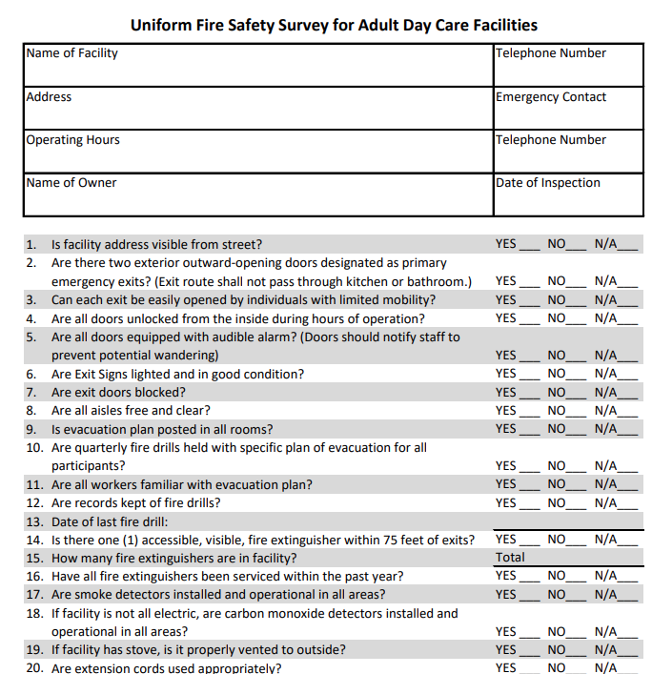
Uniform Fire Safety Survey
The Fire Safety Survey should be used to ensure your facility meets fire safety requirements.
In addition to annual fire inspections, providers must also be completing and documenting quarterly drills for fire & inclement weather.
Completed during enrollment
Annual inspections required
Must be kept on file for audit
In addition to the annual fire safety surveys, providers must also perform quarterly drills for fire and inclement weather. Documentation of these drills must be maintained and available for audit.
Link: Fire-Safety-Inspection-for-ADC-.pdf
Notes:
The Fire Safety Survey should be used to ensure your facility meets fire safety requirements. In addition to annual fire inspections, providers must also be completing and documenting quarterly drills for fire & inclement weather.

Slide 29
Facility Maintenance
Documents & Logs:
Annual Fire Safety Inspection
Maintenance Plans:
Schedule for regular disposal of expired foods
Schedule replacement of blown out light bulbs throughout the facility.
Schedule daily rounds to ensure adequate supply of tissue, soap and paper towels in restrooms
Schedule for testing exit alarms, smoke detectors, & fire extinguishers
Policy for Repairs & Maintenance
Log of Maintenance, Repairs, & Janitorial Services
Pest Control
Annual Facility Review Attestation
Protocols of storage of toxic chemicals
ADC facility records must include documentation of maintenance and janitorial services, including which staff are responsible for identifying and correcting needed repairs. Someone must be responsible for disposing expired foods, testing alarms, restocking supplies, and so forth.
Notes:
ADC facility records must include documentation of maintenance and janitorial services, including which staff are responsible for identifying and correcting needed repairs. Someone must be responsible for disposing expired foods, testing alarms, restocking supplies, and so forth.

Slide 30
Exit doors:
Alarms missing or inoperable
Exit signs missing or inoperable
Hard to open/close
Improper direction of swing
Locked from inside
Clutter:
Rest area used as junk storage
Doorways and exits blocked
Office space cluttered and unorganized
Storage closets/area accessible to beneficiaries
Other:
Damaged ceiling tile
Pest infestations
Lack of cleanliness of facility
Lack of ADA compliant ramps, rest rooms (participants), and passageways
Use of participant restrooms by employees
Inoperable call buttons
Torn and damaged furniture
Inadequate lighting throughout facility
Lack of thresholds and damaged flooring
Toiletries for the restroom (paper towels, soap, tissue)
Frequent Issues of Non-Compliance
Building & Facility Maintenance

Slide 31
Staffing Requirements
Organizational Chart example
Staff Qualifications & Credentials
Background, OIG, and Nurse Aide Registry Checks

Slide 32

Administrator/CEO/President
Program Director
Licensed Nurse
Activities Director
Food Services Coordinator/ Food Server
Program Assistant
Driver
Organizational Chart
When sending updated organizational charts to DOM, please use the shown template and include the names & job titles of the staff assigned to each role.
Providers must employ (as a W2 employee) all staff listed on the organizational chart shown, with the exception of the role of licensed nurse, which may be contract staff.
Driver and Food Server may be replaced with the use of transportation or catering contracts.
All staff must complete the training requirements detailed in Administrative Code, Part 208 Rule 1.3C
There must be at least two (2) persons, with one (1) being a paid employee, at the adult daycare center at all times when there are beneficiaries in attendance.
The employee-to-attendee ratio must be a minimum of one to six (1:6) in all programs except in programs serving a high percentage of day service attendees who are severely impaired which must maintain an employee ratio of one to four (1:4).
Notes:
When sending updated organizational charts to DOM, please use the above template and include the names & job titles of the staff assigned to each role.
Providers must employ (as a W2 employee) all staff listed on the organizational chart shown, with the exception of the role of licensed nurse, which may be contract staff.
Driver and Food Server may be replaced with the use of transportation or catering contracts.

Slide 33
Staffing & Qualifications
Administrator/CEO/President
A master’s degree and one (1) year supervisory experience, either full-time or an equivalent, in a social or health service setting, or
A bachelor’s degree and three (3) years supervisory experience, either full-time or an equivalent, in a social or health service setting; or comparable technical and human service training with demonstrated competence and experience as a manager in a health or human service setting.
Developing administrative policies and procedures;
Developing resources for the facility, including fund-raising, grant writing, budget development, and fiscal monitoring;
Ensuring compliance with licensing and funding regulations;
Facilitating and organizing advocacy efforts;
Assessing the facility’s progress in accordance with established goals and objectives and quality assurance plan;
Implementing board policies; and
Hiring and supervising staff.
Duties may include:
Administrator must have:
The administrator or CEO is responsible for developing administrative policies, hiring staff, and fiscal management. This role is not required to be on-site full time.
Please refer to Administrative Code, Part 208, Rule 1.3 for full staffing requirements.
Notes:
The administrator or CEO is responsible for developing administrative policies, hiring staff, and fiscal management. This role is not required to be on-site full time.

Slide 34
Staffing & Qualifications
Full-time Program Director (on-site)
Program Director must have:
Planning the ADC services to meet individual needs of the participants,
Duties may include supervision of or direct responsibility for the following:
Liaison with community agencies, and
Providing services to individuals and families when necessary.
A bachelor’s degree in health, social services, or a related field and one (1) year supervisory experience, either full-time or an equivalent, or
Comparable technical and human services training with demonstrated competence and experience as a manager in a health or human services setting.
Ensuring compliance with licensing and funding regulations in absence of Administrator/CEO/Owner,
If the Administrator is not on-site full time during operating hours, then a program director is required to oversee the planning ADC services to ensure individual needs are met.
Please refer to Administrative Code, Part 208, Rule 1.3 for full staffing requirements.
Notes:
If the Administrator is not on-site full time during operating hours, then a program director is required to oversee the planning ADC services to ensure individual needs are met.

Slide 35
Staffing & Qualifications
Licensed Nurse
Contract or On Staff
Must be on-site a minimum of (8) eight hours per week during normal business hours, when beneficiaries are present.
Must have:
Duties may include:
A valid state license
Minimum of one (1) year applicable experience, either full-time or equivalent.
Must adhere to the scope of practice pursuant to the Nursing Practice Law and the rules and regulations of the Mississippi Board of Nursing.
The service hours must be tracked on a service log, including date, time in and time out.
Must be available on call as needed.
Assist with preparation and administration of Individual Service Care Plan, nutritional assessments, and oversight of all health-related activities and services.
Notes:
A licensed nurse is required to be on site at least 8 hours per week during normal business hours when beneficiaries are present. This replaces the previous requirement to have an RN on-site full time.

Slide 36
Staffing & Qualifications
Activities Coordinator
Full Time
Must be on-site daily.
Must have:
Duties may include:
Bachelor’s degree and at least one (1) year of appropriate experience, either full-time or an equivalent, in developing and conducting activities for the type of population to be served, or
An associate degree in a related field and at least two (2) years of appropriate experience, either full-time or equivalent.
Assist with preparation and administration of Individualized Care Plan.
Plans and manages daily activities.
Assist with transportation.

Slide 37

Staffing & Qualifications
Program Assistants are responsible for providing assistance to beneficiaries and may assist with escorting beneficiaries during transportation.
If food is prepared on-site, a ServSafe Certified employee is required to oversee the preparation and serving of food. The servsafe employee must be the actual cook, not the staff responsible for supervising the cook.
Program Assistant
Full-time
Program Assistant must have:
A high school diploma or the equivalent and at least one (1) year experience, either full-time or an equivalent, in working with adults in a health care or social service setting.
Must receive training in working with older adults and conducting activities for the population served.
Duties may include:
Providing personal care and assistance to participants; working with other staff members as required in implementing and carrying out services and activities and in meeting the needs of individual participants; and
Assisting with transportation of and escorting participants to, from, and within the facility, if appropriate.
ServSafe Certified Employee
A ServSafe Certified employee is responsible for overseeing the preparation and serving of food, if food is prepared on site.
Notes:
Program Assistants are responsible for providing assistance to beneficiaries and may assist with escorting beneficiaries during transportation.
If food is prepared on-site, a ServSafe Certified employee is required to oversee the preparation and serving of food. The servsafe employee must be the actual cook, not the staff responsible for supervising the cook.

Slide 38
Driver
  If transportation is not contracted, the ADC must have a driver that meets the following requirements:
Keep in mind that members who rely on wheelchairs or other mobility devices may need additional assistance getting into their homes at drop off. Be sure there is adequate staff to assist.
Providers who are transporting members who rely on wheelchairs need to be well trained in the safe operation of lifts, & how to secure the wheelchair in the van or bus.
  Must abide by federal, state and local laws,
  Must be eighteen (18) years of age and have a current driver’s license to operate the assigned vehicle. Current license must include appropriate class type for the vehicles your agency uses. Refer to the Dept of Transportation for class types.
  Must be courteous, patient and helpful to all passengers and be neat and clean in appearance,
  Must wear a visible, easily read name tag which identifies the employee and the employer,
  Must provide an appropriate level of assistance to a beneficiary when requested or when necessitated by the beneficiary’s mobility status or personal condition, including curb-to-curb, door-to-door, and hand-to-hand assistance, as required.
Notes:
Keep in mind that members who rely on wheelchairs or other mobility devices may need additional assistance getting into their homes at drop off. Be sure there is adequate staff to assist.
Providers who are transporting members who rely on wheelchairs need to be well trained in the safe operation of lifts, & how to secure the wheelchair in the van or bus.
Current license must include appropriate class type for the vehicles your agency has. Please refer to the Dept of Transportation for class type. (Class Type D)

Slide 39
The ADC Provider must ensure that the driver is immediately removed from service if he/she:
Fails an annual random drug test.
Is convicted of:
Two (2) moving violations or accidents related to transportation in the previous five (5) years as verified by an annual Motor Vehicle Report 68 (MVR), or
(2) Any federal or state crime listed in Miss. Code Ann § 43-13-121.
Has a suspended or revoked driver’s license for moving traffic violations in the previous five (5) years as verified by an annual MVR.
Notes:
In an effort to ensure safe transportation for beneficiaries, additional regulations were adopted which are in line with other DOM non-emergency transportation services.

Slide 40

Volunteers
If the facility utilizes volunteers, they:
  Cannot provide services in place of required employees and can only be allowed on a periodic/temporary basis.
  Must be individuals or groups who desire to work with adult day service beneficiaries.
  Must successfully complete an orientation/training program.
  Have responsibilities that are mutually determined by the volunteers and employees and performed under the supervision of facility staff members.
  Have duties that either supplement required employees in established activities or provide additional services for which the volunteer has special talent/training.
  Must record their hours and activities.
Notes:
Federal Labor Laws prohibit employees from volunteering hours of service to their employers.

Slide 41

National Fingerprint Criminal Background Check
1915(c) HCBS waiver providers are required to conduct a national criminal background check with fingerprints on all employees and volunteers participating in face-to-face interactions with beneficiaries prior to employment and every two (2) years thereafter. The provider must maintain these records in the employee’s and volunteer's personnel file.
State only and name only background checks are insufficient. Full rap sheet must be included with results letter from MSDH and placed in employee’s and volunteer's personnel file for auditing purposes.
Providers are not authorized to offer a waiver of any kind to allow disqualified applicants to work in the waiver program.
The non-criminal justice form and the applicant authorization form are now auto generated thru SAFER.
Disqualifying Events
Not have been nor employ individuals or volunteers participating in face-to-face interactions with beneficiaries who have been convicted of or have pleaded guilty or nolo contendere to:
a felony of possession or sale of drugs,
murder, manslaughter, armed robbery, rape, sexual battery,
any sex offense listed in Miss. Code Ann. § 45-33-23(h),
child abuse,
arson, grand larceny, burglary,
gratification of lust,
aggravated assault, or
felonious abuse and/or battery of a vulnerable adult
regardless of whether any such conviction or plea was reversed on appeal, or a pardon was granted for the conviction or plea.
Background Checks - Mississippi State Department of Health
Notes:
State only and name only background checks are insufficient. Full rap sheet included with results letter from MSDH and placed in employee’s and volunteer's personnel file for auditing purposes. Providers are not authorized to offer a waiver of any kind to allow disqualified applicants to work in the waiver program. The non-criminal justice form and the applicant authorization form are now auto generated thru SAFER.

Slide 42
OIG & Nurse Aide Abuse Registry Checks
Must conduct registry checks before employment and monthly thereafter.
Maintain these records in the employee’s personnel file.
The provider must not employ individuals whose name appears on the registry lists.
Must include a printed copy with date of the check in employee’s and volunteer's personnel file for auditing purposes.
OIG Link: https://exclusions.oig.hhs.gov/
NAAR Link: https://ms.tmutest.com/search
Notes:
Monthly checks are to ensure that employees or volunteers participating in face-to-face interactions with beneficiaries are not listed on the Mississippi Nurse Aide Abuse Registry or the Office of Inspector General's Exclusion Database.

Slide 43
Staff Training:
Incomplete Training (No documents found)
Staff Qualifications:
Resumes (Does Not Meeting Staff Requirements)
Annual First Aide/CPR Certification
No Staff Orientation Upon Hire
No Social Media Confidentiality Agreement
Education
Experience
Credentials
OIG and Nurse Aide Registry Checks
Background Checks
Frequent Issues of Non-Compliance, Staffing Requirements

Slide 44
Primary & Auxiliary Services
Food Service
Transportation
Social Health &
Recreational Activities

Slide 45
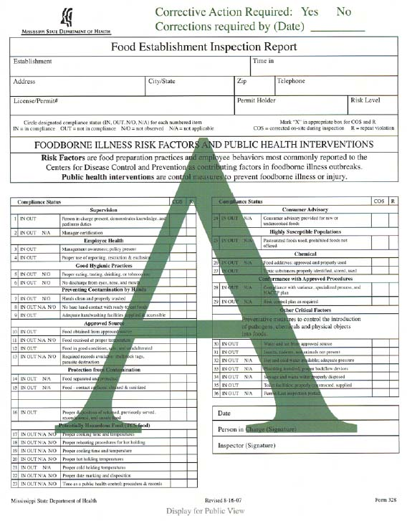
Food Services
As a reminder, if food is prepared on site, refer back to the staffing requirements for a ServSafe certified employee.
Providers must maintain records of service utilization including receipts of purchase, catering contracts, and copies of agency or caterer’s MSDH grade.
Home Delivered Meals (HDMs), fast food, and other government funded meal programs cannot be served in lieu of one (1) meal and two (2) snacks included as a component of ADC food services.
If food is prepared on site, the facility must have a permit to operate a kitchen from MS State Dept of Health (MSDH).
If food is not prepared on site, the facility must contract with and utilize a food service provider/caterer licensed by MSDH to provide nutritionally well-balanced meals that address the dietary needs of beneficiaries.
Notes:
As a reminder, if food is prepared on site, refer back to the staffing requirements for a servsafe certified employee.

Slide 46
Frequent Issues of Non-Compliance, Food Services
Administrative
No ServSafe Certified Staff
No current catering contract
No proof of food service in the form of receipts
On-site food prep with no MSDH kitchen permit
Missing nutritional assessments
Food
Failure to dispose expired food
Failure to provide nutritional food by serving fast food as meal and snack replacement

Slide 47
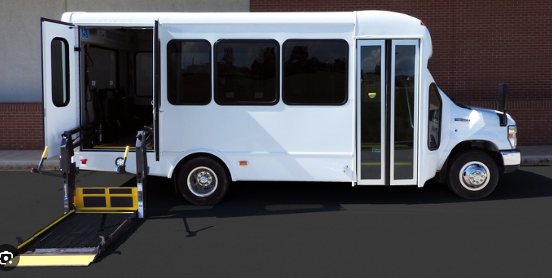
Transportation
The ADC must have a sufficient number of vehicles to transport beneficiaries between their residences and the facility, and to attend facility outings. Each vehicle must meet the requirements detailed in Administrative Code, Part 208.
If the facility contracts transportation services:
The facility must be able to show current use of the transportation contract from a licensed provider of ADA compliant transportation services.
The contracted entity must meet all Division of Medicaid ADC transportation, vehicle, and driver requirements.
Vehicles used for transportation must be ADA accessible, safe, clean and well maintained.
Full requirements can be found under Rule 1.3 of Medicaid Administrative Code Part 208.
Notes:
Vehicles used for transportation must be ADA accessible, safe, clean and well maintained. Full requirements can be found under Rule 1.3 of Medicaid Administrative Code Part 208.

Slide 48
Interior
Lack of vehicle inspections & maintenance
Incomplete Information Packets
Insurance
Lack of Interior Postings
Non-Smoking
Agency Phone Number
VIN number
Seat Belt
Missing or inappropriate cutters
Missing Extenders
No Business Signs
Lack of Fire Extinguishers
Missing Spill Kits
Registration
Frequent Issues of Non-Compliance Transportation
Many of the non-compliance issues providers are cited for are due to a lack of appropriate documentation.
Additional issues include fire extinguishers that are not properly mounted, seat belt cutters that do not have safety blades, or a lack of overall cleanliness and maintenance.
https://www.transit.dot.gov/regulations-and-guidance/civil-rights-ada/ada-regulations
Notes:
Many of the non-compliance issues providers are cited for are due to a lack of appropriate documentation. Additional issues include fire extinguishers that are not properly mounted, seat belt cutters that do not have safety blades, or a lack of overall cleanliness and maintenance.

Slide 49



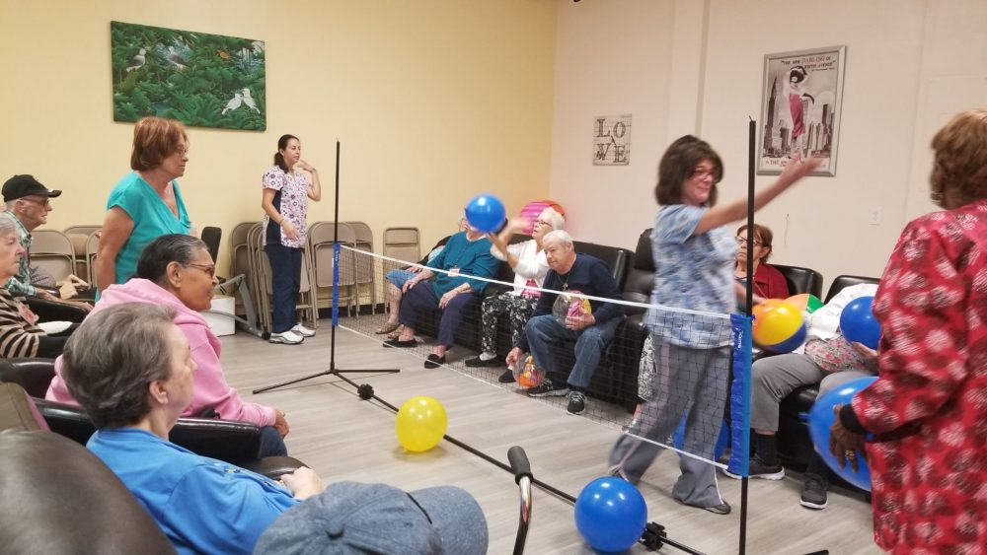

Activities offered must be reflected on the daily activities calendar and posted in an area visible to beneficiaries.
Social, Health and Recreational Activities
ADCs must meet the physical and social needs of each beneficiary and maintain compliance with the state and federal guidelines regarding services provided.
ADCs must provide social, health, and recreational activities which optimize, but not regiment, individual initiative, autonomy, and independence, including, but not limited to, daily activities, physical environment and personal preferences.
Notes:
Activities offered must be reflected on the daily activities calendar and posted in an area visible to beneficiaries.

Slide 50

If the provider chooses to have exercise equipment in the facility as part of recreational activities, the facility must meet ADA requirements for exercise equipment, including clear floor space and accessible routes.
Accessible Exercise Equipment:
At least one of each type of exercise equipment or machine must have clear floor space of at least 30 by 48 inches and be served by an accessible route.
If the clear space is enclosed on three sides (e.g., by walls or the equipment itself), the clear space must be at least 36 by 48 inches.
Key Safety Features of Equipment to Consider
Comfortable and Sturdy Seats - Ensure Seats accommodate various body types and offer secure support.
Leg or Foot Stabilizers - Provide extra support for participants with limited mobility in their legs or feet.
Large Footbeds and Foot Straps - Allow participants to comfortably and safely use pedals, especially for those with limited mobility or balance.
Self-Powered Machines - Equipment that maintains function at very low speeds, offering a range of exercise options.
Adaptive Accessories - Consider accessories that allow participants to adjust the equipment to their specific needs, such as arm handles and leg crank adjustments.
Link: Guide to the ADA Accessibility Standards

Slide 51
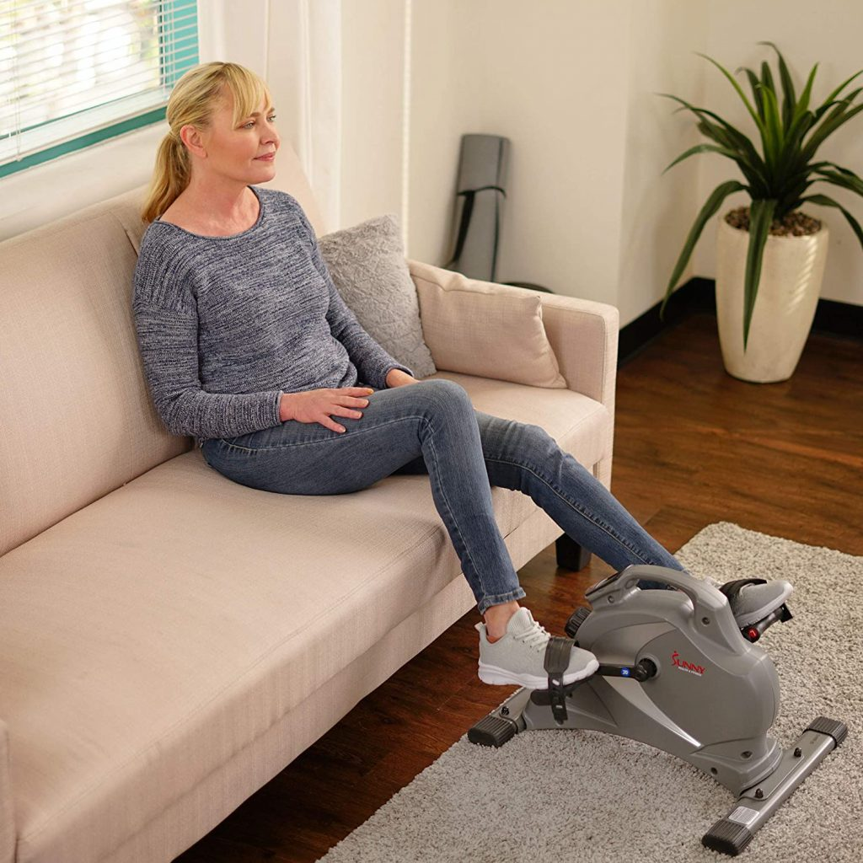
Types of Equipment to Consider:
Focus on features that accommodate a range of abilities. Look for slow-start treadmills and options for low-impact exercises such as:
Elliptical Machines – Provides low impact cardio exercise and minimal stress on joints
Recliners – Allow participants to exercise while seated, making it accessible for those with limited mobility
Low-Impact Exercise Bikes – Offer a variety of resistance levels and allows for seated exercise.
Slow-Start Treadmills – Can allow participants to begin walking at a very slow pace, making it easier to ger started and gradually increase pace with supervision.

Slide 52
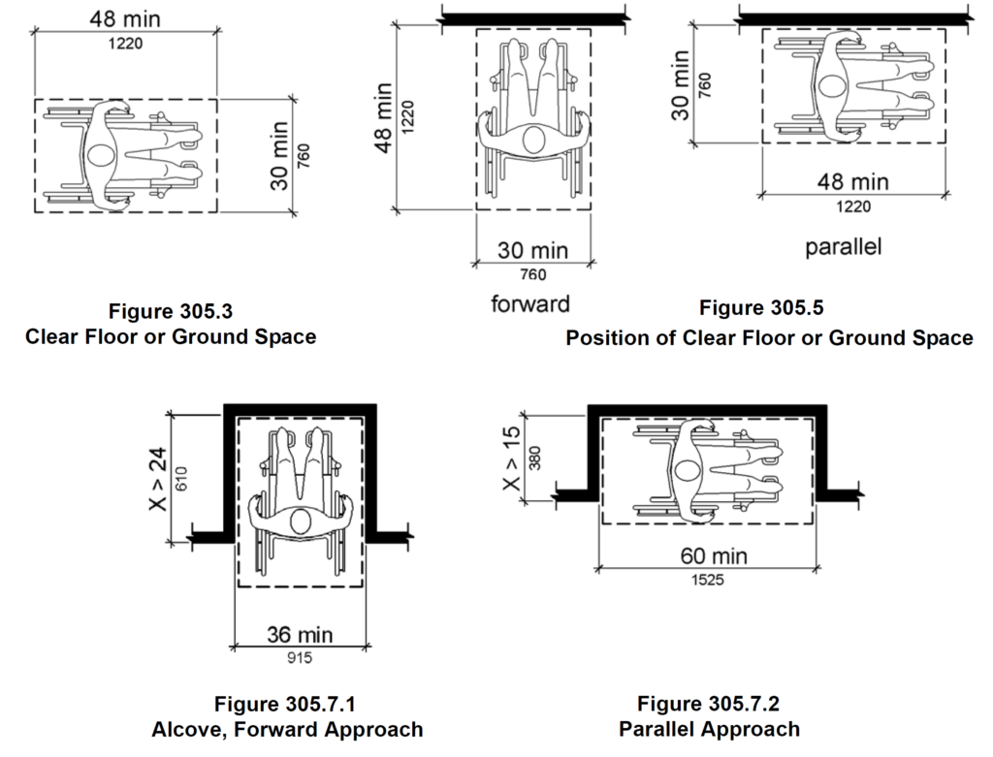
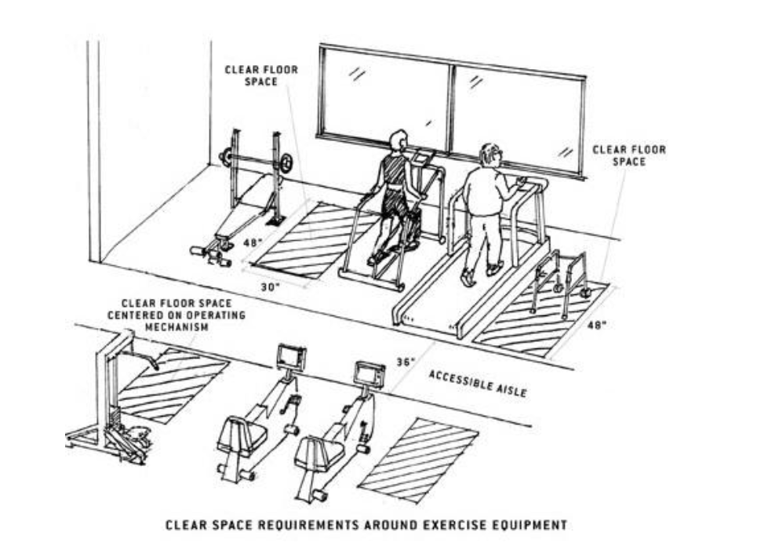

Clear Floor or Ground Space: ADA Standard Section 305
Notes:
Section 1004.1 or the 2010 ADA Standards requires a clear floor space “positioned for transfer or for use by an individual seated in a wheelchair”.

Slide 53
Record Maintenance
The following slides will address requirements for record maintenance and give several templates providers may use to meet minimum standards.
Providers are not required to use templates provided, and may instead use their own, as long as minimum standards are met in accordance with Medicaid Administrative Code, Part 208.
Staff Files
BENEFICIARY Files
Proper Storage and Accessibility

Slide 54

ADC facility records should include, at minimum:
Documentation of maintenance and janitorial services including repairs, maintenance and pest control,
Documentation of quarterly drills for fire and inclement weather,
Annual fire safety inspection reports conducted by the fire department,
Records of quarterly advisory committee meetings,
Written criteria for service provision, including procedures for detailing with emergency service requests,
Policy and procedure manuals,
Written personnel policies including the process used in the recruitment, selection, training, retention, and termination of employees,
Current and historical organizational charts including the names and job titles of owners, operators, managers, administrators, and other supervisory staff,
Current and historical employee listing that captures names, staff/tax id numbers, employment hire and termination dates, and
Service records of licensed nurses which includes dates in the facility, arrival and departure times, services performed, and signature of administrator or program director.
Shown here is a list of all required documentation. This documentation is required to substantiate claims and without it you may be subject to claims recoupment.
It is very important that files be maintained and stored not only in a HIPAA compliant manner, and available for auditors immediately, but also protects the documents from water damage or pests.
Notes:
Shown here is a list of all required documentation. This documentation is required to substantiate claims and without it you may be subject to claims recoupment. It is very important that files be maintained and stored not only in a HIPAA compliant manner, and available for auditors immediately, but also protects the documents from water damage or pests.

Slide 55
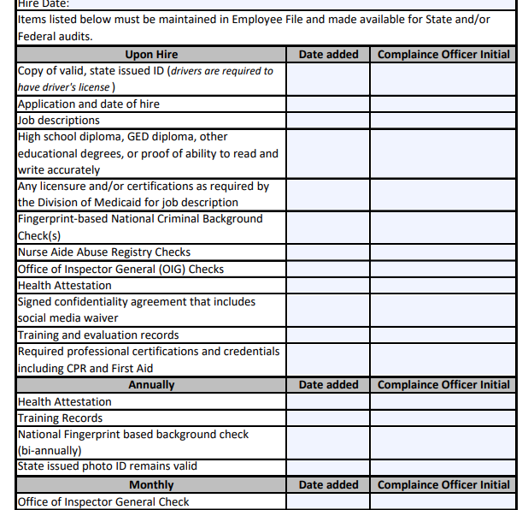
Staff Records
All staff records should include, at a minimum, the following required credentialing and qualification documents:
Copy of valid, state issued ID,
Job description,
Application and date of hire,
High school diploma, General Educational Development (GED) certificate, other educational degrees, or proof of ability to read and write accurately,
Any licensure and/or certifications as required by the Division of Medicaid for job description,
Results of fingerprint-based National Criminal Background check(s),
Results of monthly Nurse Aide Abuse Registry checks,
Results of monthly Office of Inspector General (OIG) checks,
Annual attestation of health,
Signed confidentiality agreement that includes social media waiver, and
Proof of training/evaluations, required professional certifications, and credentials including CPR and First Aid.
This checklist for staff files is available on the HCBS Providers Webpage to help track that all credentialing requirements are addressed timely.
If providers do not have proof that all staff are fully and appropriately credentialed, claims may be subject to claims recoupments.
Link: Employee-File-Checklist-8.1.2024.pdf
Notes:
This checklist for staff files is available on the HCBS Providers Webpage to help track that all credentialing requirements are addressed timely. If providers do not have proof that all staff are fully and appropriately credentialed, claims may be subject to claims recoupments.

Slide 56
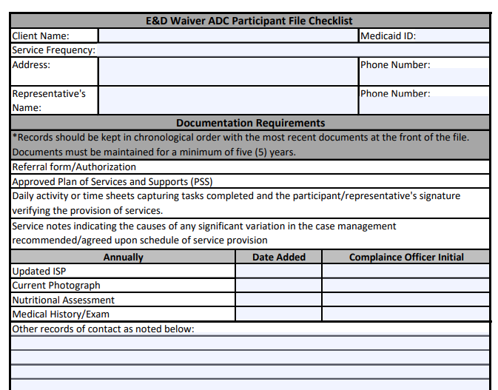
Beneficiary Records
Records for beneficiaries receiving Adult Day Care (ADC) should include, at minimum:
Individualized Service Plan (ISP), with documentation of annual review,
Approved Plan of Services and Supports (PSS),
Daily activity or time sheets capturing service notes and the beneficiary/representative’s signature verifying the provision of services,
Current photograph,
Medical history or medical exam completed within six (6) months of admission,
Annual nutritional assessment, and
Daily Progress Notes.
Link: ADC-Participant-File-Checklist.pdf
Notes:
The Participant file checklist addresses all the minimum documentation requirements for your participants.

Slide 57
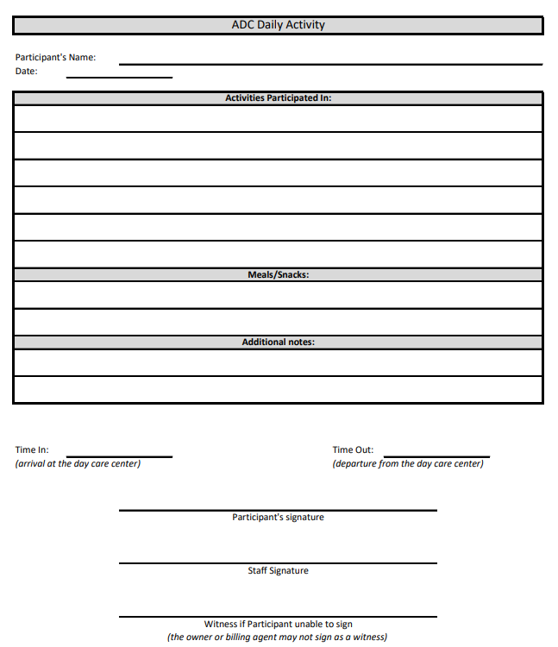
Standardized Progress Note
Records for beneficiaries receiving Adult Day Care (ADC) must include Daily activity or time sheets capturing service notes and the beneficiary/representative’s signature verifying the provision of services.
These must be written and maintained daily as part of each participant’s records. These notes must include date of service, time services began and ended, identification of person receiving services, and summary of services received including meals and activities. The standardized progress note, as shown in the example, provides space to track all required data and can also be used as the time sheet for your facility which will ensure more complete records for auditing. As a reminder, at no time should a member be asked or allowed to sign in for additional dates. Progress notes and time sheets should be completed and signed on the date service is rendered.
Must include:
Date of service
Time service began/ended
Identity of person receiving services
Summary of services received including meals and activities
Link: ADC-Standardized-Progress-Note.pdf
Notes:
Records for beneficiaries receiving Adult Day Care (ADC) must include Daily activity or time sheets capturing service notes and the beneficiary/representative’s signature verifying the provision of services.
These must be written and maintained daily as part of each participant’s records. These notes must include date of service, time services began and ended, identification of person receiving services, and summary of services received including meals and activities. The standardized progress note, as shown in the example, provides space to track all required data and can also be used as the time sheet for your facility which will ensure more complete records for auditing. As a reminder, at no time should a member be asked or allowed to sign in for additional dates. Progress notes and time sheets should be completed and signed on the date service is rendered.

Slide 58
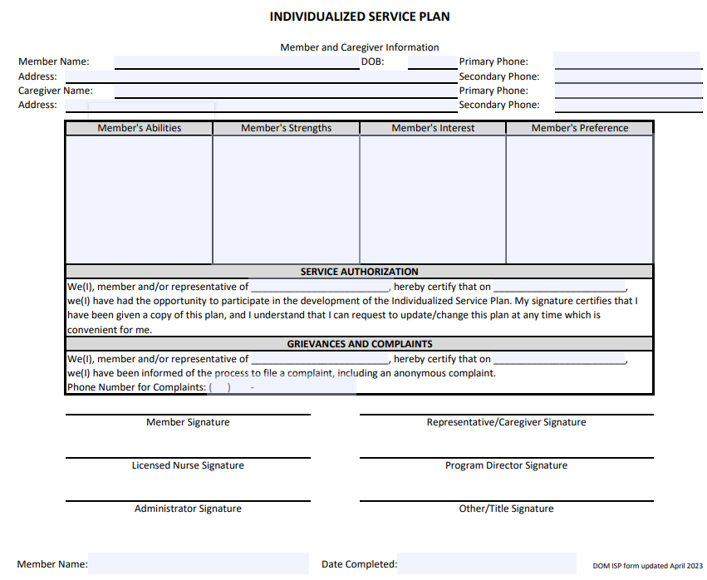
Individualized
Service Plan
Completed at initial intake,
Review and update annually,
Should identify the person’s:
  preferences and expectations for services,
  strengths and needs,
  service provider(s) names.
The ISP must be created at initial intake and at least annually thereafter, with the participant and/or their primary caretaker, along with the information from the PSS, their medical history & nutritional assessment. This is the plan for how your ADC will help this individual meet their goals and care for their needs.
Link: ISP-April-2023.pdf
Notes:
The ISP must be created at initial intake and at least annually thereafter, with the participant and/or their primary caretaker, along with the information from the PSS, their medical history & nutritional assessment. This is the plan for how your ADC will help this individual meet their goals and care for their needs.

Slide 59
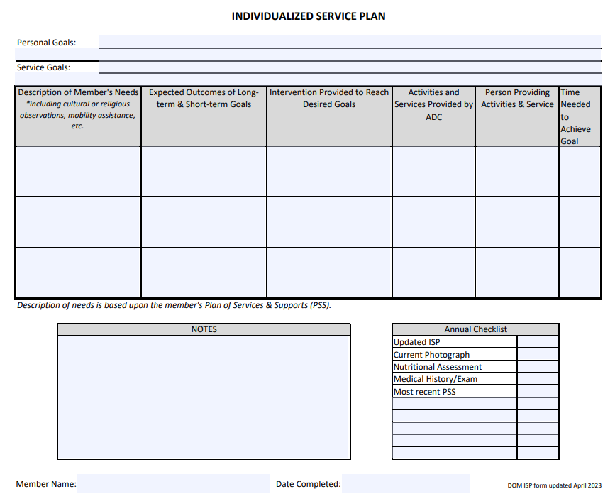
Individualized
Service Plan
The things that are important TO a person, are easily identified as the things that bring them joy. What are some of the things that help them to have more good days?
The things that are important FOR a person, are easily identified as the things that keep the healthy and safe, such as prevention of illness and being in a safe environment free from fear.
Providers have access to free training on Person Centered Planning and ISP development through the PCPI training institute. More information is available on the HCBS Providers Website.
Personal Goals help to identify what is important TO the member
Service Goals help to identify what is important FOR the member.
The annual checklist is available to ensure that the required annual updates are made.
Link: ISP-April-2023.pdf
Notes:
The things that are important TO a person, are easily identified as the things that bring them joy. What are some of the things that help them to have more good days?
The things that are important FOR a person, are easily identified as the things that keep the healthy and safe, such as prevention of illness and being in a safe environment free from fear.

Slide 60

Proper Storage & Accessibility
Storage
Lockable file storage for the security and maintenance of all files in compliance with HIPAA standards.
Climate controlled storage safe from pests and weather damage.
Records documenting the provision of services must be maintained by the providers of waiver services for a minimum of five (5) years. If, at the conclusion of the five-year period, there is ongoing litigation or an open audit, the provider must maintain these records until the litigation or audit is concluded.
Accessibility
Ensuring immediate access to all beneficiary and employee records as required for audit purposes.
Filing system of storage of records to be more accessible for auditors.
Annual
Alphabetical
Numerical
Color Code
Providers must ensure that all records are stored in a secured manner and must be available for immediate access by auditors.
At all times, there must be a staff member on site that can grant auditors access to all records.
Notes:
Providers must ensure that all records are stored in a secured manner and must be available for immediate access by auditors. At all times, there should be a staff member on site that can grant auditors access to all records.

Slide 61
Frequent Issues of Non-Compliance
Record Maintenance
Administrative
Improper business operating hours
Improper staffing ratios
Inaccurate organizational charts
Lack of daily progress notes
Missing documents/procedures posted
  Fire procedures
  Evacuation plan
  Grievance policy
  Privilege Tax License
Missing Confidentiality Agreement
Missing/incomplete individualized service plan
Missing participants physical exam (6 months prior to admission)

Slide 62

Additional Resources

Slide 63

Marketing, Referrals, PSS
In order to ensure that waiver providers are in compliance with DOM regulations regarding freedom of choice, solicitation, and protection of PHI, please refer to the following guidance for appropriate marketing and referrals of potential waiver beneficiaries.

Slide 64

Freedom of Choice
Waiver providers are prohibited from any actions which would in any manner, deny or restrict that individual's free choice of a provider of any services for which the individual may be eligible. Providers cannot use any method of inducement, including free transportation, refreshments, cash or gifts, to influence a beneficiary to select a certain provider.
Waiver providers must keep in mind that not all individuals interested in services will qualify. Additionally, those who do qualify must be guaranteed the freedom to choose any qualified provider servicing their area.

Slide 65


Referrals & PSS
The process shown here has been created to ensure providers are following requirements, so all members have freedom of choice. The E&D waiver is not the only option for services, the MAC Center & PDD can help members navigate those choices.
Once a beneficiary chooses a waiver program, their name is placed on the local waitlist until a slot becomes available. Once a slot becomes available, an assessment is completed by the case managers at the PDD and financial eligibility is determined by the regional office. Once eligibility is established, the beneficiary then gets to choose a service provider approved for their area. This choice results in the submission of a referral and a Plan of Service.
When a referral is received, whether it be for an initial enrollment or recertification, compare the frequency on that referral to the frequency on the PSS and confirm that the Provider Number listed is correct. Notify the case managers of discrepancies.
Waiver providers should not be completing waiver intake referral forms and sending them to Case Managers. While performing marketing for your agency, if an individual shows interest in Home & Community Based Services, that individual should be provided with contact information for the Mississippi Access to Care Network, or the MAC Centers. The MAC Center in their area can be contacted by phone at 1-844-822-4622 or via the “Send a message to MAC Center” button on their webpage at https://www.mississippiaccesstocare.org/help-info/contact-us.
Once the individual contacts the MAC Center, they will receive information on available services as well as referrals to applicable programs to meet their needs. After speaking with the MAC Center, if the individual is interested in applying for a Medicaid waiver, their name will be placed on a waiting list and will be evaluated for physical and financial eligibility when an open slot becomes available.
When a referral is received, Providers must compare the frequency on the referral to the frequency on the PSS. If discrepancies are found, the Provider must notify the PDD immediately.
PDD Services – Mississippi Association of Planning and Development Districts (MAPDD)
Notes:
The process shown here has been created to ensure providers are following requirements, so all members have freedom of choice. The E&D waiver is not the only option for services, the MAC Center & PDD can help members navigate those choices.
Once a beneficiary chooses a waiver program, their name is placed on the local waitlist until a slot becomes available. Once a slot becomes available, an assessment is completed by the case managers at the PDD and financial eligibility is determined by the regional office. Once eligibility is established, the beneficiary then gets to choose a service provider approved for their area. This choice results in the submission of a referral and a Plan of Service.
When a referral is received, whether it be for an initial enrollment or recertification, compare the frequency on that referral to the frequency on the PSS and confirm that the Provider Number listed is correct. Notify the case managers of discrepancies.

Slide 66
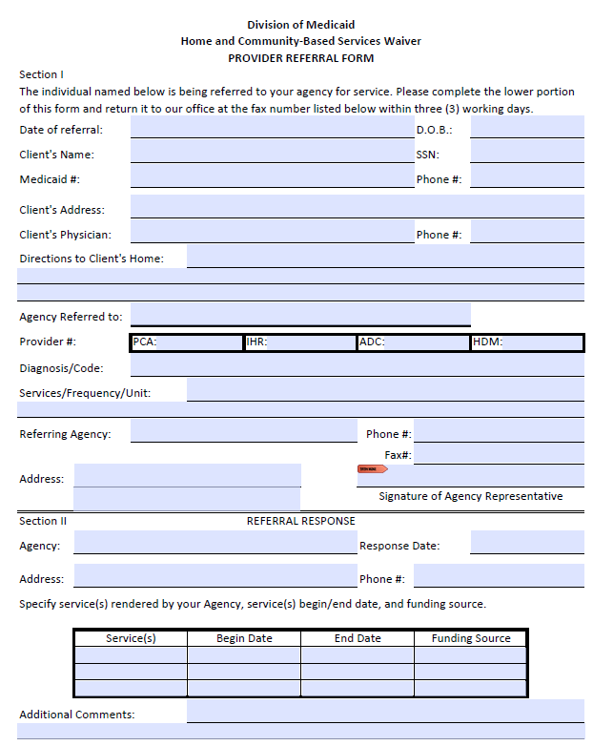
Referrals & PSS
When a referral is received, Providers must confirm accuracy. If discrepancies are found, the Provider must notify the PDD immediately.
Compare the frequency on the referral to the frequency on the PSS,
Confirm provider numbers are accurate,
Ensure start/end date is appropriate based on date received.
Providers must confirm acceptance of the referral within three (3) working days.
If authorization starts or stops mid-month, claims submitted should accurately reflect authorization rather than span billing for the entire month.

Slide 67

Annual Updates
LTSS is now utilizing SmartSheets to gather Annual Contact Updates from ADC Providers. You can scan the QR code and fill out the form to ensure our office has the most current information for your agency.
Providers are required to report changes in contact information, administrative staffing, ownership and licensure within ten (10) calendar days to the Division of Medicaid. You may also use the SmartSheet to report such changes.
LTSS uses the information from this annual update to ensure that the Case Managers have accurate contact information for the Freedom of Choice list so you can continue to receive referrals.
LTSS also uses this information to confirm that your facility is still at the address we have on file.
https://app.smartsheet.com/b/form/739e772328314df5b1d98ff88bf5f9e4

Slide 68

Quality Management
If an E&D Waiver provider fails to respond to contact attempts timely or respond to requests for documentation/training verification in established timeframes, the Division of Medicaid may halt the acceptance of Medicaid referrals or waiver admissions until the E&D waiver provider establishes contact or demonstrates compliance with the regulatory agency
The decision to halt Medicaid referrals or waiver admissions is at the discretion of the Division of Medicaid.
Notes:
If the Division of Medicaid is unable to contact your agency, or your agency fails to respond to communications from DOM, your agency may be removed from the FOC list until contact is reestablished.

Slide 69



Providers must report:
Critical incidences including all instances of abuse, neglect, and exploitation (including the unauthorized use of restraints, restrictive interventions, and/or seclusion) within twenty-four (24) hours of the occurrence or knowledge of the occurrence to the Division of Medicaid and other applicable agencies as required by law.
Any complaints not resolved within seven (7) days to DOM.
APS would receive reports of Abuse, Neglect, Exploitation, or suspicious death.
The PDD would receive reports of beneficiaries or their relatives acting inappropriately with Provider Staff.
DOM would receive all other complaints.
Adult Protective Services - Mississippi Department of Human Services
Notes:
APS would receive reports of Abuse, Neglect, Exploitation, or suspicious death.
The PDD would receive reports of beneficiaries or their relatives acting inappropriately with Provider Staff.
DOM would receive all other complaints.

Slide 70

Resources for Success
Policy Updates: Get notified when new policies are announced, email a contact name, place of business and a contact number (optional) to DOMPolicy@Medicaid.MS.Gov
Late Breaking News: To sign up to receive email alerts every time DOM posts a Late Breaking News update, just email a contact name, place of business and a contact number (optional) to LateBreakingNews@medicaid.ms.gov
If you have questions about background checks, please contact MS Department of Health Julie.Henderson@msdh.ms.gov
If you have questions about your responsibilities as an employer, please contact the U.S. Department of Labor Local Offices | U.S. Department of Labor

Slide 71

Professionalism from providers is key in helping improve effective communication with the Division of Medicaid. This guide should be beneficial to those providers interested in helping improve the etiquette of staff and streamlining the best response from DOM in answering your questions or concerns.
All emails should include a signature, topic, and, if PHI is used, they must be encrypted. This helps ensure that the privacy of the beneficiary is protected and that DOM has a contact plus the issue addressed within the same email. If in doubt about your ability to encrypt emails, send us a request for an encrypted email and we can assist you.
Another note is that email addresses should be appropriate. Having email domains that are able to be passed down will make it easier for providers in case there is an instance of the staff being removed from the position. The new staff that fills the position should have a seamless transition to the approved email domain.
Finally, please do not send the same email to multiple staff at DOM. Emailing HCBSProviders will get your request to our entire team. However, if you send that same email to multiple people, it can create confusion and additional work which slows down general response time.
  All emails should include a signature. The signature should have the name of the person emailing, role in agency, agency’s name, provider ID(s), phone number, email, and fax number
  The topic should be in the email subject line.
  All messages should be clear and concise. This includes phone calls, voicemails and emails.
  All emails containing beneficiary specific information (names, Medicaid ID, Date of Birth, etc.) must be encrypted. This is to ensure that the privacy of the beneficiary is protected.
  Email addresses should be appropriate. This includes the following:
    Email domain should be able to be passed down
      Ex) Approved: Admin@HealthCareAgency.com or AdminHealthCareAgency@gmail.com
      Ex) Not Approved: CowgirlJane601@gmail.com
Professional Provider Etiquette
Notes:
Professionalism from providers is key in helping improve effective communication with the Division of Medicaid. This guide should be beneficial to those providers interested in helping improve the etiquette of staff and streamlining the best response from DOM in answering your questions or concerns.
All emails should include a signature, topic, and be encrypted. This helps ensure that the privacy of the beneficiary is protected and that DOM has a contact plus the issue addressed within the same email. If in doubt about your ability to encrypt emails, the HHA Portal has a secure message feature that automatically protects PHI and allows you to communicate directly with our staff. Please limit the message portal to emails that require the use of PHI if not directly related to HHA.
Another note is that email addresses should be appropriate. Having email domains that are able to be passed down will make it easier for providers in case there is an instance of the staff being removed from the position. The new staff that fills the position should have a seamless transition to the approved email domain.
Finally, please do not send the same email to multiple staff at DOM. Emailing HCBSProviders will get your request to our entire team. However, if you send that same email to multiple people, it can create confusion and additional work which slows down general response time.

Slide 72

Contact Information
Mississippi Division of Medicaid
Office of Long Term Services & Supports
Phone: (601) 359-6141
Website: https://medicaid.ms.gov/hcbs-waiver-providers/
Email Address: HCBSProviders@medicaid.ms.gov
Address: Office of Long Term Services & Supports
Division of Medicaid
Walter Sillers Building
550 High Street
Jackson, MS 39201

Slide 73



Need Technical Assistance?
Gainwell
  Recredentialing applications
  Issues with MESA
  Updating agency contacts and address
  Requesting 1099 tax forms
DOM
  Expanding service area
  Relocating
  Change of Ownership
  Staffing changes
  Audits
PDD
  Requesting more hours for clients
  Any adjustments made to PSS
  Missing lock-in on PSS
  Beneficiaries needing transportation
https://medicaid.ms.gov/wp-content/uploads/2025/05/Q2-2025-PROVIDER-FIELD-REPRESENTATIVES_Map-and-By-County_v2.0.pdf

Slide 74



