Slide 1

Office of the Governor | Mississippi Division of Medicaid
The Division of Medicaid
Personal Care and In-Home Respite Provider Training
Office of Long Term Services and Supports
June 27, 2025

Slide 2

Who is this training for?
This training is for providers who are currently enrolled to provide Personal Care (PCS) Services or In-Home Respite (IHR) under the MS Division of Medicaid Elderly & Disabled (E&D) Waiver.
Training should be completed by:
  Agency Owner,
  Administrator, and/or
  Compliance Officer
If the individual completing this training exits the company, the training must be completed by the individual hired to fill that vacant role.
Notes:
If there is a new owner or partnership is with to the agency, they must also complete and attest to this training.

Slide 3
New Provider Orientation
If you are not yet enrolled as a Medicaid Waiver Provider of E&D Personal Care or In-Home Respite Services, you may continue to review the following training materials; however, you will also be required to complete the New Provider Orientation as part of the enrollment process.
https://medicaid.ms.gov/hcbs-waiver-providers/

Slide 4



Overview of Training
Introduction
Training Topics
Additional Resources
DOM HCBS Team
Overview of the Waiver Program
Covered Services
Admin Code Changes
Organizational Changes
Organizational Requirements & Responsibilities
MS Electronic Visit Verification
Record Maintenance
Marketing, Referrals & PSS
Contact Updates for FOC List
Resources for Success
Notes:
This presentation is color coded with the corresponding colors shown under Training Topics. This will help you quickly locate the topics for future reference. Please note the “changes” symbol beside Admin Code Changes. When you see this symbol know this indicates any changes or clarifications made in the Admin Code.

Slide 5
Introduction

Slide 6

LTSS
Long Term Services & Supports
Organizational restructuring at the Division of Medicaid has resulted in HCBS Provider Relations being moved under the umbrella of Long Term Services and Supports (LTSS). We continue to work in collaboration with the Office of Long Term Care, but now also provide supports to Waiver Providers under the Intellectual Disabilities/Developmental Disabilities (ID/DD) & Community Support Programs (CSP).

Slide 7
LTSS Team
Misty Jenkins
Senior Director
Long Term Services & Supports
Nancy Dampier
Director
HCBS Provider Relations
Gabrielle Grant
LTSS Solutions Manager
Paulette Johnson
Director
Long Term Care
Kenosha Williams
Lead Reviewer
E&D Provider Enrollment
Alexis Martin
Reviewer
E&D Provider Enrollment
Penelope Boyd
CSP Beneficiary Support
Terri Wilkerson
E&D Beneficiary Support
Estel Stringer
ID/DD Beneficiary Support

Slide 8
Elderly & Disabled Waiver:
Home and Community Based Services
The E&D Waiver is administered and operated by the Division of Medicaid.
Beneficiaries enrolled in the E&D Waiver must reside in a private residence that is fully integrated with opportunities for full access to the greater community and meets the requirements of a Home and Community-Based (HCB) setting in 42 C.F.R. § 441.301(c)(4) and (5).
Beneficiaries enrolled in the E&D Waiver are prohibited from receiving additional Medicaid services through another waiver program.

Slide 9
E&D Waiver Beneficiary Eligibility Criteria
Who is Eligible?
Must be twenty-one (21) years of age or older.
Must require nursing facility level of care as determined by a comprehensive long-term services and supports (LTSS) assessment.
Must meet the criteria in one (1) of the following Categories of Eligibility (COE):
Supplemental Security Income (SSI) eligible under 20 C.F.R. § 416.202, or
An aged, blind or disabled individual who meets all factors of institutional eligibility.
If income exceeds the current institutional limit, the individual must pay the Division of Medicaid the portion of their income that is due under the terms of an Income Trust to qualify.
Beneficiaries enrolled in the E&D Waiver cannot reside in a nursing facility or licensed or unlicensed personal care home.
In the event of imminent danger to the beneficiary, caregiver or service provider, the beneficiary may be discharged from the waiver immediately.
Notes:
Beneficiaries must have BOTH financial eligibility, as determined by the Regional Office, and clinical eligibility, as determined by the Division of Medicaid office of Long Term Services & Supports.

Slide 10

Covered Services
  The Division of Medicaid covers certain home and community-based services as an alternative to institutionalization in a nursing facility through the Elderly and Disabled Waiver (E&D). These services are:
    Personal Care Services
    In-Home Respite Services
    Adult Day Care Services
    Case Management
    Environmental Safety Services
    Medication Management
    Home Delivered Meals
    Institutional Respite
    Extended Home Health
Notes:
There are many services covered under the E&D Waiver, but this training covers Personal Care and In-Home Respite Services.

Slide 11
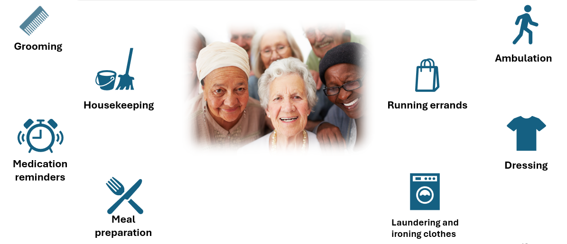
Personal Care and In-Home Respite Services are designed to meet the needs of aged and disabled individuals through:

Slide 12
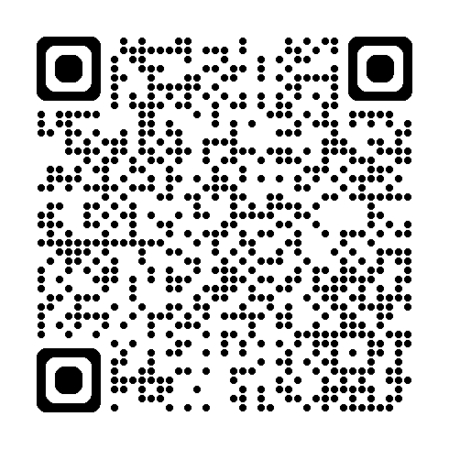
Administrative Code Part 208, Chapter 1
Home and Community Based Services
Administrative Code Link: https://medicaid.ms.gov/wp-content/uploads/2025/05/Title-23-Part-208-HCBS-LTC-eff.-6.1.25.pdf
Notes:
Administrative Code Part 208, chapter 1 is currently available for review on the website. Throughout this presentation will be several links to additional resources, this will all be available on the HCBS Providers webpage.

Slide 13

Administrative Code Part 208, Chapter 1
Personal Care & In-Home Respite Services
Some of the most impactful changes for PCS & IHR providers in the updated Admin Code, effective June 1, 2025, are:
  Mandatory staffing changes
  Required reporting
  Updates to organizational requirements
Notes:
When you see the “changes” picture, that indicates a change or clarification made in the admin code.

Slide 14
Training Topics

Slide 15
Organizational Changes
Change of Ownership
Relocations
Satellite Offices
Designated Worksites
Notes:
Our first round of training topics will be on different types of Organizational Changes. This counts for changes in ownership or changes in office spaces.

Slide 16
Changes of Ownership (CHOW)
Notifying DOM of Change of Ownership within 35 days of change
Completing a CHOW packet with LTSS
New owner must maintain beneficiary file records for a minimum of five (5) years
Notes:
Our Office frequently sees providers who are selling their business without notifying the Division of Medicaid timely. We’d like to remind everyone that there cannot be a transfer of ownership of your Medicaid issued provider ID without first notifying Medicaid. We must ensure that the new owners are qualified to provide the services and go through all required credentialing. As a reminder, the NEW owner is responsible for maintaining all files and documents from the previous owner for auditing purposes.
The new owner is assuming all responsibility and liability for all claims that were filed prior to the transfer. A provider/facility that undergoes a change of ownership must notify the Office of LTSS within ten (10) days, and the Office of Provider Enrollment within thirty-five (35) days after any change in ownership.
A CHOW packet must be received, reviewed, and approved by the Office of Long-Term Services & Supports before the provider can complete a Mississippi Medicaid Provider Application Packet.
The new provider must continue to maintain all Medicaid beneficiary records for at least six (5) years, unless an alternative method for maintaining the records has been established in writing and approved by the Division of Medicaid as required by Health Insurance Portability and Accountability Act of 1996 (HIPAA).

Slide 17
Transactions that constitute a CHOW are:
Partnership to limited liability company, or single proprietorship to organization)
Mergers, when a new organization is formed, and the merging companies are non-surviving
Consolidation of two or more corporations resulting in a new corporate entity
Removal, addition, or substitution of one or more individuals as partners (under Mississippi law, these actions result in dissolution of an older partnership and creation of a new one)
Transfers between different levels of government, such as city to county, state to county, etc.
Transfer (sale, gift, exchange of stock) that results in a fifty (50) percent or more change.
Notes:
The following are examples of changes of ownership. This list is not exhaustive. A few things to consider here that we’ve seen impact providers: if you have a business partnership and one partner passes away, this is a change in ownership and must be reported. If you plan to pass your business to another business partner or relative in the event of your death or disability, we recommend having them added as a partner now, even with as little as 1% ownership, so that in those events, your business can continue providing care uninterrupted. Providers should contact the Division of Medicaid’s Office of Long Term Services & Supports to begin this process.

Slide 18
Relocations
Provider must complete a Relocation packet through the LTSS Office for review
The LTSS Office must complete a virtual site visit
Once the new location is approved, providers must submit a Change of Address form in MESA
If in the market to relocate, the LTSS Office can complete a virtual site visit to ensure that the new location meets the requirements for PCS-IHR before the owner signs a new lease agreement or purchase
Notes:
The following are examples of changes of ownership. This list is not exhaustive. A few things to consider here that we’ve seen impact providers: if you have a business partnership and one partner passes away, this is a change in ownership and must be reported. If you plan to pass your business to another business partner or relative in the event of your death or disability, we recommend having them added as a partner now, even with as little as 1% ownership, so that in those events, your business can continue providing care uninterrupted. Providers should contact the Division of Medicaid’s Office of Long Term Services & Supports to begin this process.

Slide 19
Satellite Offices
Provider must complete a Satellite Office packet through the LTSS Office for review
The LTSS Office must complete a virtual site visit
Once the new location is approved, the LTSS Office must share added counties to the appropriate PDD
If in the market to open a brick & mortar, the LTSS Office can complete a virtual site visit to ensure that the new location meets the requirements for PCS-IHR before the owner signs a new lease agreement or purchase
Notes:
Satellite Offices Admin Code Part 208 Chapter 1 Rule 1.3: Provider Enrollment
The process for opening up a Satellite Office is a little similar to a Relocation. For Satellite Offices, the provider must complete a Satellite Office packet through the LTSS office. Then, the LTSS office must complete a virtual site visit. Once the new location is approved, the addition of counties will be shared to the appropriate PDD and reflected on the next freedom of choice distribution.
All files originating at the satellite office must be securely transported and stored at the main office to be available for audit.
Also, if in the market of opening a brick and mortar, our office is happy to do a virtual visit of the new location. If seeking to add additional counties to an established Main Office or Satellite Office, fully submit an Office Location application, submit an organizational chart of staff at all locations, and the privilege tax license for the Main Office or Satellite Office referenced. A key change in the Administrative Code is that providers must not serve counties more than sixty (60) miles driving distance from the physical office.

Slide 20
Designated Worksites
Provider must complete a Designated Worksite packet through the LTSS Office for review
Provider must submit required documents to the LTSS Office for review
Once the application is approved, the LTSS Office must add the Designated Worksite to the Freedom of Choice (FOC) list
The Supervisor and Compliance Officer must attest the responsibilities of the Designated Worksite Supervisor and notify any changes to LTSS within ten (10) calendar days.
Designated Worksite Link: https://medicaid.ms.gov/wp-content/uploads/2025/06/Designated-Worksite-Form-6.5.2025.pdf
Notes:
Designated Workspaces Admin Code Part 208 Chapter 1 Rule 1.3: Provider Enrollment
A huge change that has been made in the Administrative Code is the allowance of Designated Worksites. If deciding to forgo a physical space, a Supervisor may be assigned to a designated worksite in the requested area; however, the proper steps must be taken in order to achieve this. The provider must complete a Designated Worksite packet and submit required documents. Once the application is approved, the worksite will be added to the Freedom of Choice List. If any changes are to occur, the LTSS Office must be notified within 10 calendar days.
All files originating at the designated worksite must be securely transported and stored at the main office to be available for audit.

Slide 21
Organizational Requirements & Responsibilities
Background, Office of the Inspector General (OIG), and Nurse Aide Abuse Registry (NAAR) Checks
Business Line of Credit
Organizational Chart
Staffing

Slide 22

National Fingerprint Criminal Background Check
1915(c) HCBS waiver providers are required to conduct a national criminal background check with fingerprints on all employees and volunteers participating in face-to-face interactions with beneficiaries prior to employment and every two (2) years thereafter. The provider must maintain these records in the employee’s and volunteer’s personnel file.
Disqualifying Events:
Not have been nor employ individuals or volunteers participating in face-to-face interactions with beneficiaries who have been convicted of or have pleaded guilty or nolo contendere to:
A felony of possession or sale of drugs,
Murder, manslaughter, armed robbery,
Rape, sexual battery, any sex offense listed in Miss. Code Ann. § 45-33-23(h),
Child abuse,
Arson,
Grand larceny, burglary,
Gratification of lust,
Aggravated assault, or
Felonious abuse and/or battery of a vulnerable adult,
Regardless of whether any such conviction or plea was reversed on appeal or a pardon was granted for the conviction or plea.
Link: https://msdh.ms.gov/page/30,0,206.html
Notes:
Admin Code Part 208 Chapter 1 Rule 1.3: Provider Enrollment
Prior to employment and every two (2) years thereafter, providers must conduct a national criminal background check with fingerprints on all employees participating in interactions with beneficiaries. Those employees must not have been convicted or have pleaded guilty or nolo contendere to this list of disqualifying events. Please keep full rap sheets with Mississippi Department of Health’s results letter in the employee’s file for auditing purposes. For any questions regarding the background checks, you may visit Mississippi Department of Health’s website. There is also a section on the HCBS Providers Website which we are working on revising to reflect recent changes in MSDH Processes.
State only and name only background checks are insufficient. Providers are not authorized to offer a waiver of any kind to allow disqualified applicants to work in the waiver program. The non-criminal justice form and the applicant authorization form are now auto generated thru SAFER.

Slide 23
OIG & Nurse Aide Abuse Registry Checks
Must conduct registry checks before employment and monthly thereafter.
Maintain these records in the employee’s personnel file.
The provider must not employ individuals whose name appears on the registry list.
Must include a printed copy with date of the check in employee’s and volunteer's personnel file for auditing purposes.
OIG Link: https://exclusions.oig.hhs.gov/
NAAR Link: https://ms.tmutest.com/search
Notes:
Admin Code Part 208 Chapter 1 Rule 1.3: Provider Enrollment
Providers must conduct monthly OIG and Nurse Aide Abuse Registry Checks for all staff and ensure not to hire or employ individuals whose name appears on the registry list. The results of these checks must be maintained in the employee’s personnel file.

Slide 24


Business Line of Credit
Establish and maintain a business line of credit for business operations from either a financial institution licensed to conduct banking or other Financial Deposit Insurance Corporation (FDIC) or National Credit Union Administration (NCUA) insured financial institutions.
The approval amount for the business line of credit must be enough to cover operational costs/expenditures for at least three (3) months at all branch locations.
Notes:
Admin Code Part 208 Chapter 1 Rule 1.3: Provider Enrollment
Prior to the implementation of MESA, newly enrolling providers were required to establish a business line of credit.
With updates to the Administrative Code, all E&D providers are required to establish and now maintain a business line of credit for operations as proof of financial solvency. To ensure continuity of business operations and member services, providers must maintain a line of credit available to use in the event that there are reimbursement delays in claims processing with the Division of Medicaid. The line of credit will ensure that your agency can continue payroll processes.

Slide 25
Organizational Chart
Administrator/CEO/President
Compliance Officer
Supervisor
Direct Care Worker (DCW)
Direct Care Worker (DCW)
Notes:
Admin Code Part 208 Chapter 1 Rule 1.3: Provider Enrollment
Providers must employ (as a W2 employee) all staff listed on the organizational chart shown. Contract staff (1099 self-employed) are not allowed by Federal Labor Law regulations.
When sending organizational charts to our office, please be sure to use the format provided along with the names and location for the staff. Once again, let DOM know of any changes in organizational structure. This must be reported in writing to DOM within 10 business days.
All staff must complete the training requirements detailed in Administrative Code, Part 208 Rule 1.3C

Slide 26

Provider Responsibilities
  Successfully pass a facility inspection by the Division of Medicaid.
  Maintain the office’s physical address until the provider agreement is terminated.
  Maintain a roster of qualified personnel necessary to provide authorized services.
  Have responsible personnel management
  Be compliant with all federal and state regulations.
Notes:
Admin Code Part 208 Chapter 1 Rule 1.3: Provider Enrollment
Providers are responsible for ensuring their facility passes DOM inspection, maintain the facility’s physical address, maintain a roster of qualified staff, and remain compliant with all federal and state regulations.

Slide 27

Compliance Officer Requirements
  There must be a Director/Compliance Officer, with the following qualifications, responsible for ensuring overall program compliance.
    At least two (2) years of supervisory experience in programs dealing with elderly and disabled individuals and meet one (1) of the following requirements:
      A Bachelor's Degree in social work, home economics, or a related profession, with two (2) years of direct experience working with aged and disabled persons, or
      A Licensed Registered Nurse (R.N.) or Licensed Practical Nurse (L.P.N.), with two (2) years of direct experience working with aged and disabled persons, or
      Be a high school graduate with diploma or have a General Educational Development (GED) certificate, and four (4) years of direct experience working with aged and disabled persons.
Notes:
Admin Code Part 208 Chapter 1 Rule 1.3: Provider Enrollment (Edit notes)
Changes to the Administrative Code aligned the credentialing requirements for the Compliance Officer to match those of the Direct Care Supervisors. Compliance Officers with either a bachelor’s degree or a licensed RN or LPN must have at least two (2) years of direct experience working with aged and disabled persons in addition to two years of supervisory experience.
Those that have a high school diploma or have a GED certificate must have at least four (4) years of direct experience working with aged and disabled persons.

Slide 28
Compliance Officer Responsibilities
  Responsibilities for the Compliance Officer include but are not limited to:
    Ensuring continuing compliance with the Medicaid Administrative Code, Medicaid provider agreement, all applicable state and federal laws, quality assurance standards, and the CMS approved waiver.
    Ensuring all mandatory training and certifications are completed timely.
    Ensuring all background checks are completed timely and maintained appropriately.
    Ensuring all OIG and Nursing Exclusion checks are completed timely and maintained appropriately.
    Ensuring all Corrective Action Plans are implemented appropriately if necessary.
    Ensuring immediate access to all participant and employee records as required for audit purposes.
Notes:
Admin Code Part 208 Chapter 1 Rule 1.3: Provider Enrollment
The Compliance Officer is responsible for ensuring overall program compliance with DOM policy as well as federal and state laws. This in-office role is tasked with making sure your agency is fully compliant and ready for an audit.

Slide 29

Supervisor Requirements
  There must be sufficient DCW Supervisors employed to meet staffing ratios and must have the following qualifications:
    At least two (2) years supervisory experience in programs dealing with elderly and disabled individuals and meet one (1) of the following requirements:
      A Bachelor's Degree in social work, home economics, or a related profession, with two (2) years of direct experience working with aged and disabled persons,
      A Licensed Registered Nurse (R.N.) or Licensed Practical Nurse (L.P.N.), with two (2) years of direct experience working with aged and disabled participants, and two years of supervisory experience, or
      A high school graduate with a diploma or have a General Educational Development (GED) certificate, and four (4) years of direct experience working with the aged and disabled persons.
Notes:
Admin Code Part 208 Chapter 1 Rule 1.3: Provider Enrollment
Supervisor requirements are very similar to those in the role of Compliance Officer. However, where so much of the Compliance Officers responsibilities are in-office, much of the Supervisor’s responsibilities are field work, outside of the office.
Supervisors with either a bachelor’s degree or a licensed RN or LPN to must have at least two (2) years of direct experience working with aged and disabled persons

Slide 30
Supervisor Responsibilities
  Responsibilities for the DCW Supervisor include but are not limited to:
    Supervising no more than twenty (20) full-time DCW Staff. If less than twenty PCA staff are working, only a pro rata share of a supervisor’s time is needed. For example, if four full-time PCA staff are employed, then 20% of a supervisor’s time would be required to meet this standard;
    Ensuring DCW staff timesheets and any other documents containing protected health or identifying information are securely stored while in the possession of the DCW staff or supervisor in a manner that prevents unauthorized disclosure and are returned to the main office location within ten (10) business days;
    Reviewing and approving duties on approved service plans;
    Receiving and processing requests for service;
    Evaluating the work, skills, and job performance of the DCW staff, including the completion of hands-on skills assessments;
    Making home visits with DCW staff to observe and evaluate job performance, maintain supervisory reports, and submit monthly activity sheets;
Notes:
Admin Code Part 208 Chapter 1 Rule 1.3: Provider Enrollment
Supervisors are responsible for supervising all direct care staff and there must always be enough Supervisors to meet staffing ratios. Each one (1) Supervisor may supervise a max of twenty (20) Direct Care Staff and must always be accessible to DCWs in case of emergencies. Supervisors are going into the homes, reviewing Plans of Service, evaluating job performance and making sure your agency’s services are aligned with Person Centered Care.

Slide 31
Supervisor Responsibilities
    Performing supervised direct monitoring visits in the beneficiary’s home while the DCW staff is on-site and unsupervised indirect monitoring visits, which may be performed in the beneficiary’s home or by phone, while the DCW staff is not onsite, alternating on a biweekly basis to ensure services and care are provided according to the PSS, and;
    Being accessible to DCW Staff and beneficiaries/their representatives for emergencies, case reviews, conferences, and problem solving;
    Interpreting agency policies and procedures relating to the program;
    Preparing, submitting, or maintaining appropriate records and reports;
    Planning, coordinating, and recording ongoing in-service training for the DCW Staff.
    Reporting directly to the Agency’s Director and, in the absence of the Director, is responsible for the regular, routine activities of the program.
Notes:
Admin Code Part 208 Chapter 1 Rule 1.3: Provider Enrollment
While the Compliance Officer is making sure the office is ready for an audit, the Supervisors ensure that your clients and direct care staff are well cared for by completing home visits, being available in emergencies, preparing and submitting reports and maintaining records.

Slide 32

Direct Care Worker (DCW) Requirements
  The Direct Care Staff shall have at a minimum:
    Must be a high school graduate or have a General Education Development (GED) certificate or must demonstrate the ability to read the written personal care services assignment and write adequately to complete required forms and reports of visits.
    Be at least 18 years of age;
    Must demonstrate the ability to work well with aged and disabled individuals who have limited functioning capacity;
    Possess a valid state issued ID, and have access to reliable transportation;
    Must maintain current and active first aid and CPR certification
Notes:
Admin Code Part 208 Chapter 1 Rule 1.3: Provider Enrollment. Include DCW training.
The minimum requirements to become a Direct Care worker are being at least 18 years old, have a valid ID, the ability to read and write, work well with those aged and disabled, and maintain the proper certification.

Slide 33
Direct Care Worker (DCW) Responsibilities
  Be physically able to perform the job tasks required and assurance that communicable diseases of major public health concern are not present,;
  Have interest in and empathy for, people who are ill, elderly, or disabled;
  Be emotionally mature and able to respond to participants and situations in a responsible manner;
  Have good communication and interpersonal skills and the ability to deal effectively, assertively, and cooperatively with a variety of people;
  Must not have been convicted of a crime substantially related to the dependent population or any violent crime;
  Must be able to recognize the signs of abuse, neglect and/or exploitation and the procedures to follow as required in the Vulnerable Adult Act; and
  Must have knowledge of how to prevent burns, falls, fires; and emergency numbers to contact emergency personnel if required.
  Successfully complete a mandatory training course upon hire covering each of the topics in Admin Code, Part 208, Rule 1.3C, and pass a scored examination prior to rendering services. This training course must also be attended annually for each year after hire.
Notes:
Admin Code Part 208 Chapter 1 Rule 1.3: Provider Enrollment
By definition, Direct Care Workers assist the beneficiary in meeting daily living needs and ensures optimal functioning at home and/or in the community. In practice, the direct care worker provides the care and companionship that allows the elderly and disabled to remain in their homes and community, rather than being forced to rely on institutional care.

Slide 34



MS Electronic Visit Verification (EVV)
  Effective 8/1/2023, providers have the option to either utilize the upgraded state provided EVV system through HHAeXchange or integrate their own provider selected EVV system with the HHAeXchange aggregator. For additional information on EVV in Mississippi, please visit the HHAeXchange’s Mississippi Information Center webpage at https://www.hhaexchange.com/info-hub/mississippi or email DOM at evv@medicaid.ms.gov.
  Providers must ensure that all personal care and in home respite services are electronically visit verified in a state approved solution as required by the 21st Century Cures Act.
  Manual entry of visit data shall be utilized only when the EVV system is unavailable and makes usage of the system impossible. Justification documentation must support any instance of human error in EVV and must be entered into the EVV system. Repeated instances of human error are subject to audit. Manual entry information shall include the date and time, the reason for the entry, and the identification of the person making the entry.
Notes:
MS Electronic Visit Verification (EVV) Admin Code Part 208 Chapter 1 Rule 1.6: Covered Services
As of August 1, 2023, Providers must ensure that all personal care and in home respite services are electronically visit verified as required by the 21st Century Cures Act.
The Division of Medicaid offers HHA Exchange for free to providers. This system is a way to ensure that beneficiaries are receiving the services provided as established in their plan of service and supports. If a provider chooses to pick their own DOM approved provider contracted EVV solution, the provider must (1) Ensure that electronic records reflect a clear audit trail for any edits/updates and (2) Grant system access to DOM, their contractors, and oversight entities for the purposes of auditing EVV data upon request.
If there is an instance of the EVV system being unavailable for usage to providers and their staff, manual entry of the visit data may be utilized. Justification documentation must be submitted along with the date, time, reason for entry, and the identification of the person making the entry. Please keep in mind that any repeated human errors are subject to audit.

Slide 35



Record Maintenance
Beneficiary Files
Proper Storage and Accessibility
Staff Files

Slide 36
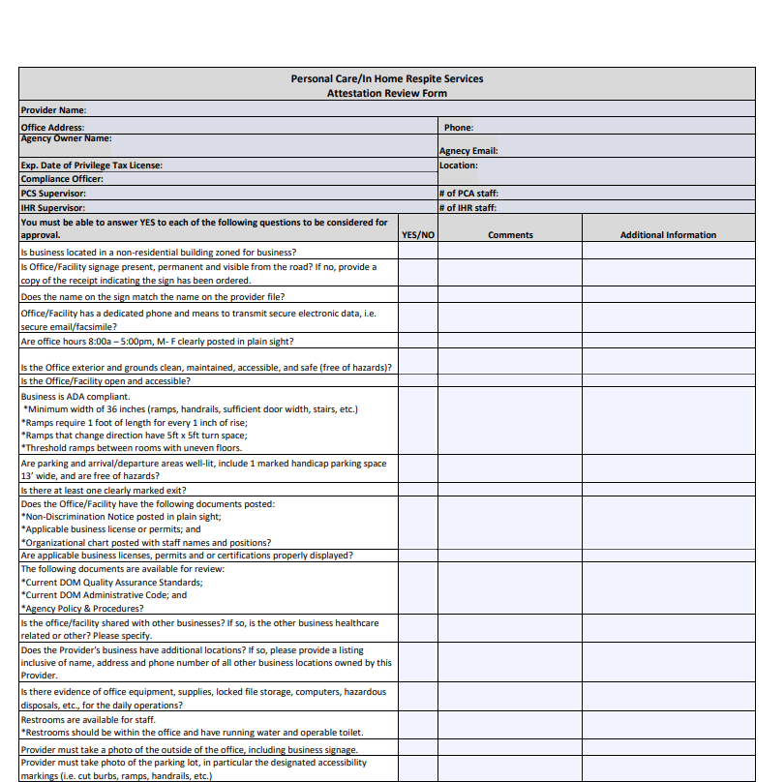
Agency Files: Attestation Review Form
  Addresses compliance of:
    ADA Regulations
    Proper File Storage
    Non-Discrimination Notice
    Business Licenses/Permits
    Organizational Chart
    Administrative Code
    Building Requirements
Facility Attestation Link: https://medicaid.ms.gov/wp-content/uploads/2025/05/PCS-IHR-Attestation-Review-Form-Website-1.pdf
Notes:
Admin Code Part 208 Chapter 1 Rule 1.3: Provider Enrollment
This Facility Review Attestation was created to help PCS-IHR providers properly address and understand regulations for ADA compliance, proper file storage, and building requirements. Keeping this form up to date will allow providers to make sure that their facility meets the standards for accessibility and auditing.

Slide 37

Agency Files: Office Documentation
  Records for PCS/IHR offices should include at minimum:
  Written criteria for service provision, including procedures for dealing with emergency service requests,
  Policy and procedure manuals,
  Records of quarterly advisory committee meetings,
  Written personnel policies including the process used in the recruitment, selection, retention, and termination of employees,
  Organizational chart including the names and job titles of owners, operators, managers, administrators, and other supervisory staff., and
  Current and historical employee listing that captures names, staff/tax id numbers, and employment hire and termination dates.
The purpose of the Advisory Board is to ensure providers are actively soliciting feedback on their services and operations from applicable stakeholders in the local community in order to facilitate ongoing quality improvements. For documentation, DOM would expect to see an agenda, sign in sheets/attendees list, and minutes from the meeting itself.
Notes:
Admin Code Part 208 Chapter 1 Rule 1.8: Documentation/Record Maintenance
Proper office documentation must consist of procedures, policies, records of quarterly advisory committee meetings, organizational charts, and both current and historical employee listings.

Slide 38
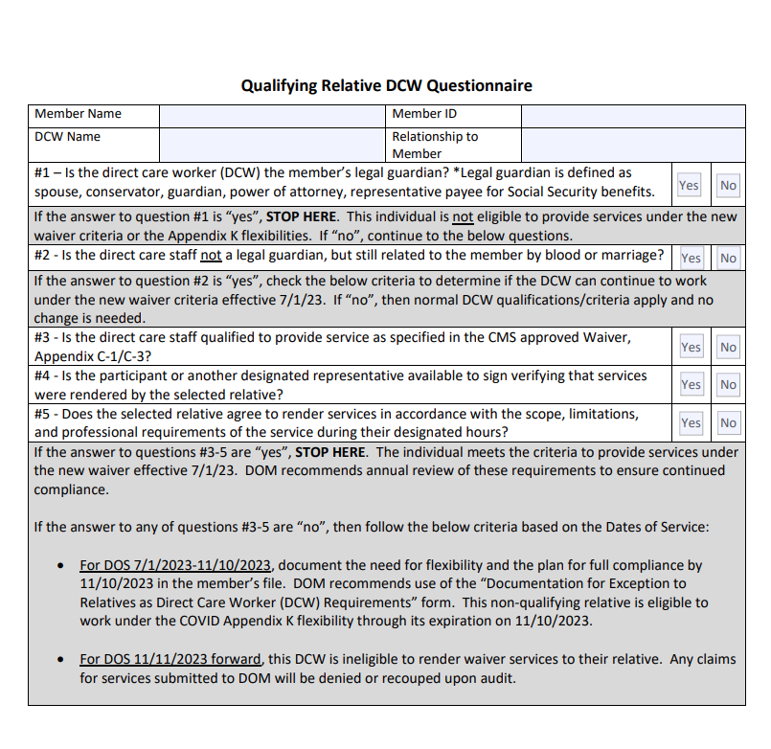
Agency Files: Qualifying Relative DCW Questionnaire
  The Division of Medicaid may allow payments for furnishing waiver services to non-legally responsible relatives only when the following criteria are met:
  The selected relative is a non-legally responsible relative who is at least 18,
  The selected relative must be qualified to provide services as specified in Appendix C-1/C-3 of the CMS approved waiver application
  The beneficiary or a designated representative signs verification that services were rendered by the selected relative, and
  The selected relative must agree in writing, signed prior to providing services, to render services in accordance with the scope, limitations, and professional requirements of the service during their designated hours
  The Division of Medicaid reserves the right to remove a selected relative from the provision of services. If the Division of Medicaid removes a selected relative from the provision of services, the beneficiary will be asked to select an alternate qualified provider
Questionnaire Link: https://medicaid.ms.gov/wp-content/uploads/2023/06/Qualifying-Relative-DCW-Questionnaire-Updated-6.20.23.pdf
Questionnaire Memo Link: https://medicaid.ms.gov/wp-content/uploads/2023/06/Notice-Regarding-Relatives-as-DCWs-Updated-6.20.23.pdf
Notes:
Admin Code Part 208 Chapter 1 Rule 1.3: Provider Enrollment
The Qualifying Relative Direct Care Worker Questionnaire was created to help providers screen staff for beneficiaries receiving services from a qualifying relative. DOM recommends that this questionnaire be completed annually and maintained in the employee file to substantiate compliance with Administrative Code requirements. The notice regarding this policy is available on the HCBS Providers website.

Slide 39

Agency Files: Common Compliance Issues
Agency
  Improper File Storage
  Missing/Incomplete files or records
  Appropriate Signage Not Visible
  Business Line of Credit Not Maintained

Slide 40
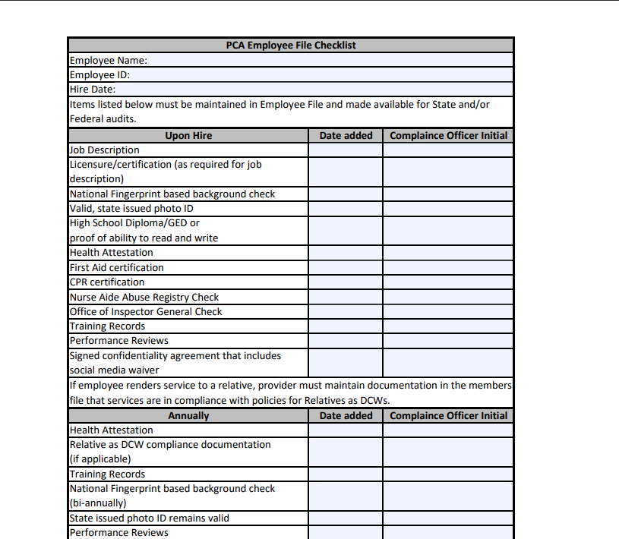
Staff Files: Employee File Checklist
All staff records should include, at a minimum, the following required credentialing and qualification documents:
Copy of valid, state issued ID,
Job description,
Application and date of hire,
High school diploma, General Educational Development (GED) certificate, other educational degrees, or proof of ability to read and write accurately,
Any licensure and/or certifications as required by the Division of Medicaid for job description,
Results of fingerprint-based National Criminal Background check(s),
Results of monthly Nurse Aide Abuse Registry checks,
Results of monthly Office of Inspector General (OIG) checks,
Annual attestation of health,
Signed confidentiality agreement that includes social media waiver, and
Proof of training/evaluations, required professional certifications, and credentials including CPR and First Aid.
Employee File Checklist Link: https://medicaid.ms.gov/wp-content/uploads/2023/05/Employee-File-Checklist-5.17.23.pdf
Notes:
Admin Code Part 208 Chapter 1 Rule 1.8: Documentation/Record Maintenance
DOM has created the Employee File Checklist to simplify the process of maintaining staff records. This list includes, at a minimum, the required credentialing and qualification documents. Upkeeping this list will help Compliance Officers ensure overall program compliance. In case there is an audit by DOM, the agency will need to make sure that all files, including the employee file checklist, are easily accessible.

Slide 41
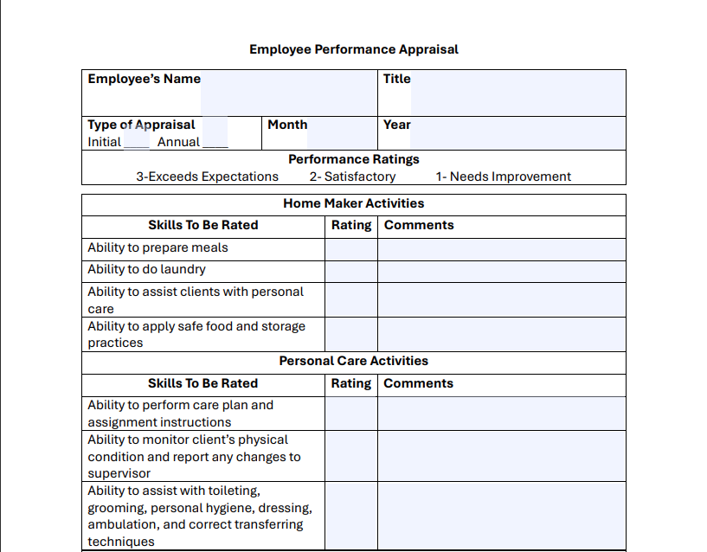
Staff Files: Employee Performance Appraisal
  Employee Performance Appraisals should be completed at hire and annually thereafter.
  Addresses the performance of:
  Home Maker Activities
  Personal Care Activities
  Service Delivery
  Technical Skills and Communication
  Health and Safety Activities
  Work Habits
  Personal Attributes
  Accountability
  Overall Performance
Performance Appraisal Link: https://medicaid.ms.gov/wp-content/uploads/2025/06/Employee-Performance-Appraisal.pdf
Notes:
Admin Code Part 208 Chapter 1 Rule 1.3: Provider Enrollment
The Employee Performance Appraisal Form should be completed by the PCA Supervisor, but may also be completed by an Administrator, CEO, Manager, or Compliance Officer. With the completion of the appraisal, the performance of care provided to the beneficiary will be rated and scored to a certain accountability of the direct care worker. This appraisal should be completed at hire and annually thereafter.

Slide 42
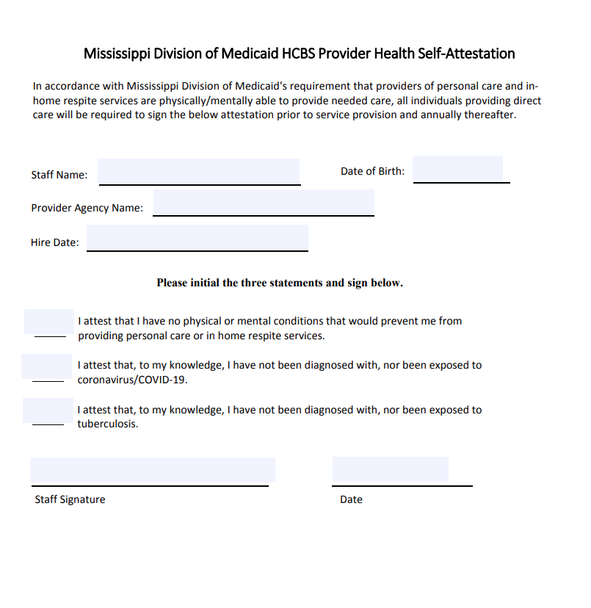
Staff Files: Health Attestation
  Health Self-Attestation forms should be completed at hire and annually thereafter.
  Addresses accountability of:
  Being physically/mentally able to provide care
  Not being diagnosed/exposed to COVID-19
  Not being diagnosed/exposed to tuberculosis
Health Attestation Link: https://medicaid.ms.gov/wp-content/uploads/2023/06/HCBS-Provider-Health-Self-Attestation.pdf
Notes:
Admin Code Part 208 Chapter 1 Rule 1.3: Provider Enrollment
The Health Self-Attestation should be completed at hire and annually thereafter. Please keep in mind that annual TB skin testing is not recommended by the CDC unless there is a known exposure or ongoing transmission at a health care facility. All Health Care Personnel are required to complete LTSS Annual Health Self Attestation, including the TB Risk Assessment from the CDC, which is available on the CDC website, or from the HCBS Provider Team by request.

Slide 43
Staff Files: Common Compliance Issues
Staff
  Resumes (Does Not Meet Minimum Requirements)
  OIG and Nurse Aide Registry Checks Expired
  Background Checks Expired
  Incomplete Training
  No Staff Orientation Upon Hire
  No Social Media Confidentiality Agreement
  Inappropriate Ratio of Supervisors to DCWs
  Missing Valid State IDs
Notes:
Admin Code Part 208 Chapter 1 Rule 1.3: Provider Enrollment
Common compliance issues for staff files may be easily fixed by ensuring that the Employee File Checklist has been updated by the Compliance Officer. The Employee File Checklist has a section specifically for listing dates that the files submitted by the employees have been completed. If the Employee File Checklist has accurately been maintained, common issues of incomplete resumes, expired OIG/NAAR check, expired background check and the like will be non-existent.

Slide 44
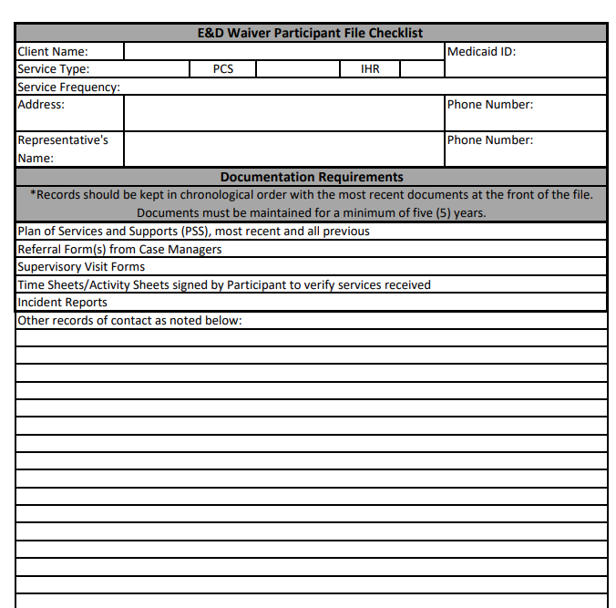
Beneficiary Files: Participant File Checklist
  Records for beneficiaries receiving Personal Care Services (PCS) & In-Home Respite (IHR) should include, at minimum:
  Referral form/authorization,
  Approve Plan of Services and Supports (PSS)
  Daily activity or time sheets capturing tasks completed and the beneficiary/representative’s signature verifying the provision of services, if task and global positioning system (GPS) information is not captured electronically in the state approved electronic visit verification system.
  Service note indicating the causes of any significant variation in the case management recommended/agreed upon schedule of service provision.
  Documentation of bi-weekly supervisory visits.
Participant File Checklist Link: https://medicaid.ms.gov/wp-content/uploads/2022/12/PCS.IHR-Participant-File-Checklist.pdf
Notes:
Admin Code Part 208 Chapter 1 Rule 1.8: Documentation/Record Maintenance
Personal Care and In-Home Respite providers must maintain all files required in the Participant File Checklist for a minimum of five (5) years. This includes the beneficiary’s most recent and all previous PSSs, referral forms from the Case Managers, time sheets, activity sheets, incident reports, and documentation of bi-weekly supervisory visits. If the daily activity or time sheets aren’t captured on HHA’s EVV service, please make sure that paper timesheets are updated with the duties performed. As a reminder, each PSS must be reviewed to make sure the information on the PSS matches the service referral.

Slide 45
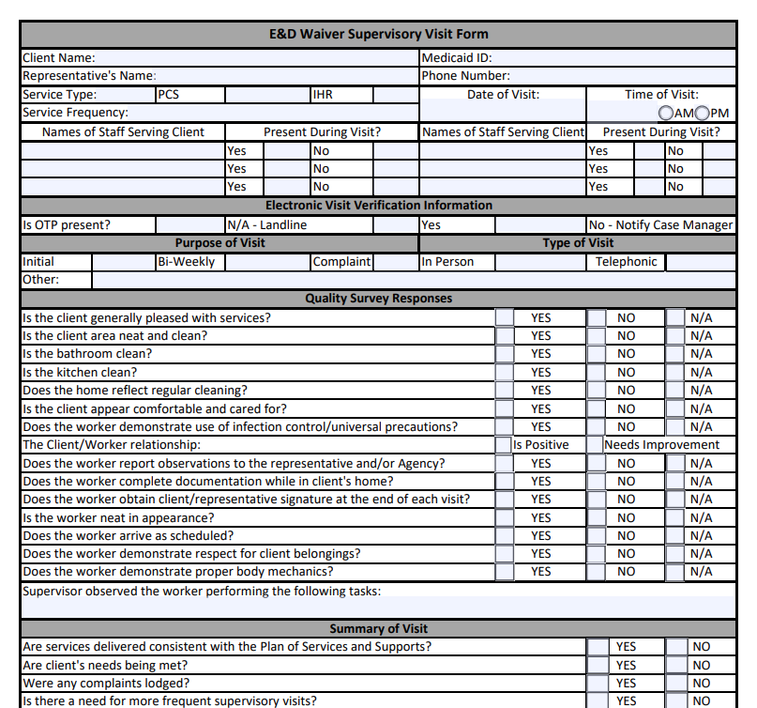
Beneficiary Files: Supervisory Visit Form
  Supervisory visits should be alternating on a bi-weekly basis to assure services and care are provided according to the PSS. Supervisors should perform following:
  Supervised direct monitoring visits in the beneficiary’s home while the PCA staff is on-site
  Unsupervised indirect monitoring visits, which may be performed in the beneficiary’s home or by phone while the PCA staff is not on-site
Supervisory Visit Form Link: https://medicaid.ms.gov/wp-content/uploads/2022/05/PCS-IHR-Supervisory-Visit-Form-1.pdf
Notes:
Admin Code Part 208 Chapter 1 Rule 1.3: Provider Enrollment
The Supervisory Visit Forms should be completed by the Supervisor that performs the alternating supervisory visits on a bi-weekly basis. This form is to ensure that the services and care have been provided to the beneficiaries by the direct care workers according to the PSS. The visits performed should be both supervised visits (with DCW staff present) and unsupervised (with DCW staff not present).

Slide 46
Beneficiary Files: Common Compliance Issues
Beneficiary
  PSS (Current and Previous) Not on File
  Missing Documentation of Bi-weekly Supervisory Visits
  Incident Reports Not Recorded

Slide 47

Proper Storage and Accessibility
  Storage
  Lockable file storage for the security and maintenance of all files in compliance with HIPAA standards.
  Climate controlled storage safe from pests and weather damage.
  Records documenting the provision of services must be maintained by the providers of waiver services for a minimum of five (5) years. If, at the conclusion of the five-year period, there is ongoing litigation or an open audit, the provider must maintain these records until the litigation or audit is concluded.
  Accessibility
  Ensuring immediate access to all beneficiary and employee records as required for audit purposes.
  Filing system of storage of records to be more accessible for auditors.
  Annual
  Alphabetical
  Numerical
  Color Code
Notes:
Admin Code Part 208 Chapter 1 Rule 1.3: Provider Enrollment
According to the Administrative Code, Providers must have proper storage and accessibility. More specifically, a lockable file storage that is away from pests and weather damage. All records must be maintained for a minimum of five years for auditing purposes. If there is ongoing audit, these records must be maintained until the audit has concluded.
These records for beneficiaries and staff must also be available for immediate access to DOM’s audit team. The filing should be organized by annual, alphabetical, numerical, or color coded.

Slide 48
Additional Resources

Slide 49

Marketing, Referrals, & PSS
In order to ensure that waiver providers are in compliance with DOM regulations regarding freedom of choice, solicitation, and protection of Protected Health Information (PHI), please refer to the following guidance for appropriate marketing and referrals of potential waiver beneficiaries.
Notes:
The following slides were created to address common compliance issues with DOM regulations for marketing and referrals for potential waiver beneficiaries. This process helps protect health information and allows beneficiaries full freedom of choice, not only to choose a provider agency, but to choose which waiver program best suits their needs.

Slide 50


Referrals & PSS
Waiver providers should not be completing waiver intake referral forms and sending them to Case Managers. While performing marketing for your agency, if an individual shows interest in Home & Community Based Services, that individual should be provided with contact information for the Mississippi Access to Care Network, or the MAC Centers. The MAC Center in their area can be contacted by phone at 1-844-822-4622 or via the “Send a message to MAC Center” button on their webpage.
Once the individual contacts the MAC Center, they will receive information on available services as well as referrals to applicable programs to meet their needs. After speaking with the MAC Center, if the individual is interested in applying for a Medicaid waiver, their name will be placed on a waiting list and will be evaluated for physical and financial eligibility when an open slot becomes available.
When a referral is received, Providers must compare the frequency on the referral to the frequency on the PSS. If discrepancies are found, the Provider must notify the PDD immediately.
Link: https://www.mississippiaccesstocare.org/help-info/contact-us
Link: http://mspdds.org/pdd-services/
Notes:
The process shown here has been created to ensure providers are following requirements, so all members have freedom of choice. The E&D waiver is not the only option for services, the MAC Center & PDD can help members navigate those choices.
Once a beneficiary chooses a waiver program, their name is placed on the local waitlist until a slot becomes available. Once a slot becomes available, an assessment is completed by the case managers at the PDD and financial eligibility is determined by the regional office. Once eligibility is established, the beneficiary then gets to choose a service provider approved for their area. This choice results in the submission of a referral and a Plan of Service.
When you receive a referral, whether it be for an initial enrollment or recertification, compare the frequency on that referral to the frequency on the PSS and confirm that the Provider Number on the PSS is accurate. Notify the case managers of discrepancies.

Slide 51

Freedom of Choice
  Waiver providers must keep in mind that not all individuals interested in services will qualify. Additionally, those who do qualify must be guaranteed the freedom to choose any qualified provider servicing their area.
  Waiver providers are prohibited from any actions which would in any manner, deny or restrict that individual's free choice of a provider of any services for which the individual may be eligible. Providers cannot use any method of inducement, including free transportation, refreshments, cash or gifts, to influence a beneficiary to select a certain provider.
Notes:
Admin Code Part 208 Chapter 1 Rule 1.4: Freedom of Choice
An undeniable right for beneficiaries is that they have the right to have the Freedom of Choice of eligible providers for covered services. With this right, providers may not require beneficiaries to sign a statement restricting their free choice to a single provider or influence them by any method of inducement. This includes and is not limited to free transportation, refreshments, cash or gifts.
If DOM is notified of any solicitation, your agency will be reported to our Program Integrity Division for investigation.

Slide 52

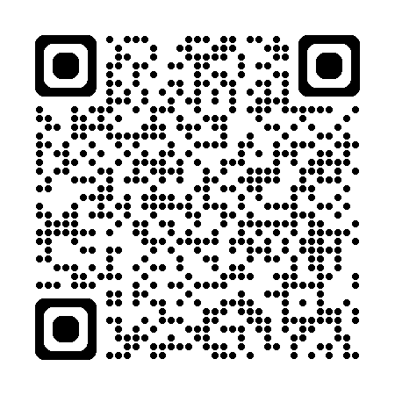



Contact Updates
LTSS is now utilizing SmartSheets to gather Contact Updates from PCS-IHR Providers. You can scan the QR code and fill out the form to ensure our office has the most current information for your agency.
Providers are required to report changes in contact information, administrative staffing, ownership and licensure within ten (10) calendar days to the Division of Medicaid. You may also use the SmartSheet to report such changes.
LTSS uses the information from this annual update to ensure that the Case Managers have accurate contact information for the Freedom of Choice list so you can continue to receive referrals.
LTSS also uses this information to confirm that your facility is still at the address we have on file.
Office Location Intake Link: https://app.smartsheet.com/b/form/d54231454eaf4513a38bfd61c722a128
Notes:
Admin Code Part 208 Chapter 1 Rule 1.5: Quality Management
The LTSS office is now utilizing SmartSheets to update contact information for Personal Care and In-Home Respite providers. This information is used to ensure that your agency has an accurate address and contact for the Freedom of Choice list so that you may continue to receive referrals.
Once again, Providers are required to report any changes in contact information, staffing, ownership, and licensure within 10 calendar days to the Division of Medicaid. Providers are able to use this Contact Form to report any changes.
The Freedom of Choice list and provider contact information is maintained separately, outside of MESA, in our office. Changes in contact info submitted via the MESA portal do not get reported to our office. Any updates needed should start by contacting LTSS and if further actions are required, we will assist with that process.

Slide 53
Resources for Success
PCS & IHR Frequently Asked Questions
Professional Provider Etiquette
Quality Management
Helpful Links

Slide 54

PCS & IHR Frequently Asked Questions
Can family members serve as Direct Care Workers (DCWs)?
Personal Care Service and In-Home Respite Service may be furnished by family members if they are not legally responsible for the person. Family members must be employed by a Medicaid approved agency that provides PCS/IHR, must meet provider standards, and must be deemed competent to perform the required tasks.
Can DCWs transport Medicaid beneficiaries?
Staff may accompany persons during community activities but cannot drive the vehicle. Beneficiaries have access to Non-Emergency Transportation services and their Case Managers can assist them with coordinating those services.
Can my Compliance Officer also serve as a Supervisor?
No, Compliance Officers and Supervisors are two different positions.
How do I expand my service area?
Send an email to HCBSProviders@medicaid.ms.gov requesting expansion and we will send a Satellite Office packet for your agency to fill out in order to expand the area.
How much should DCWs be paid?
Our office requires providers to comply with all state and federal laws and regulations and labor laws. You can contact the Department of Labor concerning basic wage standards. https://www.dol.gov/agencies/whd

Slide 55
PCS & IHR Frequently Asked Questions
Will a DCW need to clock out if running errands with a beneficiary?
  A DCW can provide services both in the home and in the community. Usually if a participant needs assistance with running errands, the Case Manager will add CAT hours to the PSS, however this is not required. Services provided in the community are billed the same way as services provided inside the home. For example, if the DCW is on the clock, and the participant wants to run some errands, the DCW would remain on the clock and travel with (but not drive) the participant during the errands. If the beneficiary leaves the home without the DCW, the DCW must clock out and leave.
I am looking to provide services for Medicare. How do I do that?
  Information on Medicare provider enrollment can be found on the CMS website linked here. https://www.cms.gov/medicare/enrollment-renewal/providers-suppliers
Are there state-approved training programs?
  Many providers choose to use the Arc of Mississippi for their training, but this is not a requirement. Please refer to the Administrative Code for appropriate procedures regarding for training staff.
Are TB skin tests and physicals still required in the Employee File?
  Annual TB skin testing of Health Care Personnel (HCP) is not recommended by the CDC unless there is a known exposure or ongoing transmission at a health care facility. All HCP are required to complete LTSS Annual Health Self Attestation, including the TB Risk Assessment from the CDC. https://www.cdc.gov/tb-healthcare-settings/hcp/risk-assessment/index.html

Slide 56

  All emails should include a signature. The signature should have the name of the person emailing, role in agency, agency’s name, provider ID(s), phone number, email, and fax number
  The topic should be in the email subject line.
  All messages should be clear and concise. This includes phone calls, voicemails and emails.
  All emails containing beneficiary specific information (names, Medicaid ID, Date of Birth, etc.) must be encrypted. This is to ensure that the privacy of the beneficiary is protected.
  Email addresses should be appropriate. This includes the following:
    Email domain should be able to be passed down
      Ex) Approved: Admin@HealthCareAgency.com or AdminHealthCareAgency@gmail.com
      Ex) Not Approved: CowgirlJane601@gmail.com
Professional Provider Etiquette
Notes:
Professionalism from providers is key in helping improve effective communication with the Division of Medicaid. This guide should be beneficial to those providers interested in helping improve the etiquette of staff and streamlining the best response from DOM in answering your questions or concerns.
All emails should include a signature, topic, and be encrypted. This helps ensure that the privacy of the beneficiary is protected and that DOM has a contact plus the issue addressed within the same email. If in doubt about your ability to encrypt emails, the HHA Portal has a secure message feature that automatically protects PHI and allows you to communicate directly with our staff. Please limit the message portal to emails that require the use of PHI if not directly related to HHA.
Another note is that email addresses should be appropriate. Having email domains that are able to be passed down will make it easier for providers in case there is an instance of the staff being removed from the position. The new staff that fills the position should have a seamless transition to the approved email domain.
Finally, please do not send the same email to multiple staff at DOM. Emailing HCBSProviders will get your request to our entire team. However, if you send that same email to multiple people, it can create confusion and additional work which slows down general response time.

Slide 57

Quality Management
If an E&D Waiver provider fails to respond to contact attempts timely or respond to requests for documentation/training verification in established timeframes, the Division of Medicaid may halt the acceptance of Medicaid referrals or waiver admissions until the E&D waiver provider establishes contact or demonstrates compliance with the regulatory agency
The decision to halt Medicaid referrals or waiver admissions is at the discretion of the Division of Medicaid.
Notes:
Please ensure that all contact information for your agency is accurate and true. The Division of Medicaid has the right to halt E&D Waiver referrals and admissions if your agency fails to respond to communications timely or if the Division of Medicaid is unable to contact your agency. Your agency will remain removed from the freedom of choice list until contact is reestablished.

Slide 58



Providers must report:
Critical incidences including all instances of abuse, neglect, and exploitation (including the unauthorized use of restraints, restrictive interventions, and/or seclusion) within twenty (24) hours of the occurrence or knowledge of the occurrence to the Division of Medicaid and other applicable agencies as required by law.
To DOM any complaints which are not resolved within seven (7) days.
Adult Protective Services - Mississippi Department of Human Services
Notes:
Any type of critical incidents, especially instances of abuse, neglect, exploitation, or suspicious death must be reported to the Mississippi Department of Human Service’s Division of Aging and Adult Services within 24 hours of knowledge of occurrence.
Providers must report any complaints which are not resolved within 7 days to the Division of Medicaid. A specific example of this is if a member is unsatisfied with their PCA, and your agency has been unable to staff a new PCA with them within 7 days.

Slide 59



Reporting Critical Incidents & Complaints
Division of Medicaid
Mississippi Planning and Development District
Phone: 844-822-4622
Email: mail@mspdds.com
Adult Protective Services
Phone: (601) 359-6141
Phone: 844-437-6282
Email: HCBSProviders@medicaid.ms.gov
Report Online: https://www.mdhs.ms.gov/aging/adult-protective-services/
Notes:
APS would receive reports of Abuse, Neglect, Exploitation, or suspicious death.
The PDD would receive reports of beneficiaries or their relatives acting inappropriately with Provider Staff.
DOM would receive all other complaints.

Slide 60



Mississippi Planning & Development Districts (PDDs)
Central Mississippi (CMPDD)
Phone: (601) 981-1511
Counties Served:
East Central (ECPDD)
Phone: (601) 683-7409
Counties Served:
Golden Triangle (GTPDD)
Phone: (662) 324-7860
Copiah
Clarke
Counties Served:
Choctaw
Hinds
Madison
Rankin
Simpson
Warren
Yazoo
Clay
Lowndes
Noxubee
Oktibbeha
Webster
Winston
Jasper
Kemper
Lauderdale
Leake
Neshoba
Newton
Scott
Smith
Notes:
The following slides will have a list of counties and the contact number for each respective PDD.

Slide 61




Mississippi Planning & Development Districts (PDDs)
North Central (NCPDD)
Phone: (662) 283-2675
Counties Served:
North Delta (NDPDD)
Phone: (662) 561-4100
Counties Served:
North East (NEPDD)
Phone: (661) 728-7038
Counties Served:
Attala
Carroll
Grenada
Holmes
Leflore
Montgomery
Yalobusha
Coahoma
Desoto
Panola
Quitman
Tallahatchie
Tate
Tunica
Alcorn
Benton
Marshall
Prentiss
Tippah
Tishamingo
South Delta (SDPDD)
Phone: (662) 378-3831
Counties Served:
Boliver
Humphreys
Issaquena
Sharkey
Sunflower
Washington

Slide 62



Mississippi Planning & Development Districts (PDDs)
Southern MS (SMPDD)
Phone: (228) 868-2311
Counties Served:
Southwest MS (SWPDD)
Phone: (601) 446-6044
Counties Served:
Three Rivers (TRPDD)
Phone: (662) 489-2415
Covington
Adams
Counties Served:
Calhoun
Forrest
George
Greene
Hancock
Harrison
Jackson
Jefferson Davis
Chickasaw
Itawamba
Lafayette
Lee
Monroe
Pontotoc
Union
Amite
Claiborne
Franklin
Jefferson
Lawrence
Lincoln
Pike
Walthall
Jones
Jones
Lamar
Marion
Pearl River
Perry
Stone
Wayne
Wilkinson

Slide 63
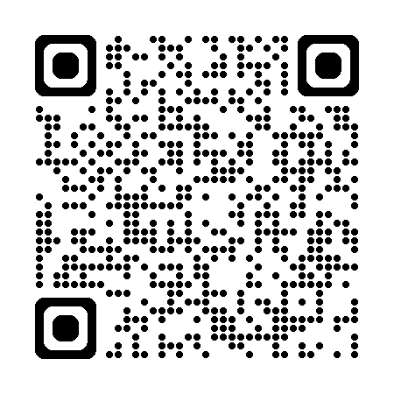
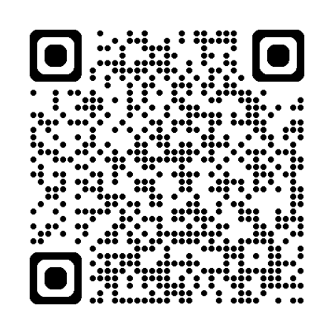
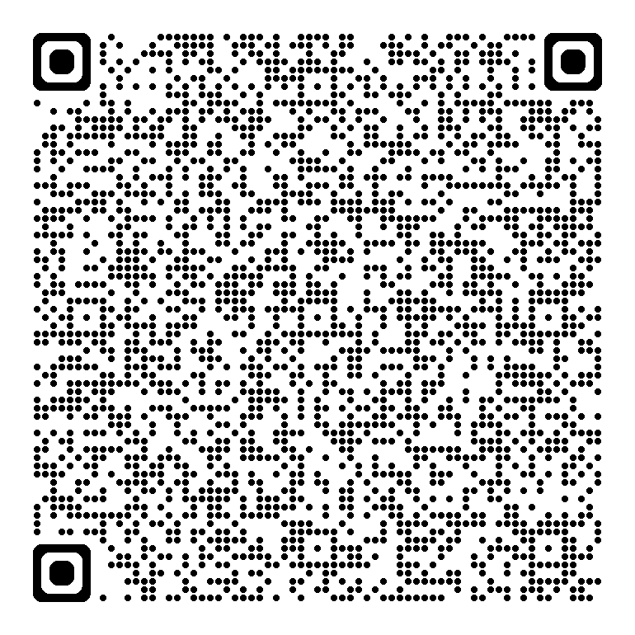
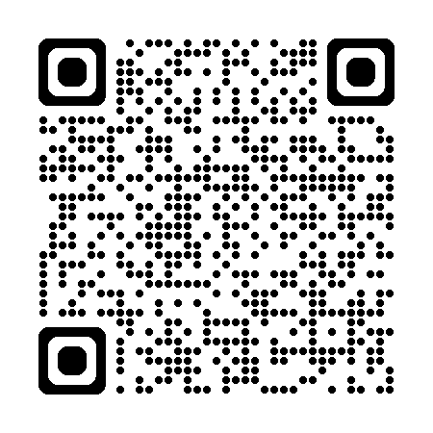
Helpful Links
HCBS Providers Site
Department of Labor
HHA Resources Library
HHA Knowledge Base
https://medicaid.ms.gov/hcbs-waiver-providers/
https://www.dol.gov/sites/dolgov/files/WHD/legacy/files/homecare_guide.pdf
https://www.hhaexchange.com/resources
https://knowledge.hhaexchange.com/provider/Content/Home/Home-C.htm
Notes:
The links and QR Codes displayed offers Providers a multitude of resources as they pertain to general E&D provider knowledge and properly filing claims.
The HCBS Providers website is where you can find all forms, trainings, and the Administrative Code.
The Department of Labor link directs you to their regulations for paying minimum wage and overtime for your staff of home care workers.
The HHA Resources Library hosts a series of webinars that may be beneficial to providers seeking to learn more about EVV, training videos, and guides to help grow your homecare agency. This should be your first resource for any issues with HHA, prior to seeking assistance from their Help Desk, or DOM.
HHA Knowledge Base also provides training videos, access to HHA frequently asked questions, a glossary for homecare terms, and troubleshooting guides.

Slide 64




Need Technical Assistance?
HHA
  Billing issues
  Staff unable to clock in/out
  Removing beneficiaries off roster
  Beneficiaries under wrong contract
Gainwell
  Recredentialing applications
  Issues with MESA
  Updating agency contacts and address
  Requesting 1099 tax forms
DOM
  Expanding service area
  Relocating
  Change of Ownership
  Staffing changes
  Audits
PDD
  Requesting more hours for clients
  Any adjustments made to PSS
  Missing lock-in on PSS
  Beneficiaries needing transportation
Gainwell Representative Link: https://medicaid.ms.gov/wp-content/uploads/2025/05/Q2-2025-PROVIDER-FIELD-REPRESENTATIVES_Map-and-By-County_v2.0.pdf
Notes:
Our office often receives questions as to who would be the most appropriate point of contact for certain issues. In an effort to give providers a greater understanding of the provision of technical services, we have divided the responsibilities of HHA, Gainwell, DOM, and PDDs.
Any questions relating to HHA missing authorizations, staff clocking in or out, or discharging beneficiaries will need to be directed towards the HHA Communications Portal or email evv@medicaid.ms.gov
Questions for recredentialing, MESA issues, updating agency contact, or requesting tax forms should be directed towards your local Gainwell Field Provider Representative. You may find their contact information on the linked PDF.
DOM should receive questions for expanding service areas, relocating, changing ownership, staffing changes, or audits. You may call or email us for any inquires.
PDDs work in hand with the beneficiary’s Case Manager. The Case Manager should always be contacted in requests more hours, PSS adjustments, and coordinating transportation.

Slide 65
Staying Informed
  Policy Updates: Get notified when new policies are announced, email a contact name, place of business and a contact number (optional) to DOMPolicy@medicaid.ms.gov
  Late Breaking News: To sign up to receive email alerts every time DOM posts a Late Breaking News update, just email a contact name, place of business and a contact number (optional) to LateBreakingNews@medicaid.ms.gov
  If you have questions about background checks please contact MS Department of Health Julie.Henderson@msdh.ms.gov
  If you have questions about MESA please contact your Gainwell Regional Field Representative https://medicaid.ms.gov/wp-content/uploads/2025/05/Q2-2025-PROVIDER-FIELD-REPRESENTATIVES_Map-and-By-County_v2.0.pdf
  If you have questions about your responsibilities as an employer, please contact Mississippi’s Department of Labor at 601-956-4347
  If you have policy questions about HHA or EVV please contact EVV@medicaid.ms.gov
Notes:
A variety of helpful links have been provided to keep you updated on related policy and regulations.
We encourage all providers to sign up for our policy distribution list and Late Breaking newsletters by contacting the email listed onscreen. Once signed up, you will receive email notifications of all proposed or implemented changes to the Medicaid State Plan, Administrative Code or the any of the Waiver Programs.
If you have any questions regarding background checks, MESA, or your responsibilities as an employer, you may click on the links above to be routed to the appropriate resource.

Slide 66


Staying in Touch
Mississippi Division of Medicaid, Office of Long Term Services & Supports
Phone: (601) 359-6141
Website: https://medicaid.ms.gov/hcbs-waiver-providers/
Email Address: HCBSProviders@medicaid.ms.gov
Address: Office of Long Term Services & Supports
Division of Medicaid
Walter Sillers Building
550 High Street
Jackson, MS 39201
Notes:
To stay in touch with the Division of Medicaid's Office of Long Term Services and Supports, you may reach us by phone, email, or mail.
To effectively communicate responses to inquires, emails sent to the HCBS email account will result in more timely response. We have multiple staff monitoring that account daily.

Slide 67

Questions?
E&D FAQ Link: https://app.smartsheet.com/b/form/857d8057557a4693a06cb00130302f4c
Notes:
If you have any questions regarding the topics covered in this presentation, please scan the QR Code and submit any questions/concerns to our E&D Frequently Asked Questions Smartsheet form.

