Slide 1

Communications Reference Guide (Toolkit)
Medicaid Management Information System (MMIS) Replacement Project (MRP)
Published as of 9/30/2022

Slide 2
Disclaimer
This is an iterative document that will be continuously updated to reflect the project’s current status, key messages, and related information to facilitate accurate and consistent messaging across the Mississippi Division of Medicaid (DOM).
As such, please follow the below guidance to help maintain version control:
Download the most recent version of the document at the link at the bottom of this page every time you choose to utilize any of the materials included in the subsequent pages
Do not save this file to your personal folders as you could accidentally use an older version of the document
Do not modify any of the following content
Reach out to the Organizational Change Management (OCM) team, if you have any questions or to submit a request to modify content
Communications Reference Guide Link
*Click the link while in presentation mode
Notes:
The link on the blue bar points to DOM OneDrive. This will be the master copy location. All updates will cascade from here. This toolkit is also posted to the MRP SME Community Teams channel.

Slide 3
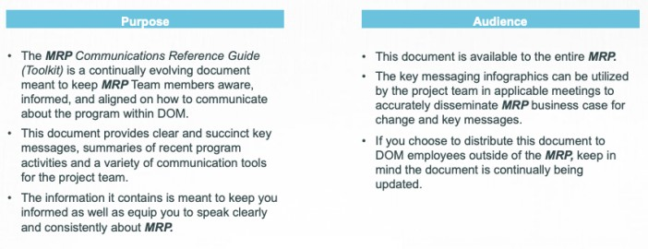
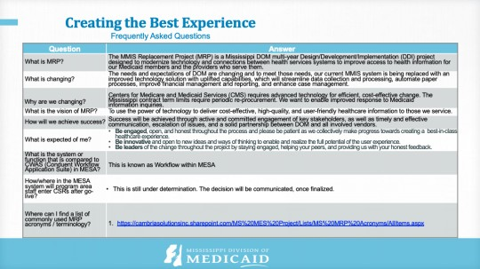
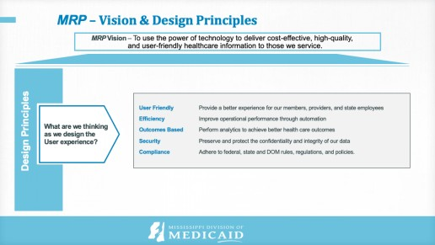
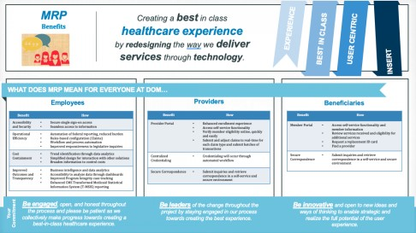
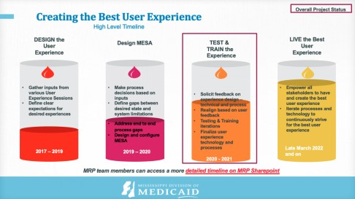
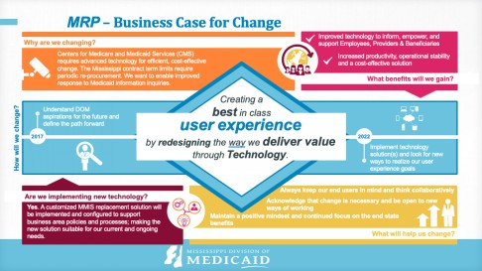
Table of Contents
Purpose & Audience
The purpose section describes the objective and audience for this document, and how the Mississippi Division of Medicaid (DOM) MRP can utilize it for communicating with their teams and other audiences.
Project Communication Tools
This section provides the project design principles, critical key messages, timelines and frequently asked questions that the MRP should be utilizing when communicating with broader audiences about the project.

Slide 4
Purpose & Audience
Purpose
Audience
The MRP Communications Reference Guide (Toolkit) is a continually evolving document meant to keep MRP Team members aware, informed, and aligned on how to communicate about the project within DOM.
This document provides clear and succinct key messages, summaries of recent project activities and a variety of communication tools for the project team.
The information it contains is meant to keep you informed as well as equip you to speak clearly and consistently about MRP.
This document is available to the entire MRP.
The key messaging infographics can be utilized by the project team in applicable meetings to accurately disseminate MRP business case for change and key messages.
If you choose to distribute this document to DOM staff outside of the MRP, keep in mind the document is continually being updated.

Slide 5

MRP Communication Tools
Executive Summary
Vision & Design Principles
Business Case for Change
Benefits
What’s Changing?
Key Messaging
High Level Timeline
Current Activities & MRP Communications
Subject Matter Expert (SME) Reflections
Frequently Asked Questions
MESA Environments & Descriptions
*Utilize the following slides and messaging in this section for communicating with your teams and other audiences.

Slide 6
MRP Executive Summary
High Level Key Messages
1
The needs and expectations of DOM are changing and to meet those needs, our current MMIS system is being replaced with an improved technology solution with uplifted capabilities, which will streamline data collection and processing, automate paper processes, improve financial management and reporting, and enhance case management.
2
The MMIS Replacement Project (MRP) is a Mississippi DOM multi-year project designed to modernize technology and connections between health services systems to improve access to health information for our Medicaid members and the providers who serve them.
3
MRP is creating a best-in-class User Experience by refining the way we deliver value through Technology. We are thinking about our staff, Providers and Beneficiaries first in everything we do. The project team is continuously gathering input from DOM staff to understand the desired user experiences and to inform key process and experience design decisions.
4
We recognize the need to provide the right supporting technologies to enable our Providers, Beneficiaries, and all staff. One component of MRP is to build the required technology infrastructure to make it easier for all users to engage with DOM processes. MESA, our new, customized Medicaid system, is planned for implementation in 2022.
5
Success will be achieved through active and committed engagement of key stakeholders, as well as timely and effective communication, escalation of issues, and a solid partnership between DOM and all involved vendors.

Slide 7
MRP – Vision & Design Principles
MRP Vision – To use the power of technology to deliver cost-effective, high-quality, and user-friendly healthcare information to those we service.
Design Principles
User Friendly Provide a better experience for our members, providers, and DOM staff
Efficiency Improve operational performance through automation
Outcomes Based Perform analytics to achieve better health care outcomes
Security Preserve and protect the confidentiality and integrity of our data
Compliance Adhere to federal, state and DOM rules, regulations, and policies
What are we thinking
as we design the
User experience?

Slide 8




MRP – Business Case for Change
Why are we changing?
Improved technology to inform, empower, and support DOM Staff, Providers & Beneficiaries
Centers for Medicare and Medicaid Services (CMS) requires advanced technology for efficient, cost-effective change. The Mississippi contract term limits require periodic re-procurement. We want to enable improved response to Medicaid information inquiries.
Increased productivity, operational stability and a cost-effective solution
What benefits will we gain?
Creating a
best in class
How will we change?
Understand DOM aspirations for the future and define the path forward
user experience
by redesigning the way we deliver value
through Technology.
2017
2022
Implement technology solution(s) and look for new ways to realize our user experience goals
Always keep our end users in mind and think collaboratively
Are we implementing new technology?
Acknowledge that change is necessary and be open to new ways of working
Yes. A customized MMIS replacement solution will
be implemented and configured to support business area policies and processes; making the new solution suitable for our current and ongoing needs.
Maintain a positive mindset and continued focus on the end state benefits
What will help us change?

Slide 9


MRP
Benefits
Creating a best in class
healthcare experience
by redesigning the way we deliver services through technology.
EXPERIENCE
BEST IN CLASS
BE THE CHANGE!
USER CENTRIC
WHAT DOES MRP MEAN FOR EVERYONE AT DOM…
DOM Staff
Providers
Beneficiaries
Benefit | How
Accessibility and Security | Secure single sign-on access Seamless access to information
Operational Efficiency | Automation of federal reporting, reduced burden Rules-based configuration (Claims) Workflow and process automation Improved responsiveness to legislative inquiries
Cost Containment | Trend identification through data analytics Simplified design for interaction with other solutions Broaden information to control costs
Improved Outcomes and Transparency | Business intelligence and data analytics Accessibility to analyze data through dashboards Improved Program Integrity case tracking Enhanced CMS Transformed Medicaid Statistical Information System (T-MSIS) reporting
Benefit | How
Provider Portal | Enhanced enrollment experience Access self-service functionality Verify member eligibility online, quickly and easily Submit and adjust claims in real-time for each claim type and submit batches of transactions
Centralized Credentialing | Credentialing will occur through automated workflow
Secure Correspondence | Submit inquiries and retrieve correspondence in a self-service and secure environment
Benefit | How
Member Portal | Access self-service functionality and member information Review services received and eligibility for additional services Request a replacement ID card Find a provider
Secure Correspondence | Submit inquiries and retrieve correspondence in a self-service and secure environment
Your Commitment
Be engaged, open, and honest throughout the process and please be patient as we collectively make progress towards creating a best-in-class healthcare experience.
Be leaders of the change throughout the project by staying engaged in our process towards creating the best experience.
Be innovative and open to new ideas and ways of thinking to enable strategic and realize the full potential of the user experience.
9

Slide 10
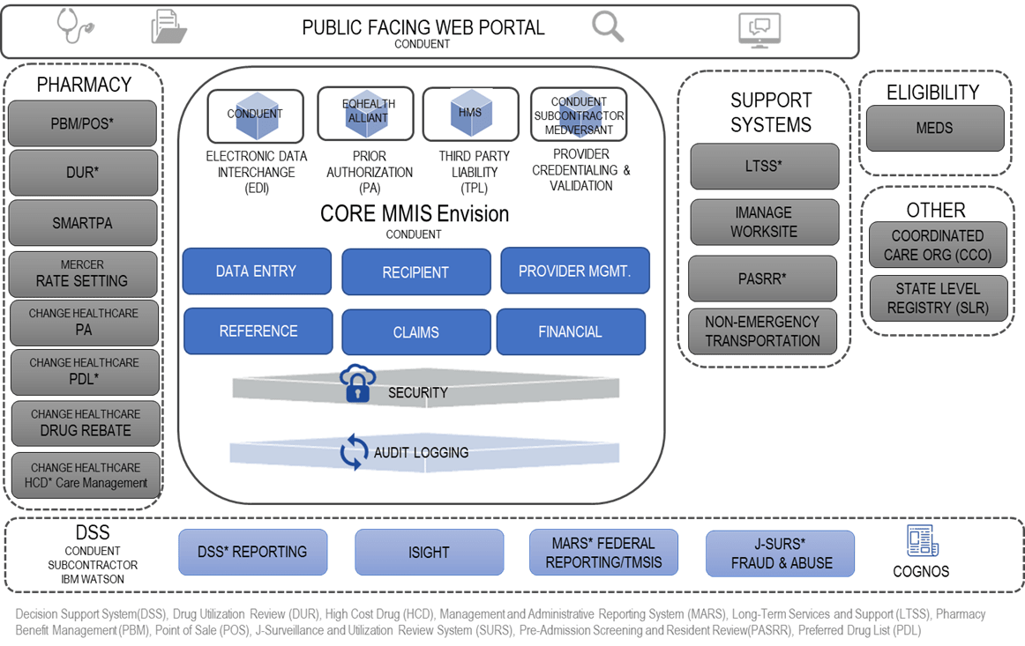
What’s changing?
Future State
MESA
Current State
Envision

Slide 11
MRP
Staff Key Messages
Creating a best in class
healthcare experience
by redesigning the way we deliver services through technology.
EFFICIENCY
BEST IN CLASS
AUTOMATION
USER CENTRIC
WHAT DO WE WANT DOM STAFF TO KNOW ABOUT MRP…
DOM is building a new MMIS, known as MESA. This updated technology will allow for better interactions and more transparency with Medicaid providers and members. MESA will replace dated technology with a more efficient version that is easier to maintain:
  MESA will be more efficient, with workflow automation so it is clear what needs to happen.
  Providers will have a new, enhanced self-service portal where they can verify member eligibility, submit claims and supporting documentation.
  A new member portal will allow self-service and access to account information. This means DOM will get fewer requests for simple information, allowing focus on other important work.
  MESA will enhance security – further protecting the confidentiality and integrity of Medicaid data.
All of this means we are setting our provider and members up for successful and respectful relationships with DOM, and generally improving their experience with government. The successful implementation of the new MMIS will support DOM’s overarching objectives of improving health outcomes, elevating quality, lowering spending trends in Medicaid, reducing unnecessary burdens on members and providers, and increasing transparency to the public.
MESA is expected to go-live in 2022. Before that happens, DOM will ensure MESA has been thoroughly tested, and staff, providers, and members have the resources they need to use it successfully.
Your Commitment
Be engaged, open, and honest throughout the process and please be patient as we collectively make progress towards creating a best-in-class healthcare experience.
Be leaders of the change throughout the project by staying engaged in our process towards creating the best experience.
Be innovative and open to new ideas and ways of thinking to enable strategic and realize the full potential of the user experience.
9

Slide 12
MRP
Provider Key Messages
Creating a best in class
healthcare experience
by redesigning the way we deliver services through technology.
SELF-SERVICE
SECURE
INTEGRATED
AUTOMATION
WHAT DO WE WANT PROVIDERS TO KNOW ABOUT MRP…
The Mississippi DOM is building a new Medicaid Management Information System (MMIS), known as MESA. This updated technology will allow for better interactions and more transparency with Medicaid providers and members.
  MESA will be more efficient, with workflow automation and easy access to a broad range of information.
  Providers will have a new, enhanced self-service portal where they can verify member eligibility, submit claims and access supporting documentation.
  DOM will implement centralized credentialing that will reduce Provider administrative burden.
  MESA will enhance security – further protecting the confidentiality and integrity of Medicaid data.
  MESA will allow us to analyze data to work toward better health care outcomes for Mississippians.
The successful implementation of the new MMIS will support DOM’s overarching objectives of improving health outcomes, elevating quality, lowering spending trends in Medicaid, reducing unnecessary burdens on members and providers, and increasing transparency to the public.
MESA is expected to go live in 2022. Before that happens, DOM will ensure MESA has been thoroughly tested, and staff, providers, and members have the resources they need to use it.
Your Commitment
Be engaged, open, and honest throughout the process and please be patient as we collectively make progress towards creating a best-in-class healthcare experience.
Be leaders of the change throughout the project by staying engaged in our process towards creating the best experience.
Be innovative and open to new ideas and ways of thinking to enable strategic and realize the full potential of the user experience.
9

Slide 13
MRP
Member Key Messages
Creating a best in class
healthcare experience
by redesigning the way we deliver services through technology.
SELF-SERVICE
ACCESSIBILITY
SECURE
MEMBER CENTRIC
WHAT DO WE WANT BENEFICIARIES TO KNOW ABOUT MRP…
The Mississippi Division of Medicaid (DOM) is building a new Medicaid Management Information System (MMIS), known as MESA. This updated technology will allow for better interactions and more transparency with Medicaid providers and members. MESA will replace dated technology with a more efficient version that is easier to maintain.
  A new member portal will allow self-service and access to account information. This adds value for Medicaid providers and members, which ultimately means value for DOM staff and the State of Mississippi.
  MESA will enhance security – further protecting the confidentiality and integrity of Medicaid data.
  MESA will allow us to analyze data to work toward better healthcare outcomes for Mississippians.
All of this means we are setting our members and their families up for successful and respectful relationships with us, and generally improving their experience with government. The successful implementation of the new MMIS will support DOM’s overarching objectives of improving health outcomes, elevating quality, lowering spending trends in Medicaid, reducing unnecessary burdens on members and providers, and increasing transparency to the public.
MESA is expected to go-live in 2022, meeting federal requirements for an MMIS and State contracting rules. Before that happens, DOM will ensure MESA has been thoroughly tested, and staff, providers, and members have the resources they need to use it.
Your Commitment
Be engaged, open, and honest throughout the process and please be patient as we collectively make progress towards creating a best-in-class healthcare experience.
Be leaders of the change throughout the project by staying engaged in our process towards creating the best experience.
Be innovative and open to new ideas and ways of thinking to enable strategic and realize the full potential of the user experience.
9

Slide 14
MRP Project– History & Current Status
2018
2019
2020
2021
2022
Initiation
Design (DSD) Reviews
Requirements Validation
Go-Live
Design
Requirements (RSD) Reviews
We Are Here
Development
Testing (incl. UAT)
Implementation
Certification
Notes:
PROJECT BACKGROUND
The MMIS Replacement Project (MRP) is DOM’s multi-year project to modernize technology and connections between health services systems to improve access to health information for our Medicaid members and the Providers who serve them.

Slide 15
Creating the Best User Experience
High Level Timeline
Overall Project Status
DESIGN the User Experience
TEST & TRAIN the Experience
Solicit feedback on experience design – technical and process
Realign based on user feedback
Testing & Training iterations
Finalize user experience technology and processes
2020 - 2022
LIVE the Best User Experience
Design MESA
Gather inputs from various User Experience Sessions
Define clear expectations for desired experiences
Make process decisions based on inputs
Define gaps between desired state and system limitations
Address end to end
process gaps
Design and configure MESA
Empower all stakeholders to have and create the best user experience
Iterate processes and technology to continuously strive for the best user experience
2017 – 2019
2019 – 2020
2022 & beyond
Notes:
LINK TO PMO TIMELINE

Slide 16
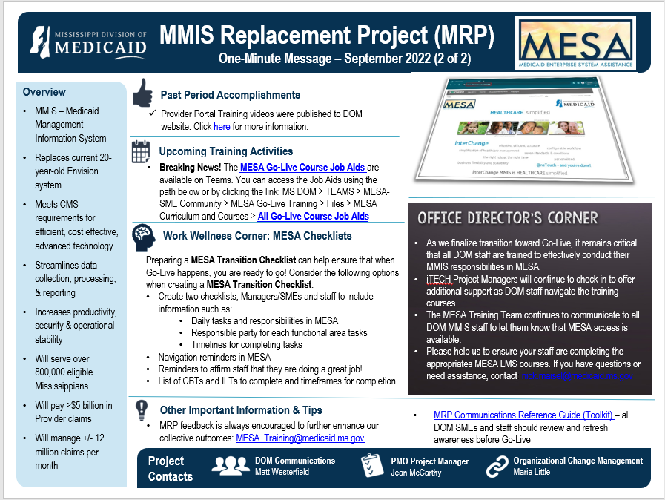
MRP Current Activities
September 2022

Slide 17
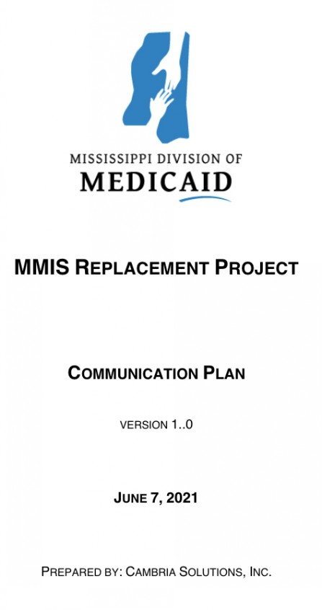
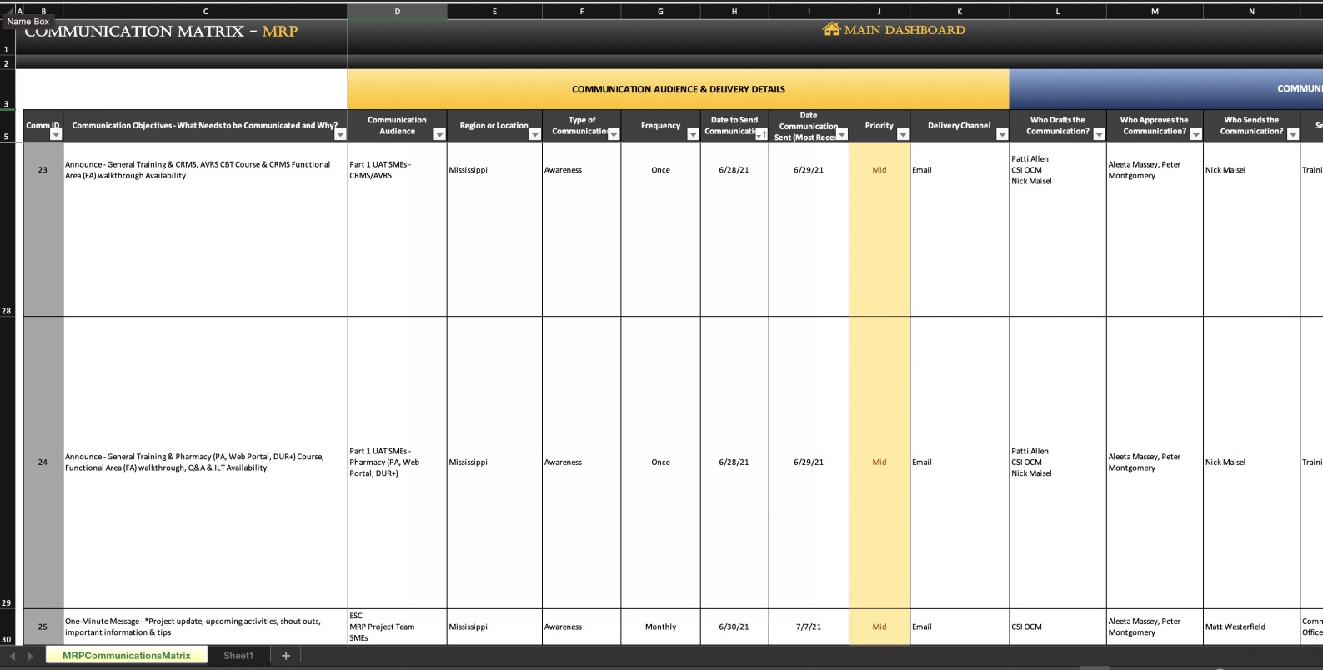
MRP Communications
Overarching plan that details the “who, what, when, why, how, when” of MRP Communications
Can be found here
Detailed document that lists out all previously released, potential, and/or planned MRP Communications
Can be found here

Slide 18
SME Reflections
January 2022 – Zeddie Parker – Claims & Reference Data Maintenance

Slide 19
Creating the Best Experience
Frequently Asked Questions
Question | Answer
What is MRP? | The MMIS Replacement Project (MRP) is a Mississippi DOM multi-year Design/Development/Implementation (DDI) project designed to modernize technology and connections between health services systems to improve access to health information for our Medicaid members and the providers who serve them.
What is changing? | The needs and expectations of DOM are changing and to meet those needs, our current MMIS system is being replaced with an improved technology solution with uplifted capabilities, which will streamline data collection and processing, automate paper processes, improve financial management and reporting, and enhance case management.
Why are we changing? | Centers for Medicare and Medicaid Services (CMS) requires advanced technology for efficient, cost-effective change. The Mississippi contract term limits require periodic re-procurement. We want to enable improved response to Medicaid information inquiries.
What is the vision of MRP? | To use the power of technology to deliver cost-effective, high-quality, and user-friendly healthcare information to those we service.
How will we achieve success? | Success will be achieved through active and committed engagement of key stakeholders, as well as timely and effective communication, escalation of issues, and a solid partnership between DOM and all involved vendors.
What is expected of me? | Be engaged, open, and honest throughout the process and please be patient as we collectively make progress towards creating a best-in-class healthcare experience. Be innovative and open to new ideas and ways of thinking to enable and realize the full potential of the user experience. Be leaders of the change throughout the project by staying engaged, helping your peers, and providing us with your honest feedback.
What is MESA? | MESA (Medicaid Enterprise System Assistance) is the acronym and branding used to describe the outcome of the MRP. It is also referred to as interChange, and MES (Medicaid Enterprise System).
What is InterChange (iC)? | Gainwell’s core Medicaid systems environment, upon which the future-state DOM core business system (MESA) is being developed - comprising of MMIS, Provider & Member Portals. Replaces Envision (aka Legacy, or Conduent).
Where can I find a list of commonly used MRP acronyms / terminology? | https://cambriasolutionsinc.sharepoint.com/MS%20MES%20Project/Lists/MS%20MRP%20Acronyms/AllItems.aspx
Notes:
Lots of MESA Training-related FAQs on LMS & MRP Teams channels.

Slide 20
Creating the Best Experience
Frequently Asked Questions (Cont’d.)
Question | Answer
Who is Gainwell? | The solution vendor for the MRP system Design, Development and Implementation (DDI), & the future-state fiscal agent (replacing Conduent & the Envision system).
What is the system or function that is compared to CWAS (Conduent Workflow Application Suite) in MESA? | This is known as Workflow within MESA
How/where in the MESA system will program area staff enter CSRs after go-live? | This is still under determination. The decision will be communicated, once finalized.
How do I find information in MESA on how a claim is paid (so that I can assist Providers with their inquiries)? | Review Go-Live Training materials relative to this topic to understand Claims panel changes & where to find desired information (different from current state Envision MMIS where this information is displayed on one screen).

Slide 21
MESA Environments
MESA Environment Name | Description
Development | Environment used to develop, and unit test all software contained within MESA.
Conversion | A dedicated implementation environment used by the conversion team to map the source Medicaid Management Information System (MMIS) data to the Mississippi MESA repository, and to validate the business rules to apply to the data during conversion.
Test | Environment used to initiate the integration of the separate components from developers. This environment provides the opportunity to test module changes as they relate to the application as a whole.
Configuration | Environment to store the official benefit plan administration and other configuration code values of the Mississippi interChange solution. This mock environment allows the configuration and validation of benefit changes outside the production environment, giving greater control to managing new or changed benefit policies.
Model Office | Environment used to perform system testing and system integration testing. MRP regression testing will be conducted in this environment.
Training | Environment used to support provider and user training of applications and mimics the respective application in Production.
Parallel | Environment used to test claims from the legacy system to ensure that policy is enforced in the new claims engine as it was in the legacy system.
UAT | Environment used to perform full-scale system integration testing and regression testing for the MESA solution. This environment must meet production capability and capacity but not affect production data. DOM business analysts must have access to the System Testing environment prior to UAT.
Trading Partner / Integration Testing | Environment allows for trading partners and providers to submit claims for testing their electronic submission compliance without impacting other environments.
Production | Environment using a set of resources and controls that directs users to a "live" service - such as a web site, a transaction processing system or an operating system which users can log into and get work done. Prior to go-live, performance testing will be run in Production.

Slide 22
MESA Module Descriptions
MESA Module Name | Description
Business Policy Administration (BPA) | Provides a configurable method for MESA to manage how and what services are covered
Buy-In | The Medicare Buy-In system processes Medicaid cost avoidance by buying into Medicare plans for eligible members to enroll dual eligible members
Claims | Processing of claims and encounters through adjudication, financial processing, history updates, and reporting
Customer Relations Management System (CRMS) | Provides access and storage of information associated with customer service contacts
Document Management (EDMS) | Electronically stores the images of inbound and outbound paper documents
Drug Rebate | Recovers money from drug manufacturers whose drugs are used by Medicaid clients in any of the Federal or State programs or Managed Care

Slide 23
MESA Module Descriptions (Cont’d.)
MESA Module Name | Description
Decision Support System (DSS) - Data Warehouse | Data storage to support reporting, data extract processing, analytical reporting for decision-making
Electronic Data interchange (EDI) | The overall interface processing for receiving, validating, sending, and responding to electronic transactions
Financial | Processes and tracks financial activity in accordance with Generally Accepted Accounting Procedures (GAAP) and CMS Federal Reporting rules
iC (interChange) Business Services Framework | Supports the automation of manual hand-to-hand processes and communicates with other systems
iC Connections | A flexible, message-oriented framework for implementing system interfaces that provides a smooth, robust, and secure data exchange capability with external applications
Letter Generator | Executes pre-defined queries using MESA data to merge the data into a pre-defined letter template with the output stored in OnDemand for viewing and printing
Managed Care | Maintains comprehensive current and historical information about CCOs enrolled with a Managed Care program/assignment plan, members who are assigned to those CCOs, and supports ongoing payments (capitations/premiums) to those CCOs

Slide 24
MESA Module Descriptions (Cont’d.)
MESA Module Name | Description
Management and Administrative Reporting (MAR) | A comprehensive management reporting suite utilizing inSight analytic reporting to enable direct interaction with program data, and management of key operational business functions
Member Data Maintenance | Manages member information, including archives, reports, transaction files, and transaction errors
Prior Authorization | Provides a mechanism to review, assess, pre-approve, and/or deny selected non-emergency medical services prior to delivery, and override ProDUR alerts set during pharmacy claims processing
Prospective Drug Utilization Review (ProDUR) | Prevents potentially harmful events, avoids unnecessary expenditures, and provides an immediate educational benefit
Program Integrity | Provides the capability to identify potential instances of fraud and/or abuse, and create and manage cases based on those potential instances
Provider Data Maintenance | Allows eligible providers to enroll in the Mississippi Medicaid program, submit claims, and maintain their current and historical information in MESA
Reference Data Maintenance | Maintains a source of reference information used by other functional areas such as claims and member processing

Slide 25
MESA Module Descriptions (Cont’d.)
MESA Module Name | Description
Security Management | A mechanism to manage MESA access which includes providing and revoking user logon and authorization through role-based access controls
System-Wide | A collection of the components that are used across the MMIS solution by many business functional areas
Third Party Liability (TPL) | A mechanism to work with the TPL vendor to share information to effectively pursue monetary recoveries related to third party payments of all or part of the expenditures for medical assistance furnished under a State plan
Automated Voice Response System (AVRS) | Enables Providers and Members to access MESA information in real-time using a touch-tone phone without engaging a call center agent
Web Portal | A web-based portal that facilitates communication with providers and members and provides easy access to important information

